Slide 1

Building regional e-Infrastructure for advanced scientific computing
Dr. Ognjen Prnjat
Director, European infrastructures and projects
GRNET – National Infrastructures for Research and Technology
*On behalf of 1000+ wonderful people involved*

Slide 2
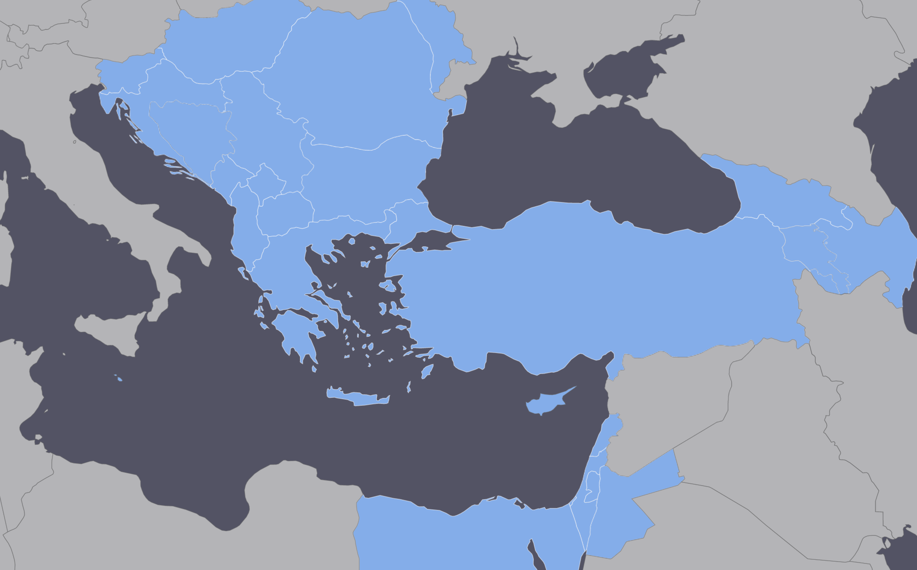
The region
Various pieces of a larger puzzle
  EU members (Greece, Cyprus, Bulgaria, Romania, Hungary, Croatia, Slovenia)
  Western Balkans
  Eastern Mediterranean, Turkey
  Easter Partnership countries (incl. Southern Caucasus)
Regional service platform of various technologies built over the last 20 years with a number of projects
Regional collaboration, but also as a springboard for joining wider EC initiatives + being more inclusive

Slide 3
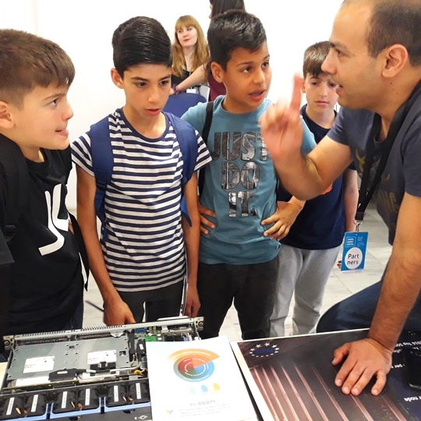
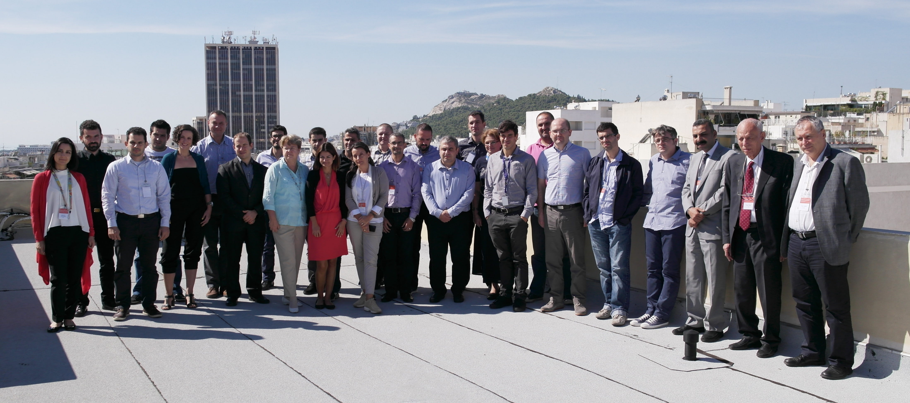
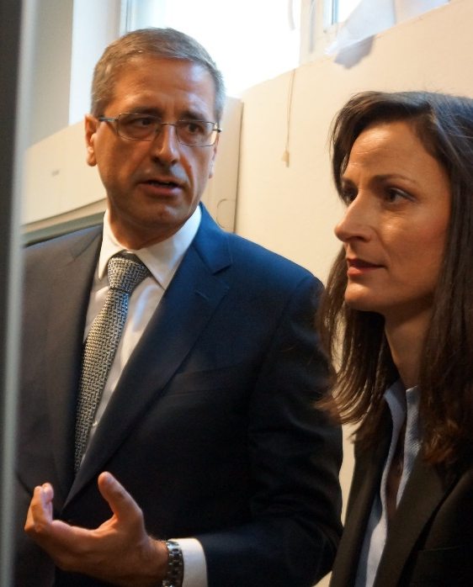
A close and wide partnership
Service provider partners
  National Research and Education Networks
  Different forms of national computing initiatives (cloud, grid, HPC) – consortia of providers per country
OS communities, research institutes, universities
Policy makers - Ministries, research councils

Slide 4
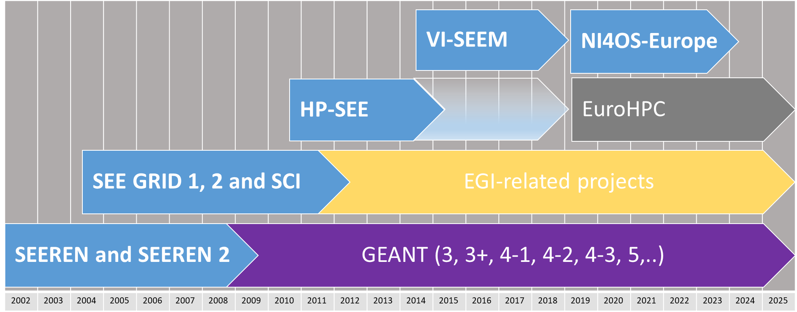
Timeline: 2 decades

Slide 5

Network

Slide 6

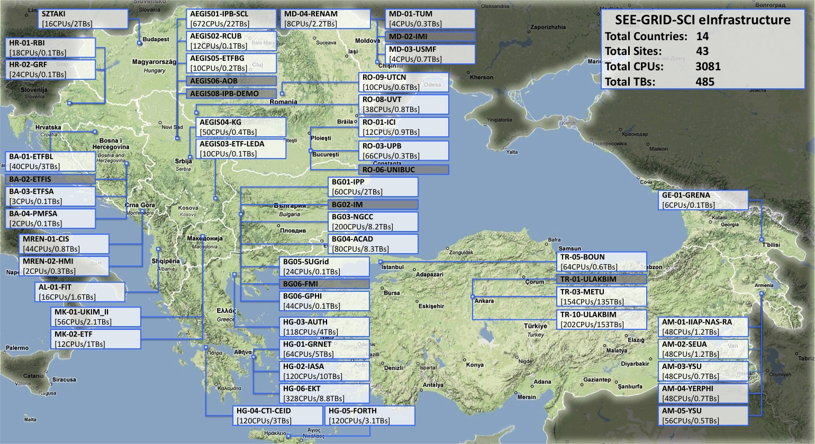
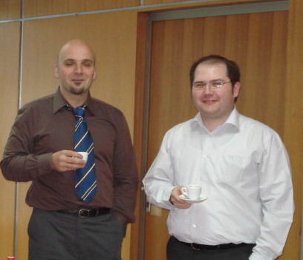
High Throughput Computing Grid
Antun as Infrastructure lead – his perfect diagram!

Slide 7


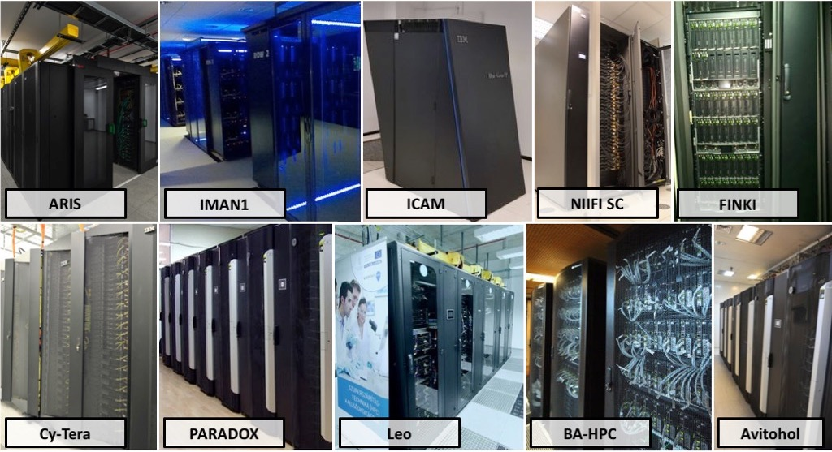
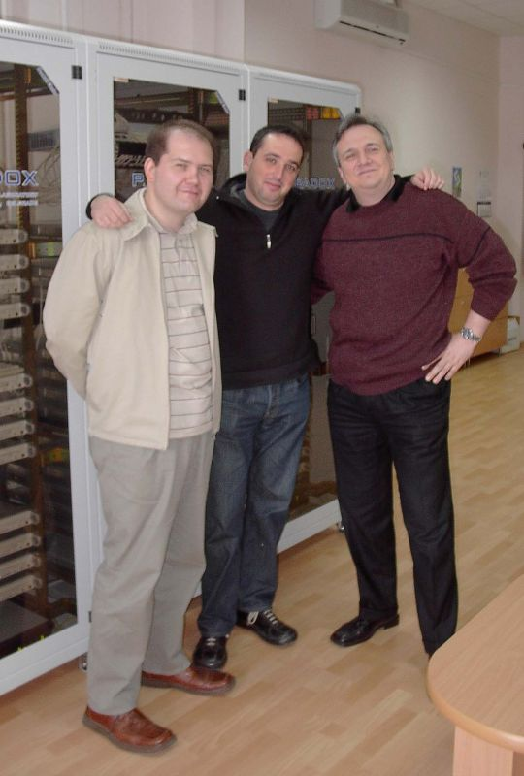
High Performance Computing
Antun at forefront of HPC operations!
3 top-500 machines at the time

Slide 8
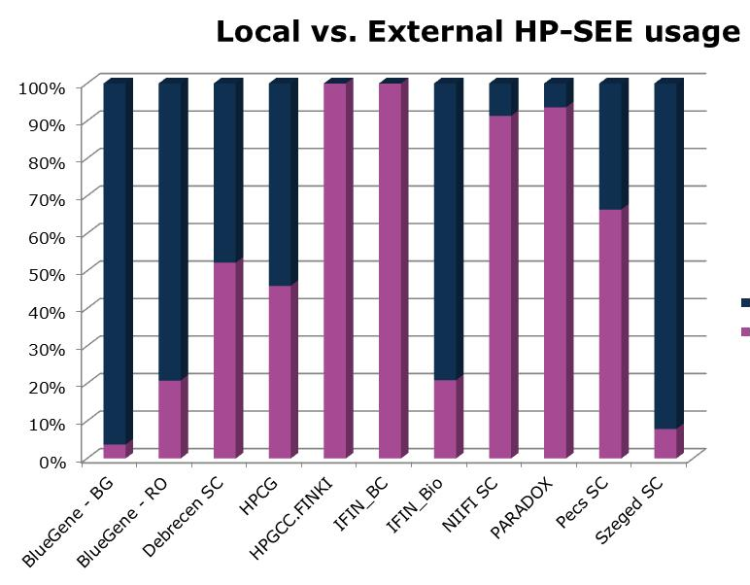
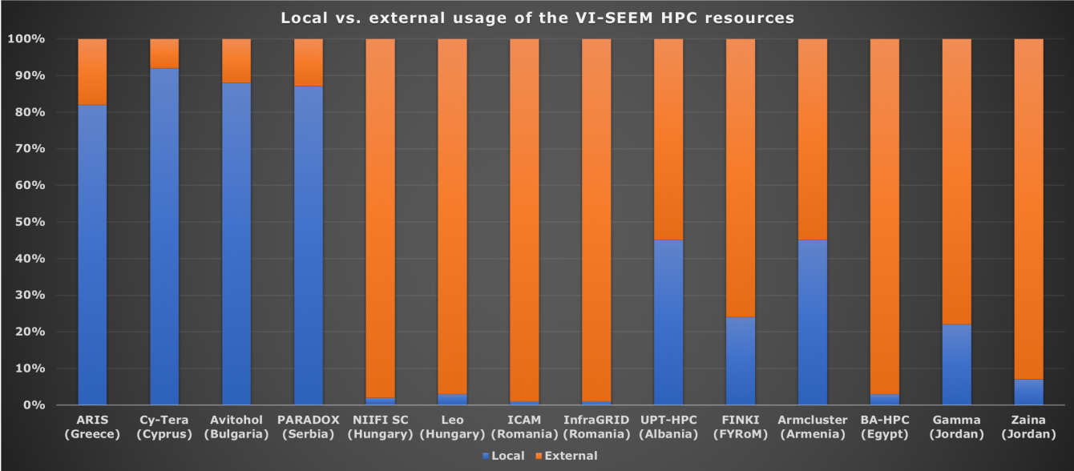
Regional cross-border communities and usage
Regional vs pan-EU HTC Grid usage

Slide 9

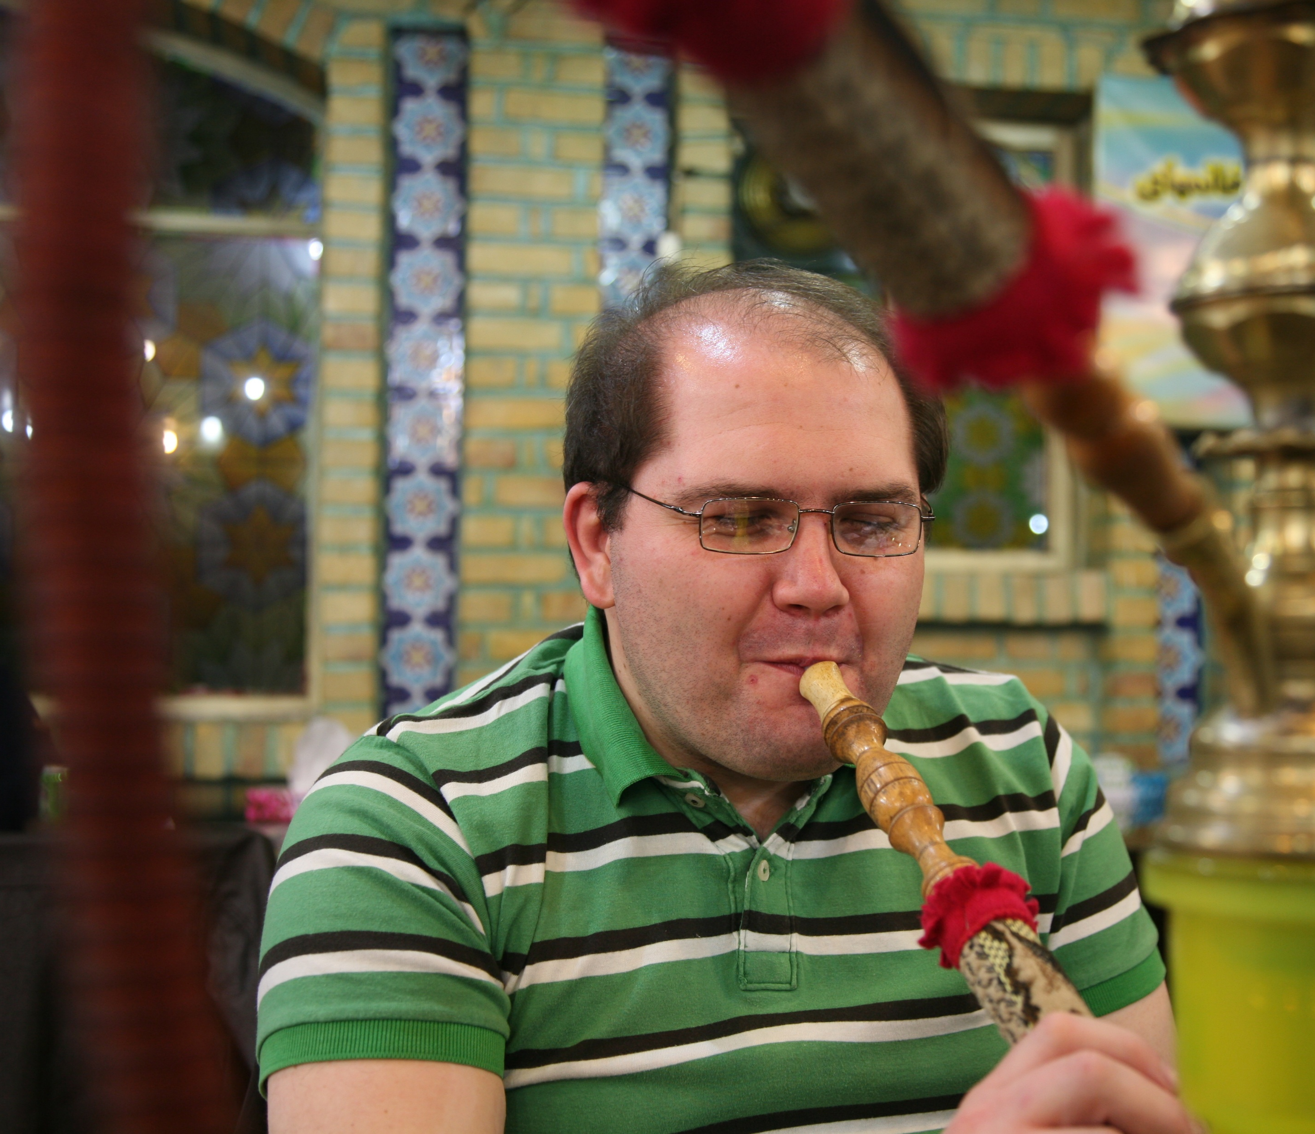

Intercontinental cooperation - Iran

Slide 10

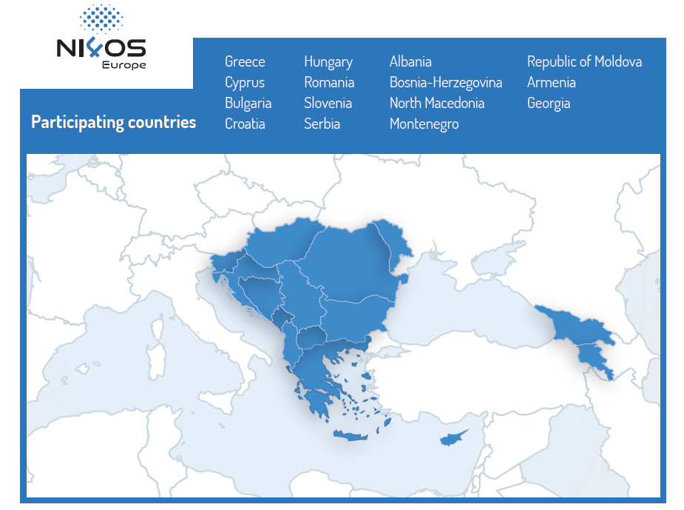
NI4OS-Europe
15 Member States and Associated Countries | 22 Partners

Slide 11
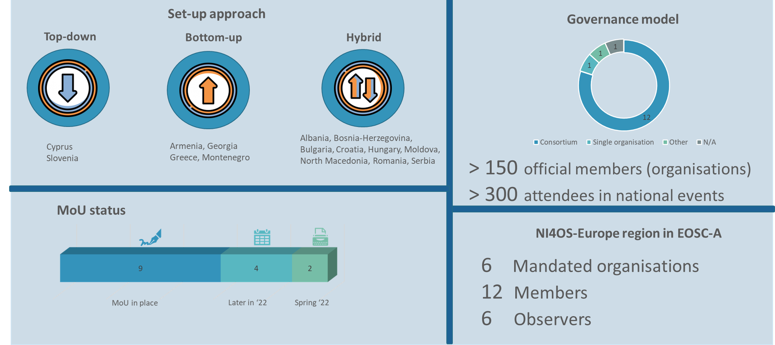
2 key results: National Open Science Initiatives

Slide 12
Services onboarded via pre-production platform: 1/3 of EOSC catalogue
16
15
16
HPC resources: CPU, GPU, Xeon Phi
Cloud Virtual Machines
Generic Storage
Data management services
6
53

Slide 13

Beyond the platform: Setting national and regional agendas
Very close relationship with governments to secure national support for electronic services and buy-in for EC initiatives
National contributions to pan-EU initiatives (GEANT, PRACE, EuroHPC, EOSC, etc)
Support for National-level projects
National policy best practices, programme guidelines, organizational aspects of NRENs, NGIs, national HPC initiatives, NOSCIs
Joint regional collaboration strategies and agendas
  Long-term regional cooperation MoUs signed in different fields
  Long-term strategy MoU between Ministries

Slide 14

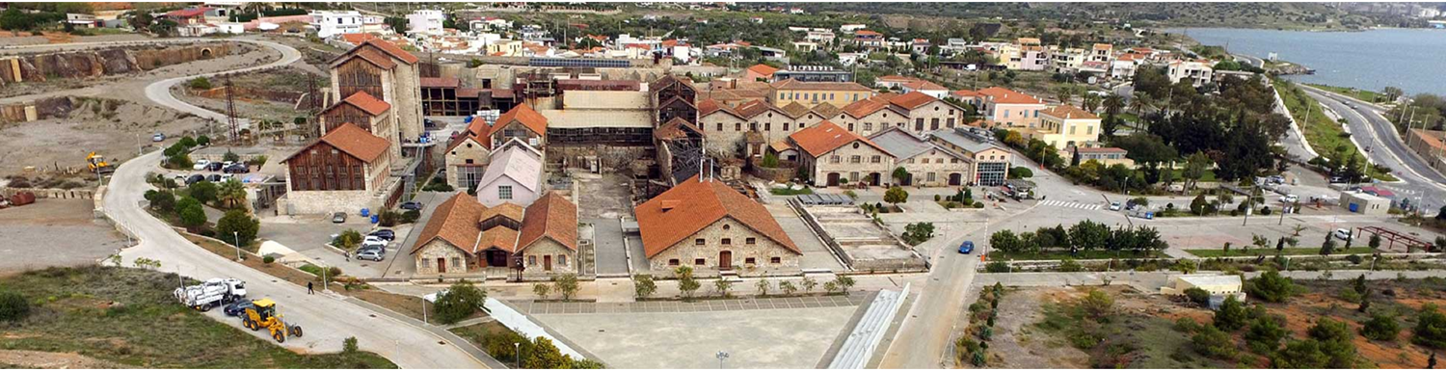
Current initiative: DAEDALUS and AI factories
DAEDALUS, SEE EuroHPC petascale collaboration with GRNET-GR, Cyprus Institute, UKIM, UDG
Pharos AI factory; SAIFA and Vezilka

Slide 15
Conclusion
Regional technical cooperation built a state of the art e-Infrastructure and services, used by cross-border communities
Also as a platform for joining wider EC initiatives + being more inclusive
More focused and efficient for the region than large pan-EU initiatives where smaller countries lose their voice
Antun’s contribution was crucial, with his lead in Infrastructure deployment and operations – he also paved the way for Serbian participation in EuroHPC and AI factories
These initiatives are pieces of the puzzle to sustain regional R&D, R&E, ICT development
  Increasing the retention of talented scientists and engineers in the region
  Easing the digital divide between the region and rest of EC
  Making available the benefits of Information Society and Open Science for all citizens
  Pursuing joint R&D efforts among countries in the region
  Regional political stability and cohesiveness

Slide 16
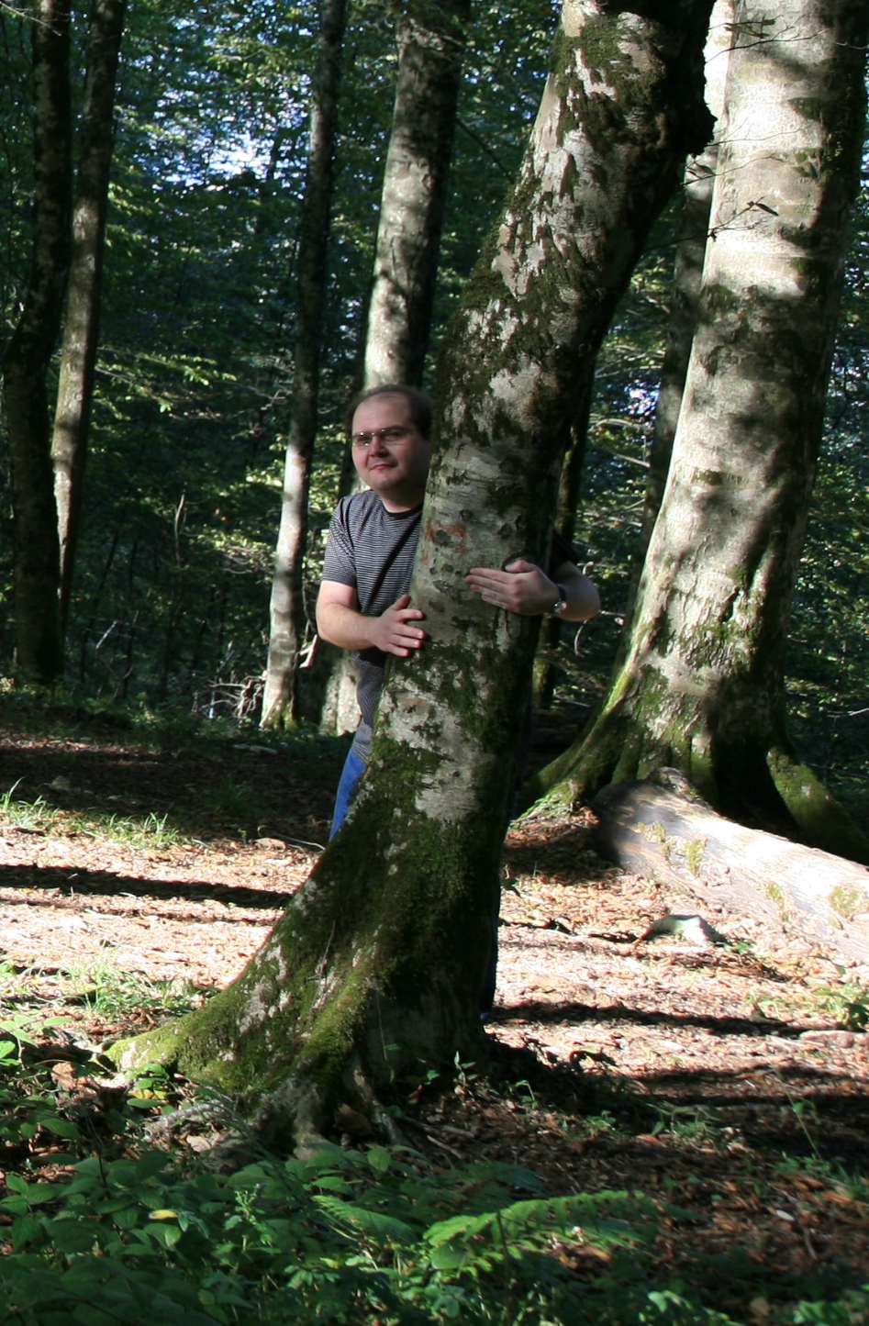


Beloved member of our community – thank you Antun!!

Slide 17
Timeline: 2 decades
SEEREN1/2: regional inter-NREN connectivity and GEANT links [DGINFSO]
BSI: Southern Caucasus links [DGINFSO]
SEELIGHT: lambda facility in SEE [Greek HiperB]
Result: sustainable national networks, most countries in GEANT, some crossborder fibers
SEEGRID1/2: regional Grid infrastructure, building NGIs and user communities
SEE-GRID-SCI: eInfrastructure for large-scale environmental science user communities. Inclusion of Southern Caucasus. [DGINFSO]
Result: national Grids, regional coordination, all countries within EGI

Slide 18
Timeline: 2 decades
HP-SEE and LinkSCEEM1/2: regional HPC interconnection (+2nd generation Caucasus link)
Result: stable national HPC centers, regional HPC sharing
SEERA-EI: regional programme managers collaboration towards common e-Infrastructure vision, strategy and regional funds [DGRTD]
Result: influencing national agendas, setting common regional policy
VI-SEEM: integrated platform of HPC, cloud, grid, data management, application-level services [DGCNCT]
Result: regional integrated platform, regional resource sharing

