Slide 1
NCC Bosnia and Herzegovina
Ana Lalović, Belgrade, May 2025

Slide 2
NCC in Bosnia and Herzegovina is partnership between two institutions:
an SME, Verlab Ltd,
a research institute, Verlab Institute
International partnerships:
EIT
EuroCC
WHO
DIH
Affiliates:
FusionX EDIH
Center for Digital Transformation
DMBIUBIH Affiliated NGO
NCC Bosnia and Herzegovina
Partner
Partner
Verlab Ltd.
Founded
Verlab Institute

Slide 3
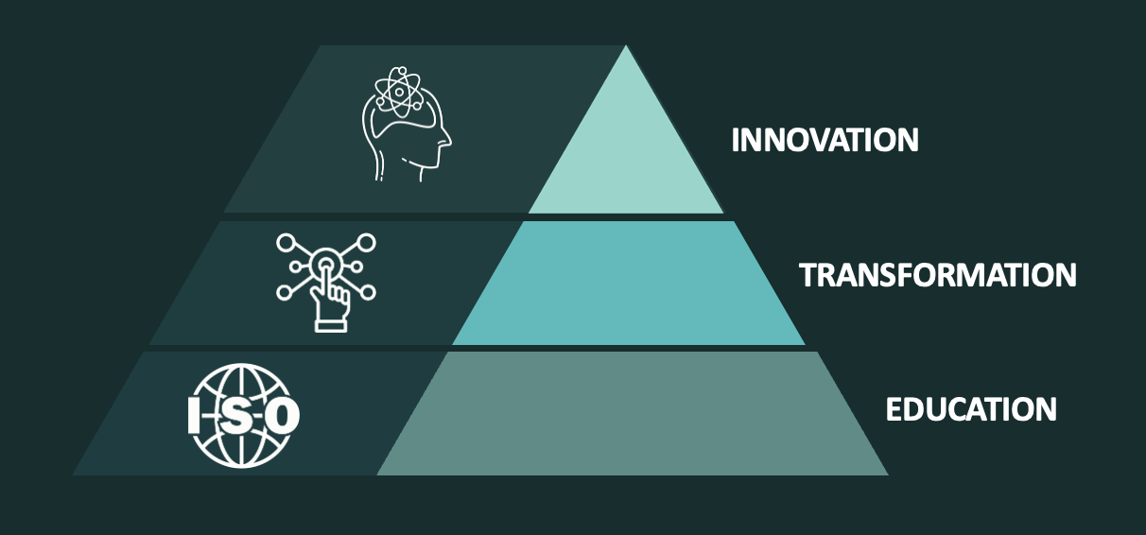
Services offered by the NCC:
Training & education: Workshops, seminars and specialised trainings, on HPC/HPDA/AI.
Consultations & advisory: HPC/HPDA/AI readiness, innovation, feasibility, and solutions.
Grant & Research Support: Assistance with national and international grant applications and academic collaborations.
Modeling & simulation: Advanced consultancy on use of HPC/HPDA/AI.

Slide 4
The NCC organized workshops, roadshows, and events, engaging 568 participants across diverse sectors such as bioinformatics, AI, climate protection, and healthcare. Notable events included:
Bioinformatics workshops (132 participants) demonstrating HPC’s role in genomic and proteomic data analysis.
Sarajevo Roadshow (240 participants) focused on climate protection using advanced technologies.
AI in Agriculture workshop (80 participants) showcasing HPC applications in big data analysis for crop management and resource optimisation. These activities highlighted the diverse applicability of HPC and significantly increased awareness among target audiences.

Slide 5
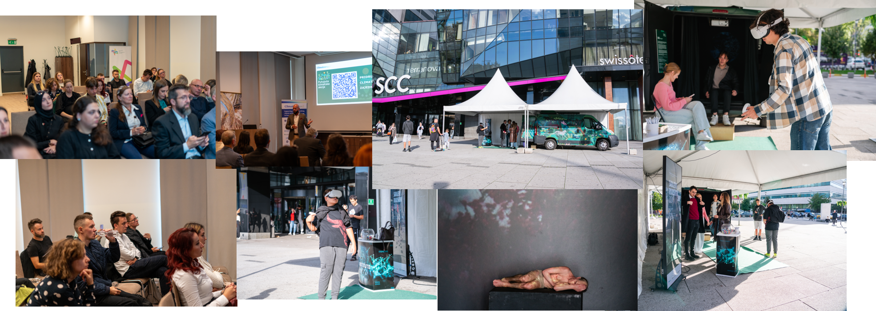
Highlights of Sarajevo Roadshow:

Slide 6
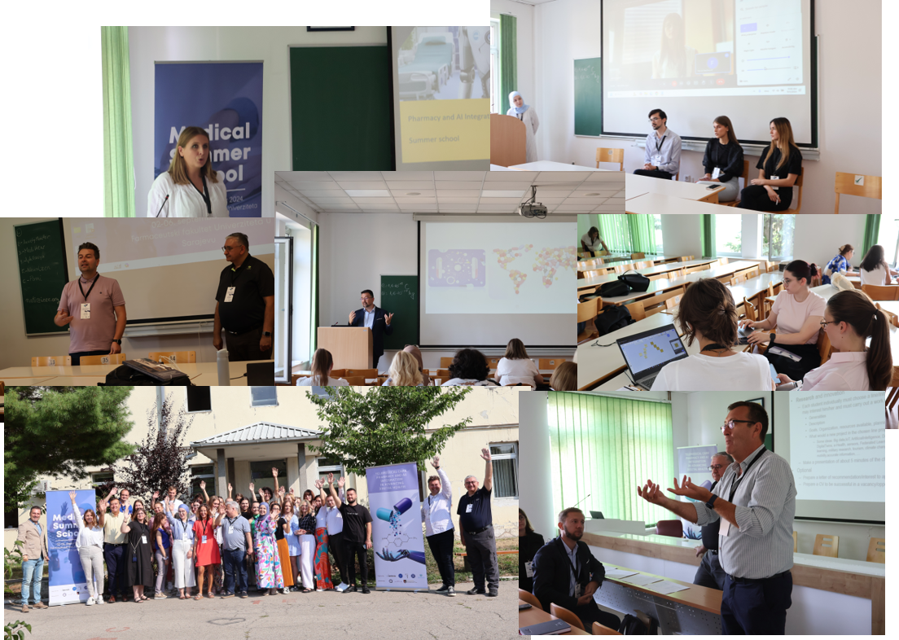
The NCC successfully organized a series of events showcasing HPC applications in various domains:
The DAAD Summer School (50 participants) highlighted HPC in medicine and digital transformation of healthcare.

Slide 7
The EIT Health Morning Talks (50 participants) in collaboration with EIT Health explored the role of big data in healthcare. These efforts significantly increased awareness of HPC’s transformative potential and established a foundation for future capacity-building initiatives.

Slide 8
In the 2024 the NCC:
organized 12 workshops with 568 participants
conducted 3 visits to other NCCs (Montenegro, Slovenia and Netherlands),
awareness raising campaign - significantly expanding collaborations with SMEs, large enterprises, public administration, and academic institutions
transitioning HPC readiness assessments to practical implementation
Overall, Year 2 has started with greater engagement, stronger collaborations and a transition from initial assessments to implementation and deeper partnerships across sectors.

Slide 9
Workshop - AI: Rules or no rules?
AI from the legal, technical, and ethical perspective
Result: Interest group for artificial intelligence issues in Bosnia and Herzegovina

Slide 10
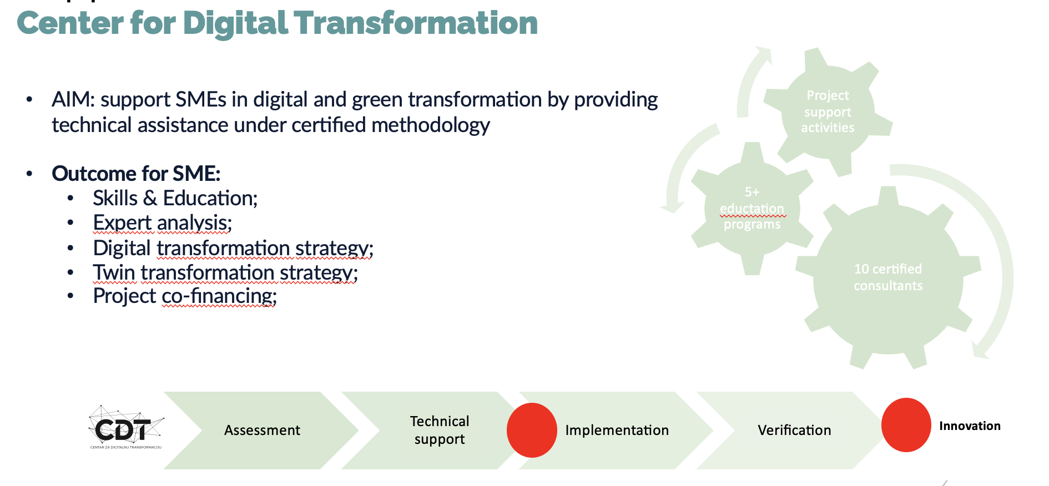
Consultancy services methodology

Slide 11
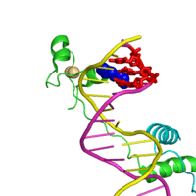
Consultancy services to Bosnalijek, pharmaceutical company in the HPC simulation of molecular dynamics.
Providing consultancy to a leading pharmaceutical company in Bosnia and Herzegovina on the use of HPC for advanced simulations of molecular dynamics, which can be used to improve their existing products formulation.

Slide 12
The NCC strengthened its regional and international presence through strategic visits and participation in events:
Collaborated with NCCs in Montenegro, Croatia and North Macedonia, fostering knowledge exchange.
Submitted a project proposal, in partnership with institutions from Montenegro, Austria, Serbia, Greece and Slovenia, aimed at developing and implementing MSc and PhD programs for HPC studies. If funded, this initiative will mark a significant step toward building a sustainable educational framework to support the HPC ecosystem in the region.
Established formal support from the Federal Ministry for Development, Entrepreneurship and Crafts for the NCC BiH Stakeholder Network.
Last week we organized three workshops with academia and one with industry.

Slide 13
Engaged 568 participants across key sectors (heatlh, agrifood and environmental protection)
Bioinformatics workshop: 132 participants
Sarajevo Roadshow: 240 participants
AI in Agriculture workshop: 80 participants
Secured pharmaceutical project (HPC for protein simulations)
Co-developed 2 project applications for SMEs funding

Slide 14
NCC BiH - Challenges
As a newly established NCC, time is needed to fully structure and optimize processes
HPC is not widely known in Bosnia and Herzegovina, requiring significant awareness-building efforts
Ecosystem mapping
A strong focus is placed on educating stakeholders about HPC benefits and applications
Lack of local HPC infrastructure - no dedicated HPC equipment yet, but a sandbox environment is being established and we are leveraging partner networks to utilize supercomputers from international collaborators
Recruitment of staff - technical expertise HPC related

Slide 15
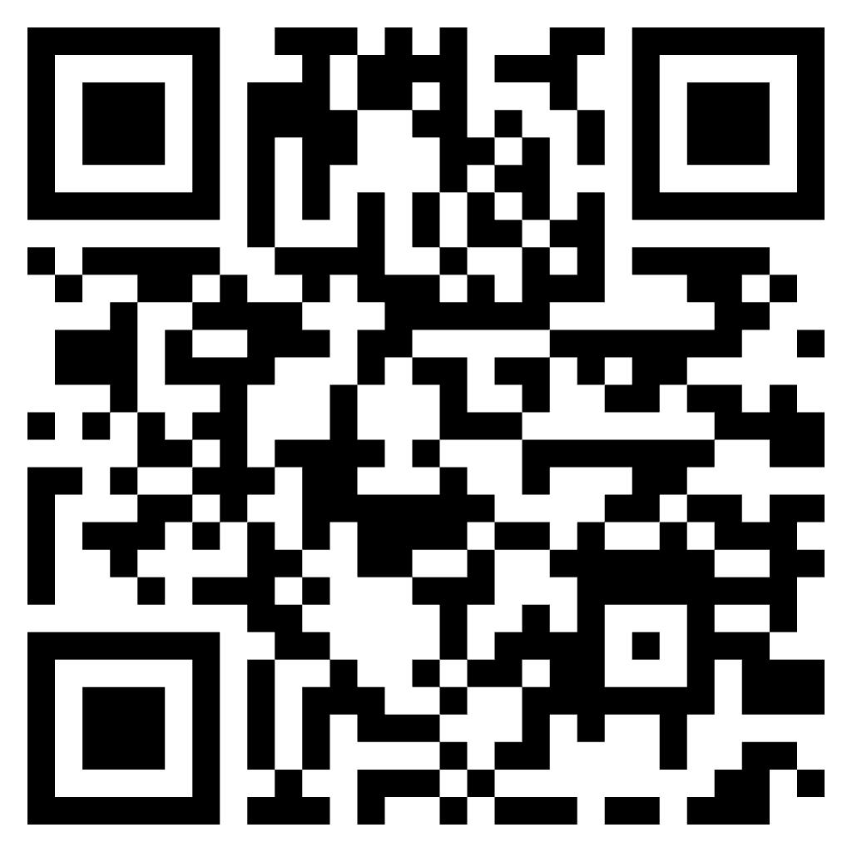
We established a website with a mailing list and a newsletter. We are dedicated to establishing an alliance between Industry, SMEs, academia and NGOs that will establish HPC ecosystem and use HPC infrastructure
Website: https://ncchpcbih.verlabinstitute.com/

Slide 16
Upcoming conference

Slide 17
Thanks!
This project has received funding from the European High-Performance Computing Joint Undertaking (JU) under grant agreement No 101191697. The JU receives support from the Digital Europe Programme and Germany, Türkiye, Republic of North Macedonia, Montenegro, Serbia, Bosnia and Herzegovina.

