Slide 1
Disaster predictions with HPC
Boro Jakimovski
NCC North Macedonia
EuroCC4SEE WORKSHOP IN BELGRADE
20-22.05.2025

Slide 2
Natural hazards
WMO classification
Geo hazards
Earthquakes
Weather hazards
Floods
Volcanoes
Tsunami
Forest fires
Slippery ground
Epidemic air-borne diseases
Droughts
Hot and cold spells
Tornadoes
Tropical cyclones
Storms, storm surges, ice storms
Heavy rainfall
Flash-floods
Hail & lightning
Avalanches, mud and landslides

Slide 3
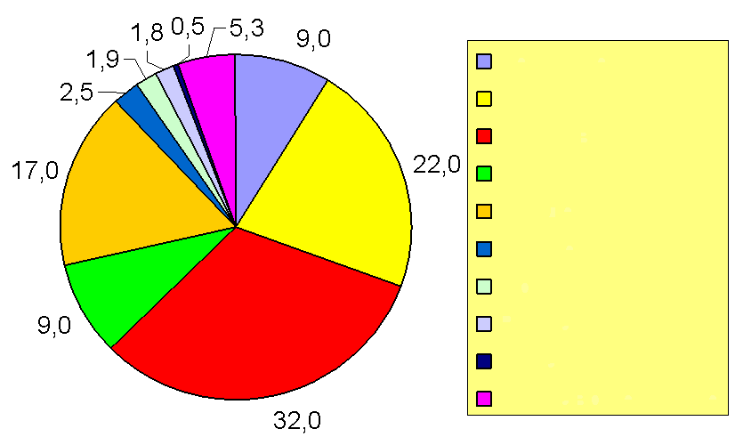
Natural hazards
WMO statistics
Earthquakes
Storms
Floods
Droughts
Epidemics
Extreme temperatures
Fires
Volcanoes
Tsunami
Slippery ground

Slide 4
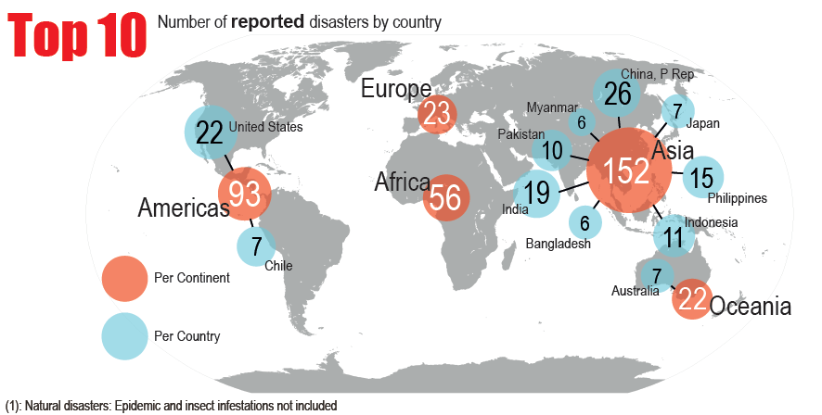
Natural hazards

Slide 5


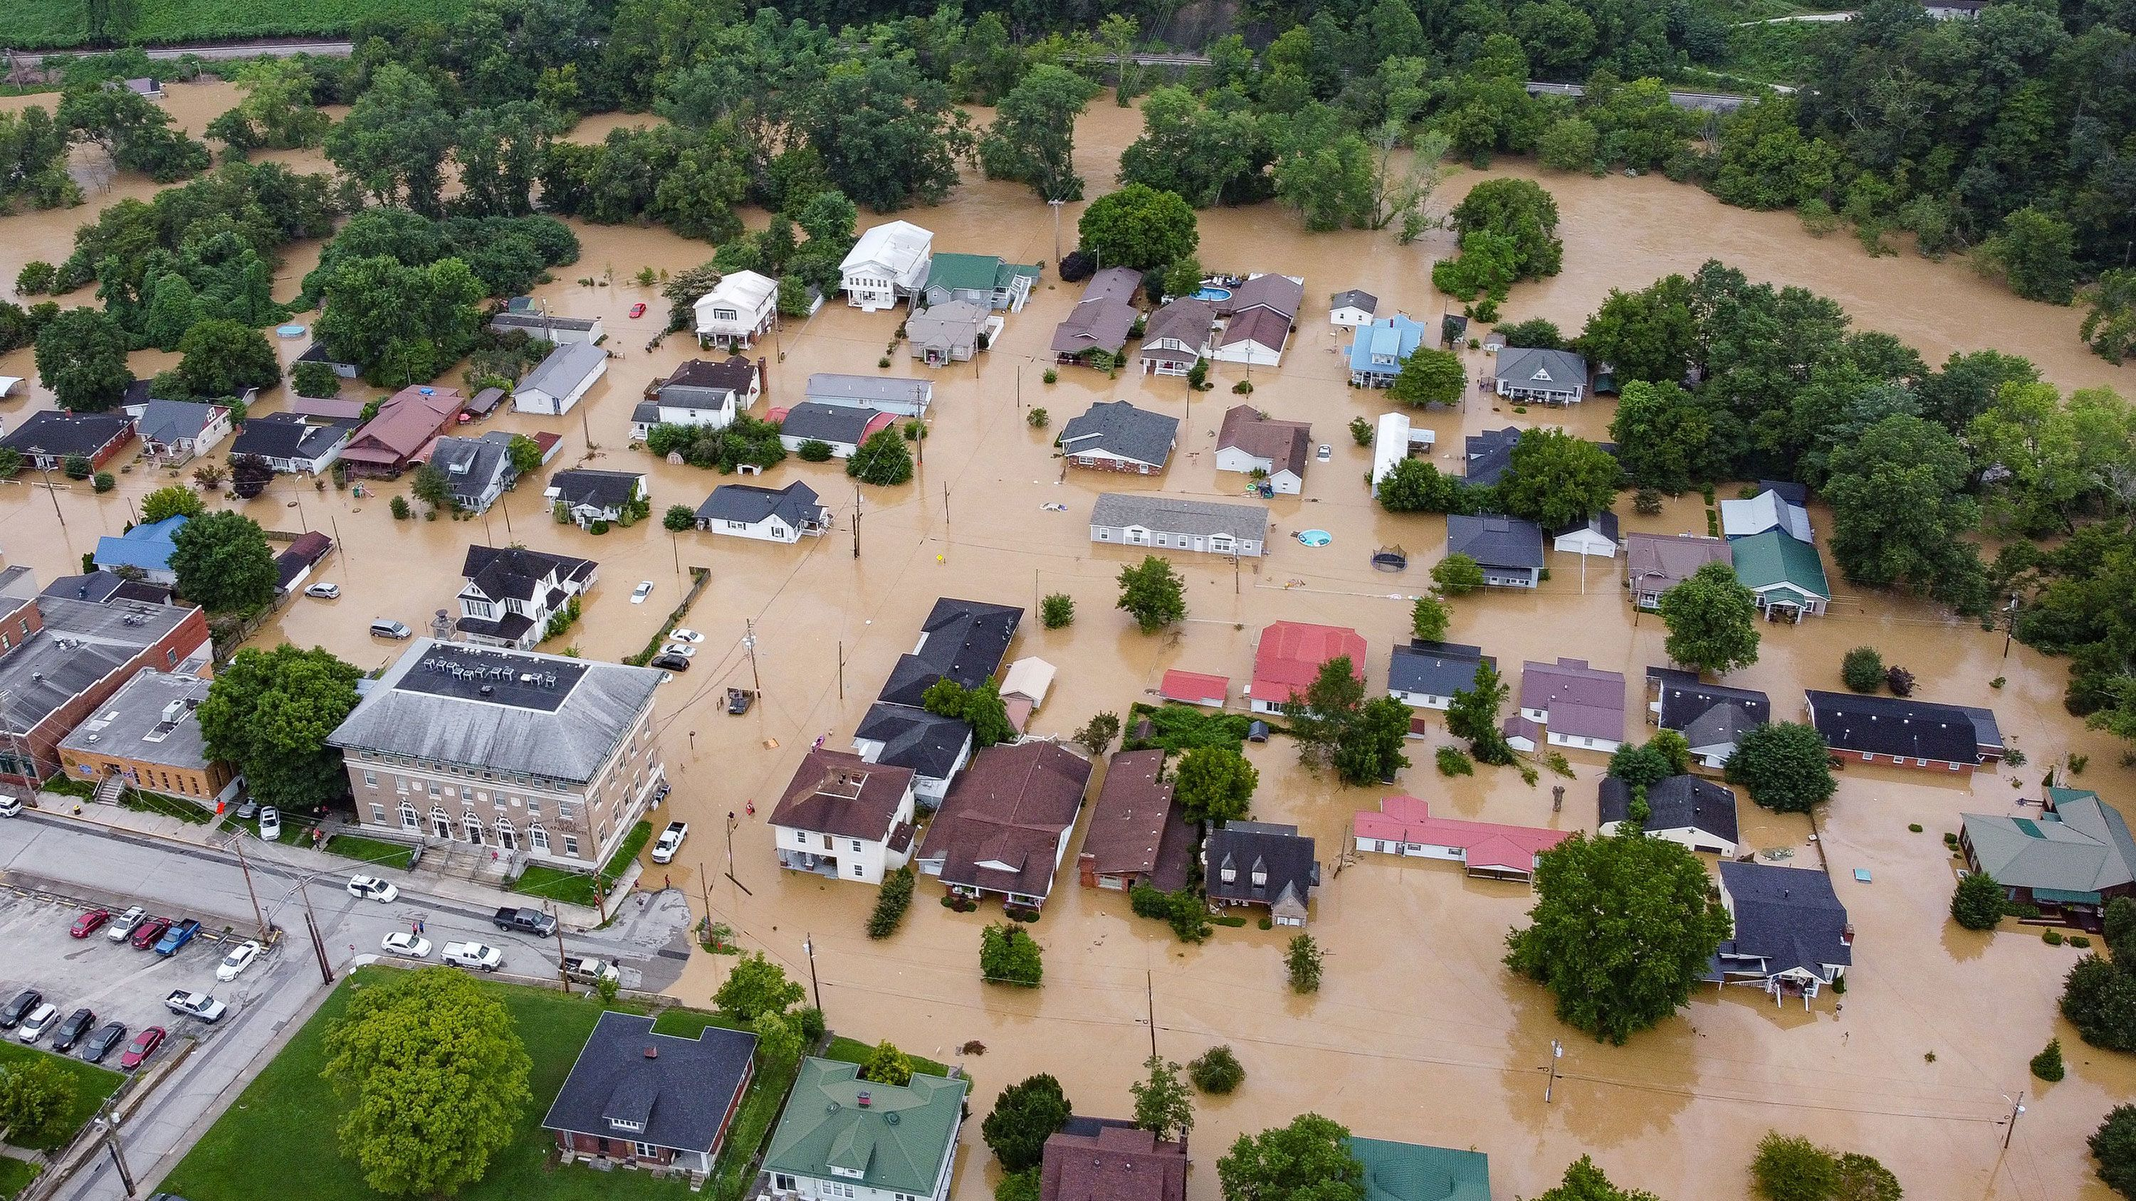

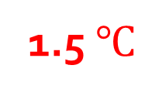
Motivation
Global climate change has caused noticeable changes in the environment
One of the most visible and disruptive impacts is the occurrence of extreme weather events
HEAT WAVES
FLASH FLOODING
GLOBAL WARMING
El-Nino
2022 was a year of climate extremes, with record-high temperatures
Credit: The New Yorker

Slide 6
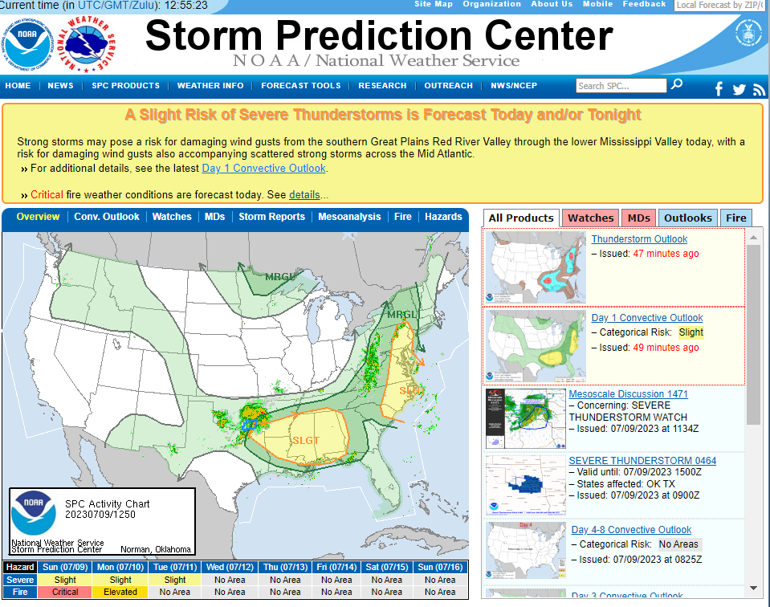
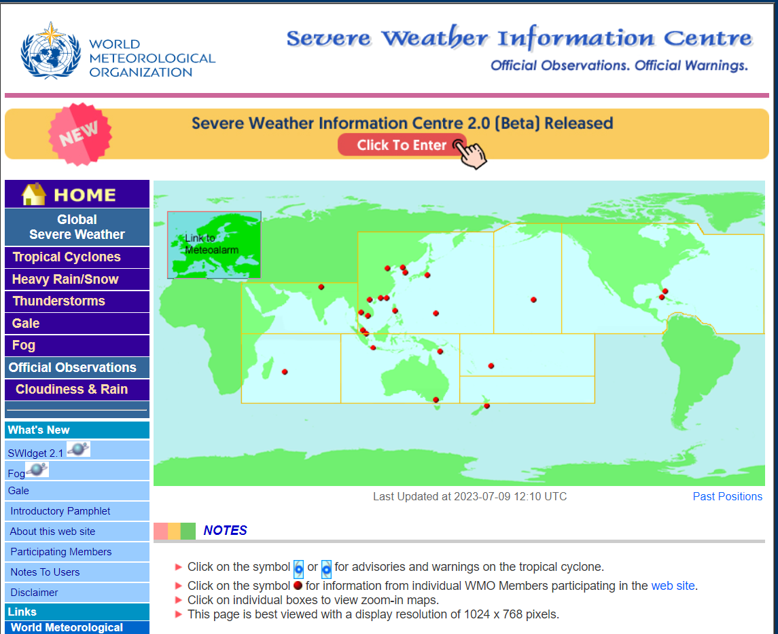
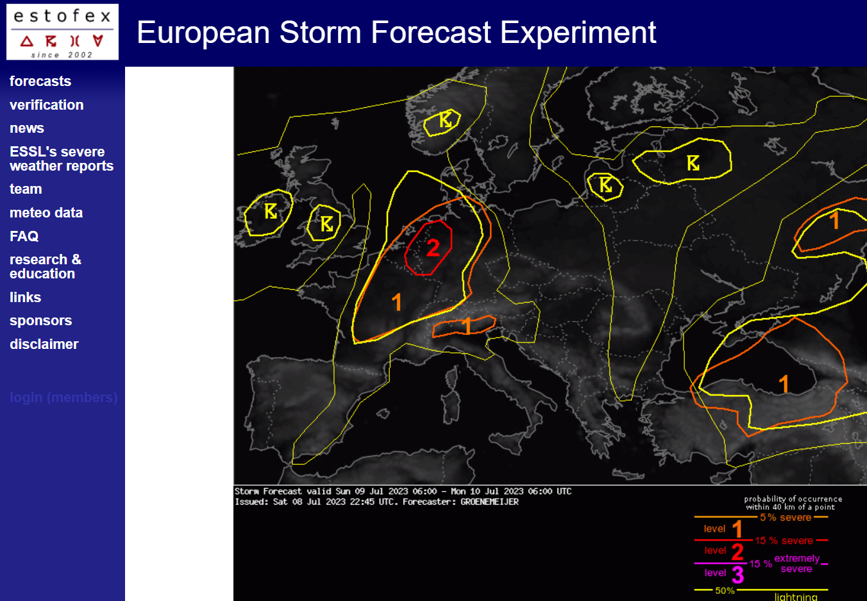
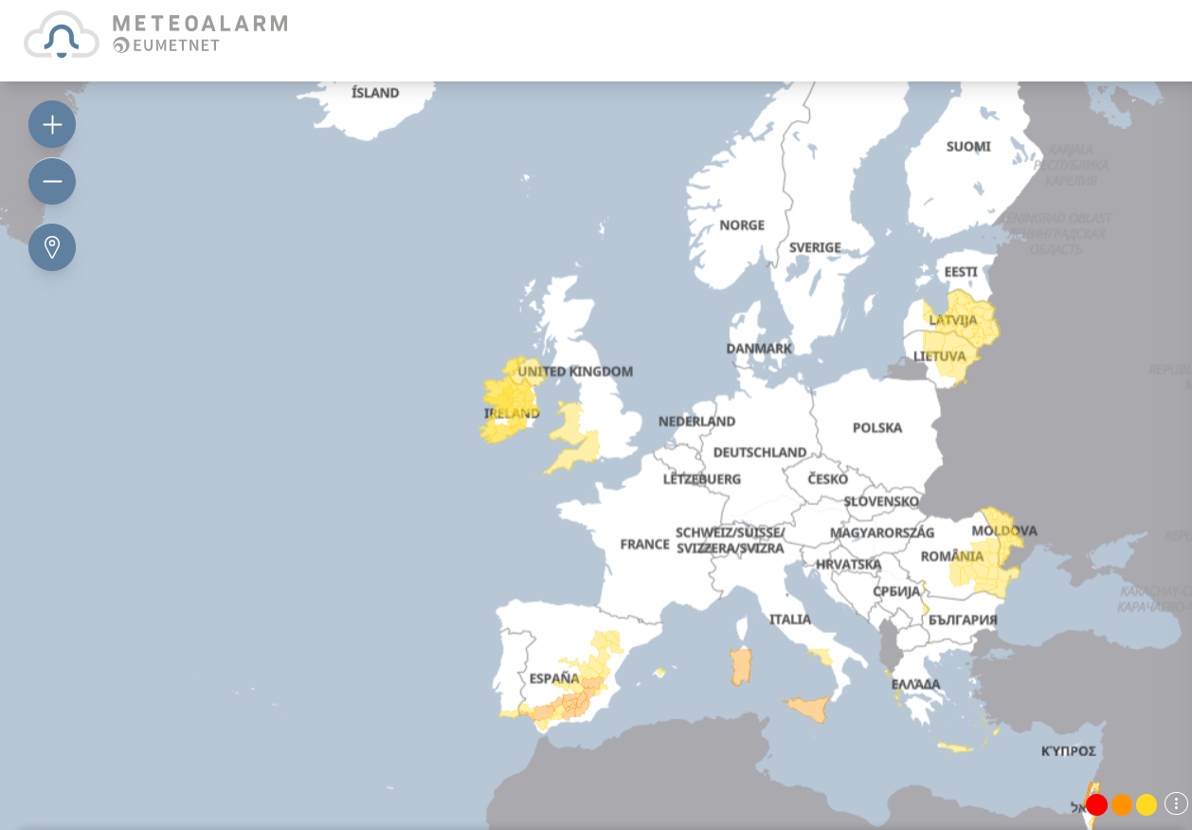
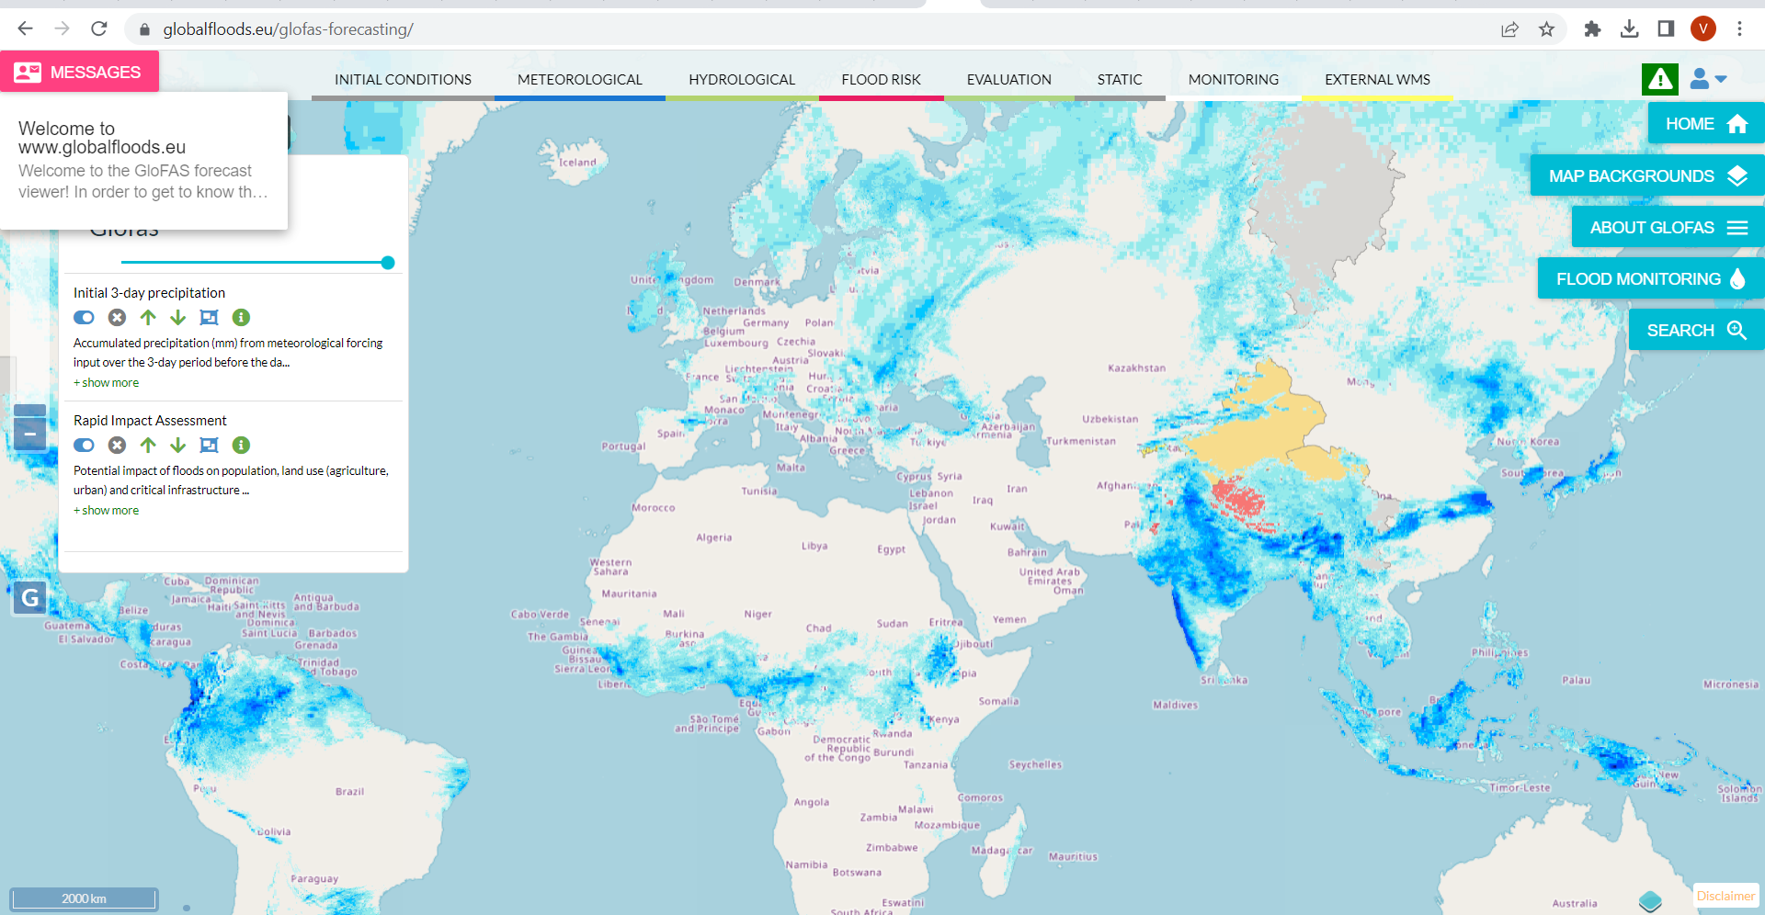
Severe weather alert systems
NOAA
WMO
ESTOFEX
EU-METEOALARM
GLOFAS

Slide 7

Center for Crisis Management
The Crisis Management Center, was established to ensure constant consultations, coordination, timely response, efficiency and appropriate use of resources available in the event of a crisis, and to ensure timely, high-quality and realistic assessment of the threat to the security of the Republic of Macedonia from risks and dangers.
Severe weather hazards present one of the most common hazard events in the past years
Timely coordination, alerting and preparation for hazardous events is very important for the Crisis management process

Slide 8
NOTHAS system
Researchers from University in Skopje developed system for severe weather prediction model
Based on several well-known Weather forecast open-source systems and tools
  WRF-NMM
  WRF-ARW
  Postprocessing outputs
  Generation of severe weather soring classification

Slide 9
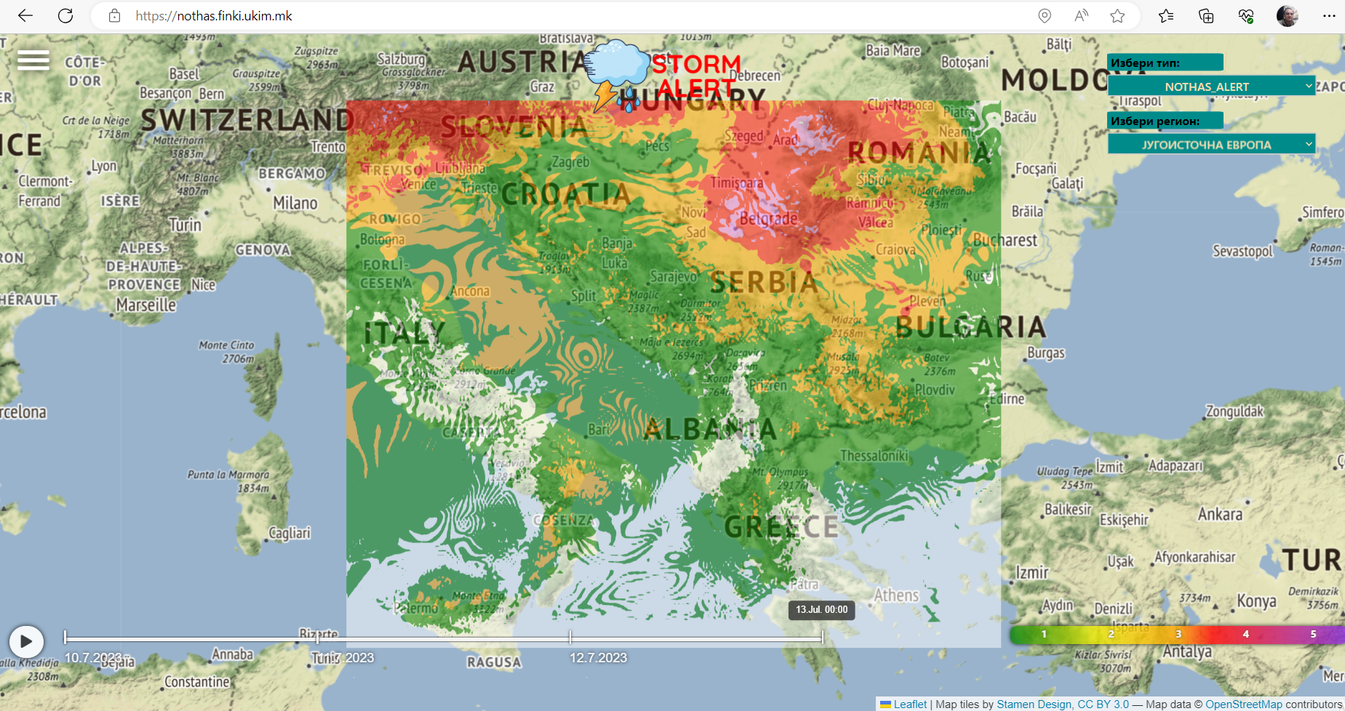
NOTHAS South East Europe

Slide 10
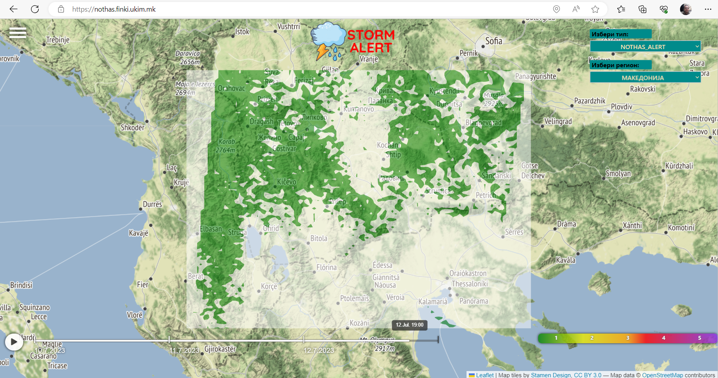
NOTHAS North Macedonia

Slide 11






Why WRF Needs HPC
High-Resolution Grids
Fine spatial resolution demands computational power
Massive Data Volume
Processing satellite imagery and observational data
Real-Time Constraints
Rapid completion for time-sensitive decisions

Slide 12
Why WRF Needs HPC
Optimization
Model verification
Ensemble forecasting
More complex models WRF-CHEM

Slide 13
The list of model configurations and physical parameterizations
Model configuration | ARW v.4.4.2 (2022) | ARW triple nested run v.4.4.2 (2022) | NMM (v.4.3.3) | Ensemble 15 members
Physics | 28, Thompson, Eidhammer (2014) | 28, 28, 28 | 8, Thompson Graupel scheme (Thompson et al. 2008) | 28, 8, 5 and 6 5, Ferrier scheme Ferrier, (1994) 6, WSM6 Hong and Lim, (2006)
PBL | 1, Yonsei University YSU Hong (2010) | 1, 1, 1 | 2, Mellor-Yamada-Janjic (Eta) TKE scheme | 1, 2
Surface physics | 2, Noah Land-Surface Model: Unified NCEP/NCAR/AFWA scheme | 2, 2, 2 | 2 | 2
Cumulus convection | 14, new scale and aerosol aware scheme (Shin and Hong, 2015; Han et al. 2017) | 14, 14, 14 | 14 | 2, 14 2, Betts-Miller-Janjic scheme
Radiation Short/Long | 1, RRTM Scheme Dudhia Scheme, Dudhia (1989) / Mlawer et al. (1997) | 1, 1, 1 1, 1, 1 | 99, GFDL scheme: Geophysical Fluid Dyn. Lab. (GFDL) 99 | 1, 1
Hor. grid resolution | 4-km | 27 x 9 x 3 km | 4-km | 4-km
Vertical levels | 44 | 44, 44, 44 | 50 | 44
Time step (s) | 10 | 90, 30, 10 | 10 | 10
Initial data and LBC | NCEP FNL GDAS 0.25 deg |  |  | Slightly perturbed IC (Scaling) 6 members

Slide 14
A combined set of physical and environmental parameters
TOTAL
ACC. RAIN
RADAR
REFLECTIVITY
BRIGHT.
TEMPERATURE
VORTICITY
CAPE
SWEAT
K-index
TOTALS
SRH
LI-index

Slide 15
HPC simulation for determination of the threshold values
Parameters with thresholds and influence in NOTHAS
Severe Weather Threat Index (SWEAT)
Most Unstable Convective Available Potential Energy (MUCAPE) (J/kg)
Gálvez-Davison Index (GDI)
Storm Relative Helicity (SRH)
Radar reflectivity (REFD) (dBZ)
Brightness Temperature (BRTH)
A total acc. hourly rain (mm)
Wind gust over land (m/s) Saffir-Simpson Hurricane Wind Scale (m/s)
K-Index
Different thresholds for different scale and location
Mid-latitude storm
Tropical cyclone (Hurricane-Typhoon)
Tropical storm

Slide 16
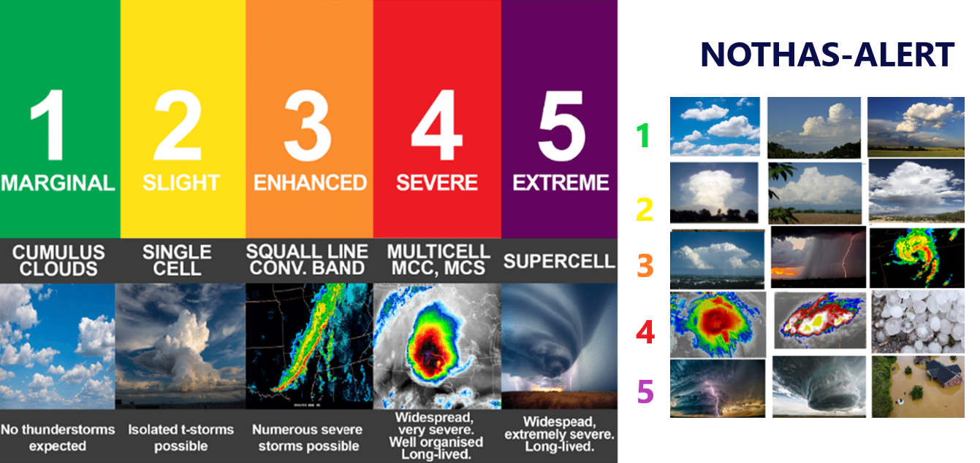
Severe convective weather alert

Slide 17
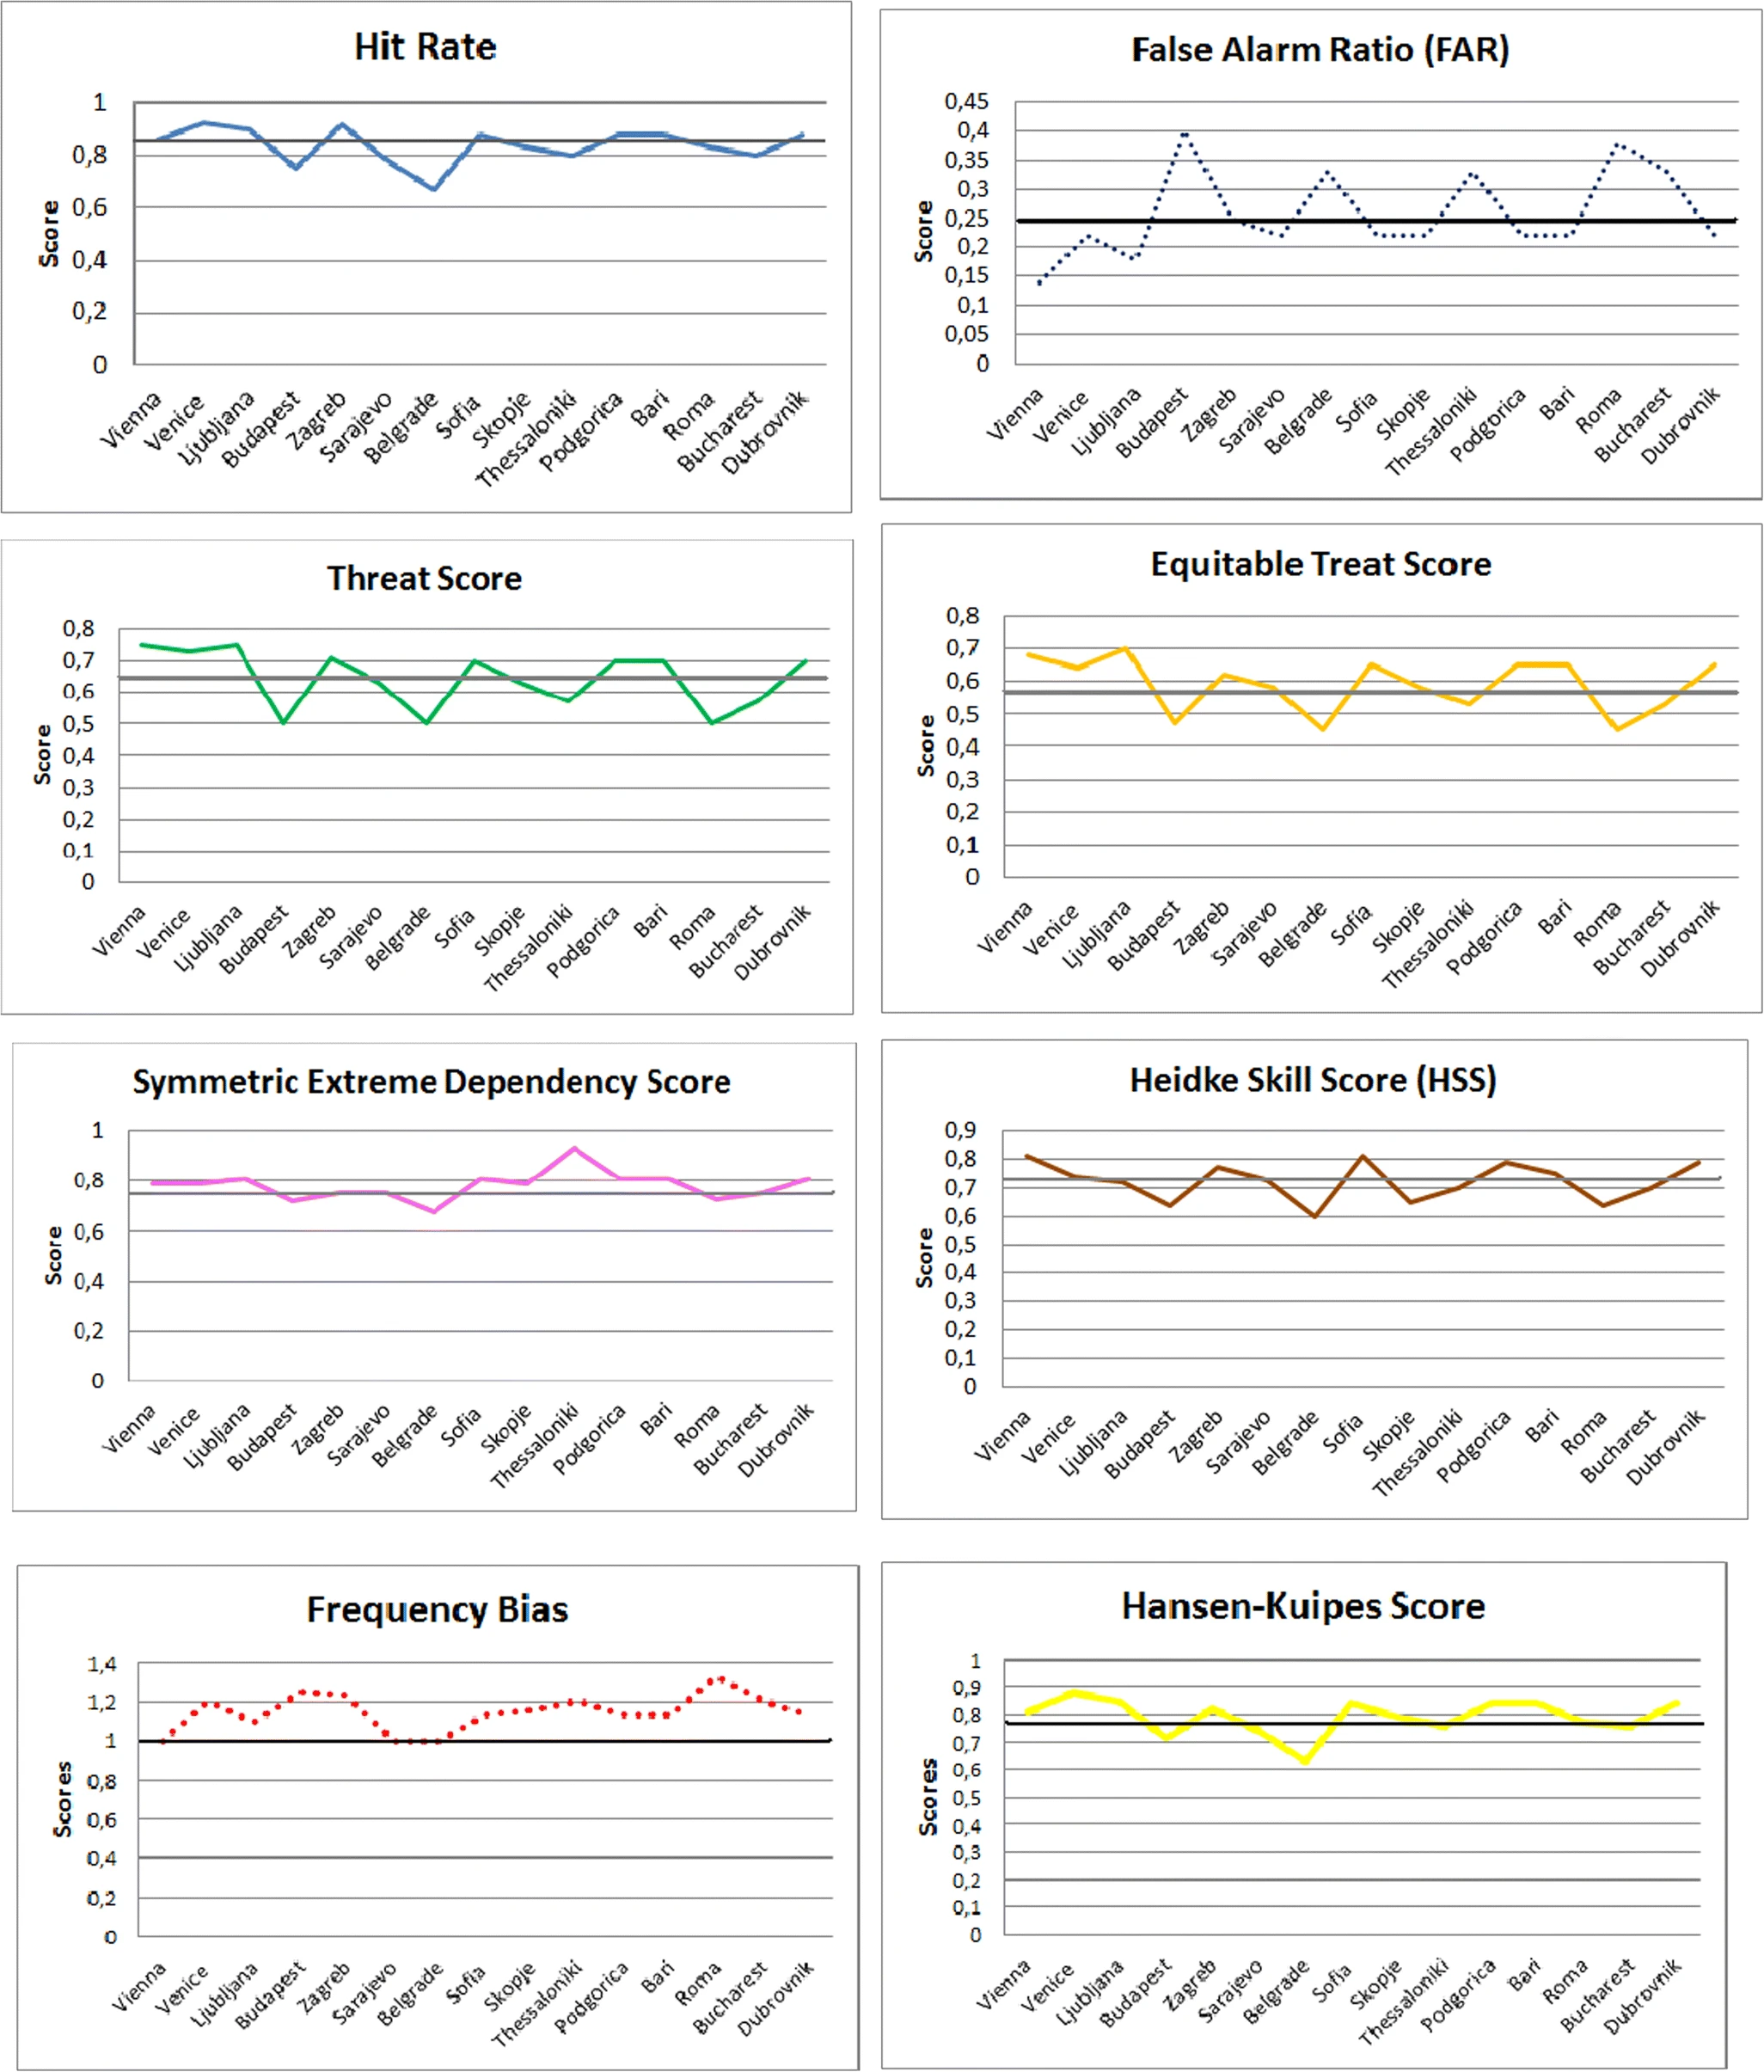
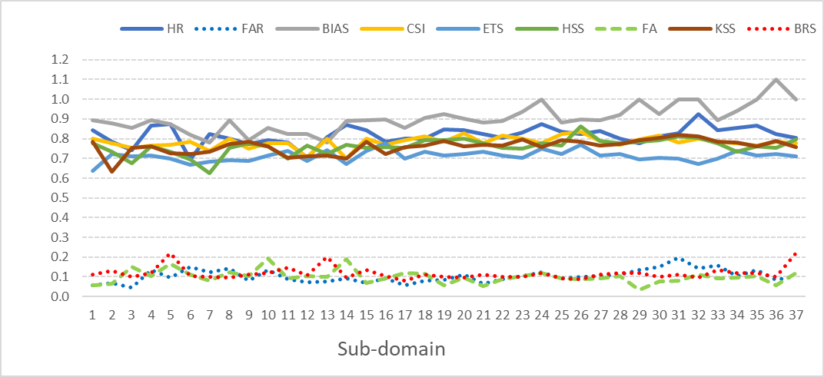
Verification Mid-latitude convective cases
Extensive set of experiments and verification has been performed from 2017-2023
Verification Tropical convective cases

Slide 18
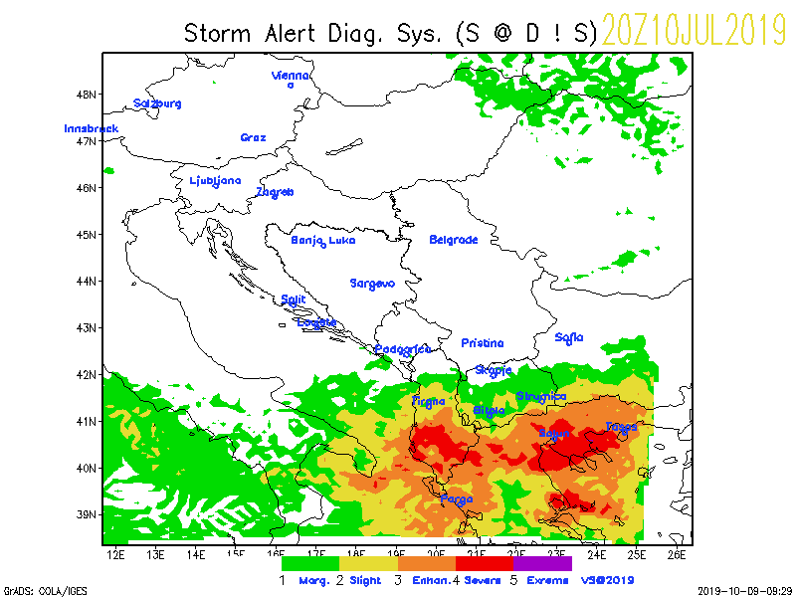
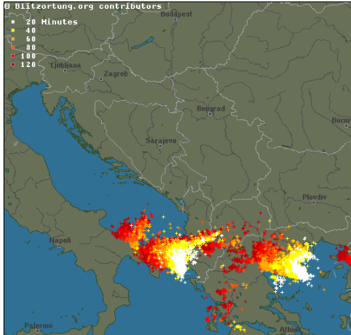
Supercell storm 10 July 2019
Halkidiki, Greece

Slide 19
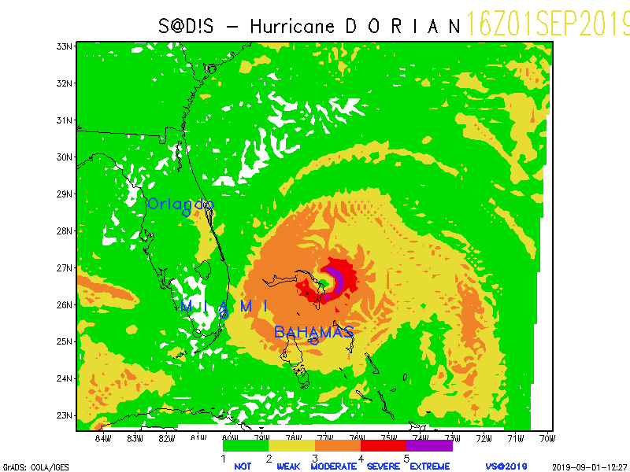
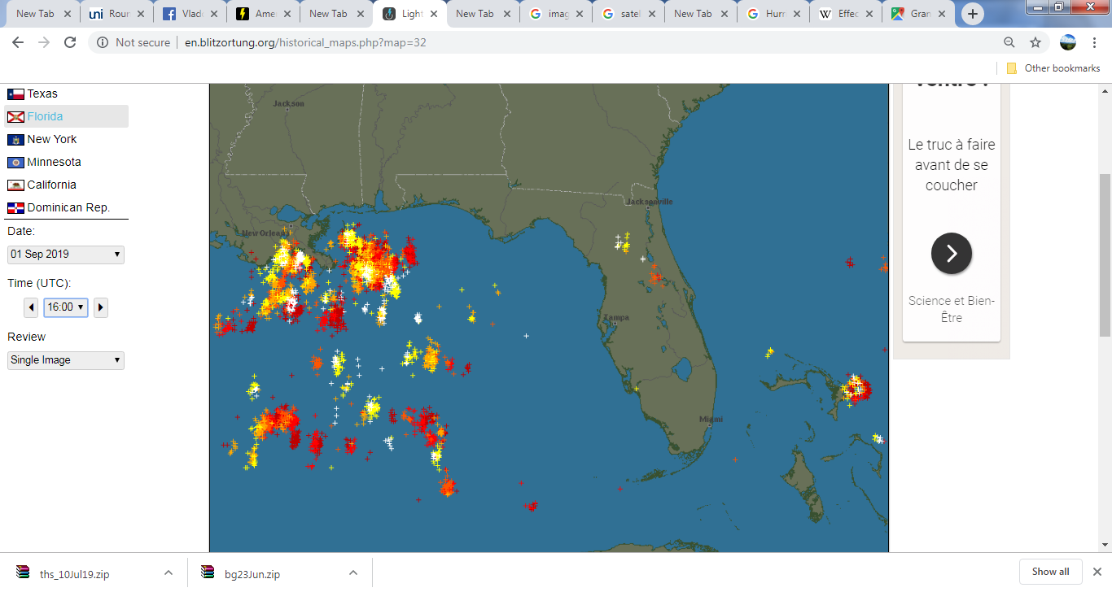
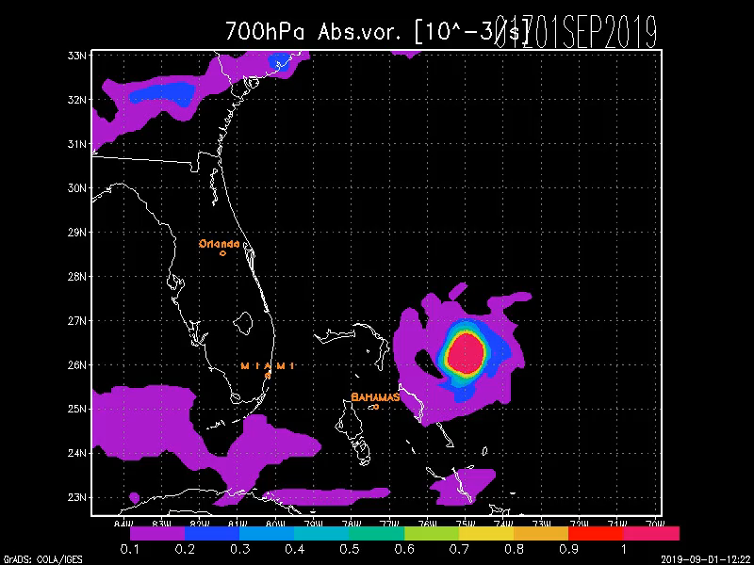
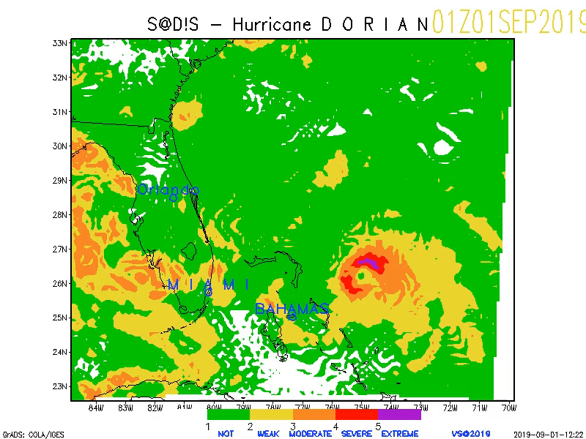
Hurricane “Dorian” 3 Sep 2019

Slide 20
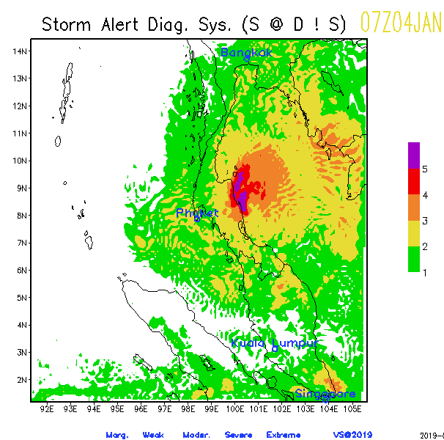
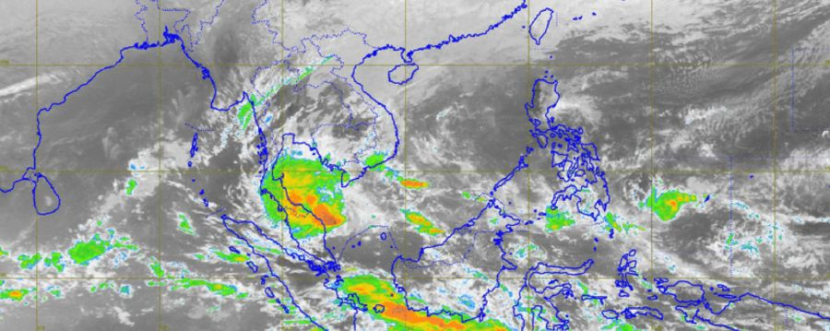
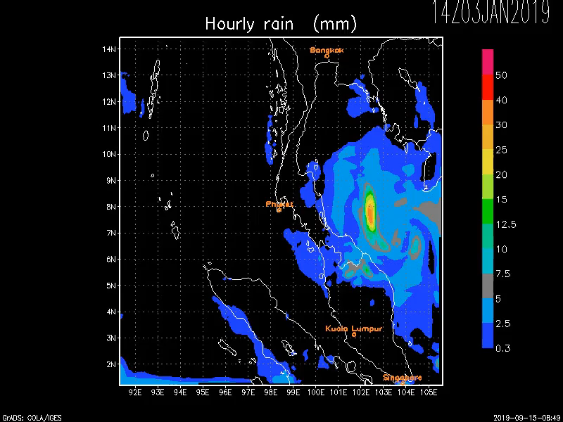
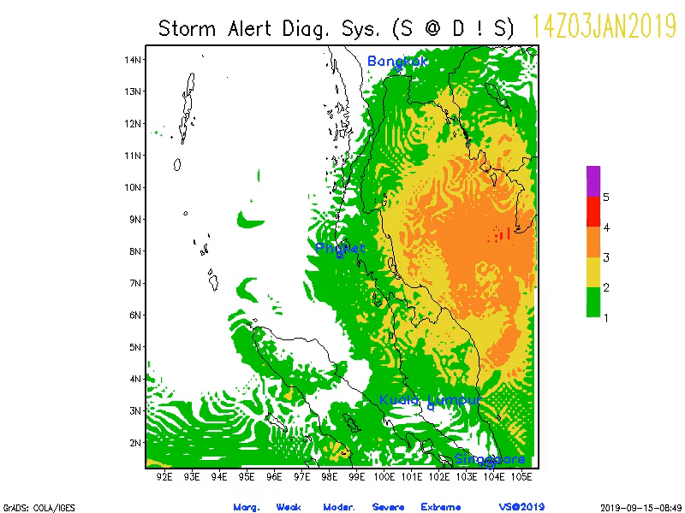
Tropical storm “Pabuk” 4 Jan. 2019

Slide 21

Thanks!
This project has received funding from the European High-Performance Computing Joint Undertaking (JU) under grant agreement No 101101903 and No 101191697. The JU receives support from the Europan Union‘s Digital Europe Programme and Germany, Bulgaria, Austria, Croatia, Cyprus, Czech Republic, Denmark, Estonia, Finland, Greece, Hungary, Ireland, Italy, Lithuania, Latvia, Poland, Portugal, Romania, Slovenia, Spain, Sweden, France, Netherlands, Belgium, Luxembourg, Slovakia, Norway, Türkiye, Republic of North Macedonia, Iceland, Montenegro, Serbia, Bosnia and Herzegovina.

