Slide 1
Weather and Climate HPC across scales
Luka Ilić
21/05/2025
EuroCC4SEE Workshop/Palata nauke, Beograd, Srbija

Slide 2
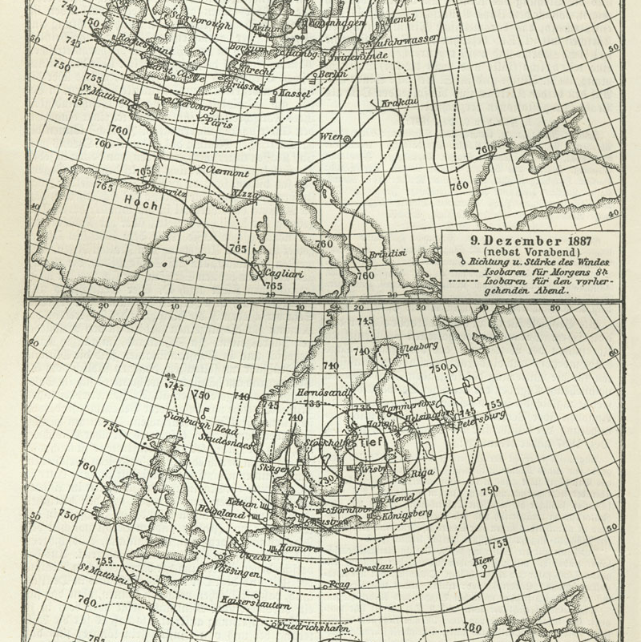
Outline
A little bit of history
Operational Weather Forecasting in different scenarios
Meteorological service nWP
Private sector
research
Experimental campaigns
Research in weather and climate
addressing uncertainty
Increased complexity
Digital twins
Ai
Weather map of Europe, December 10, 1887

Slide 3
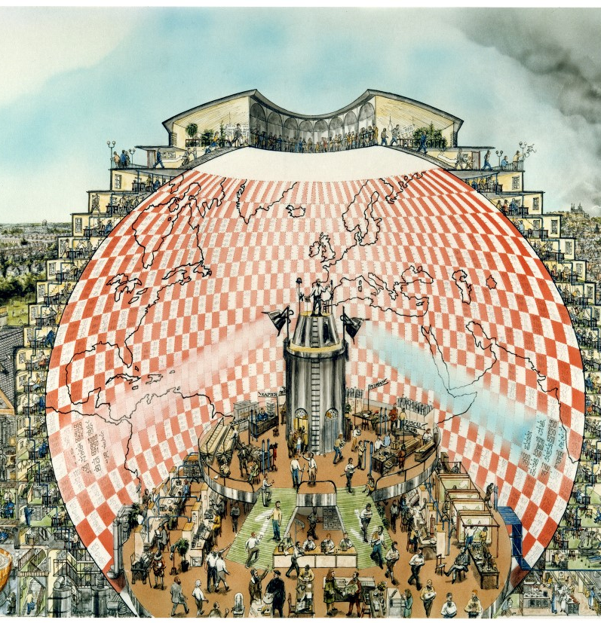
Weather Forecasting Factory
Lewis Fry Richardson (1881 -1953)
Use laws of physics
And a forecasting factory
Numerically unstable results but on the right track
Artist’s vision of a “Weather Forecasting Factory” by Stephen Conlin, 1986.

Slide 4
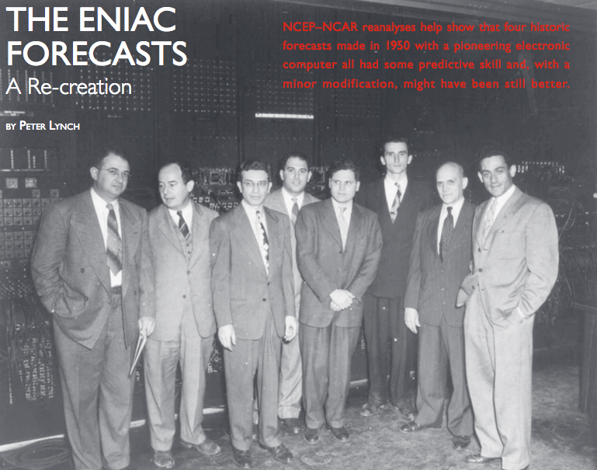
Contemporary Numerical Weather Prediction
ENIAC

Slide 5
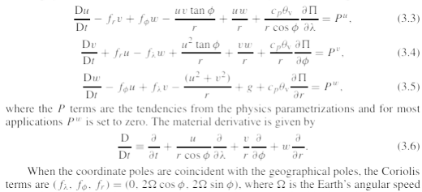
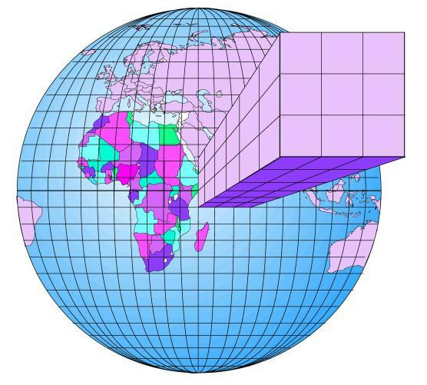



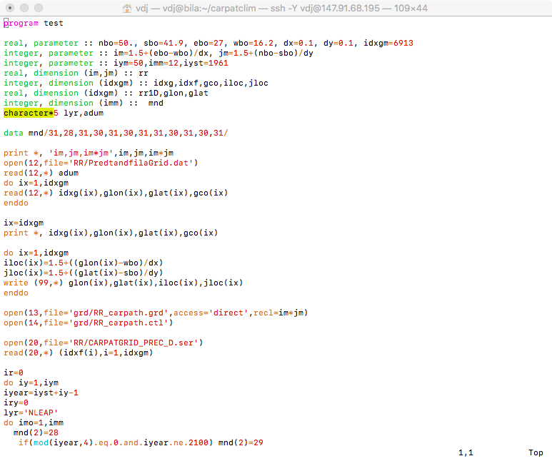
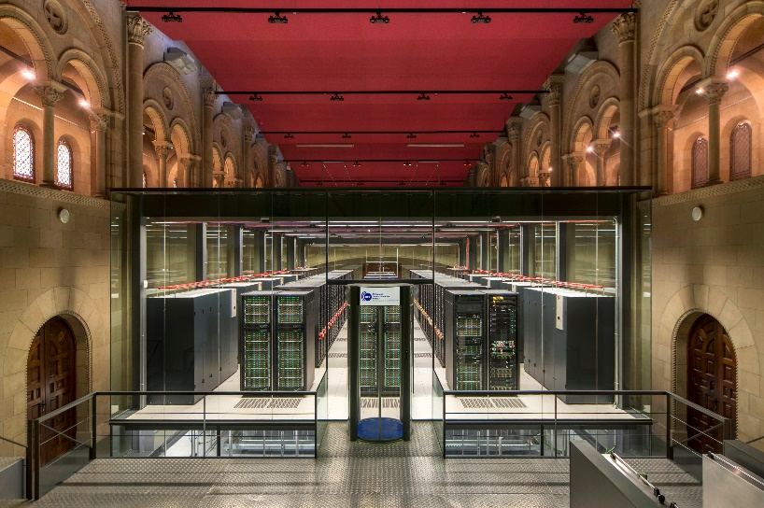

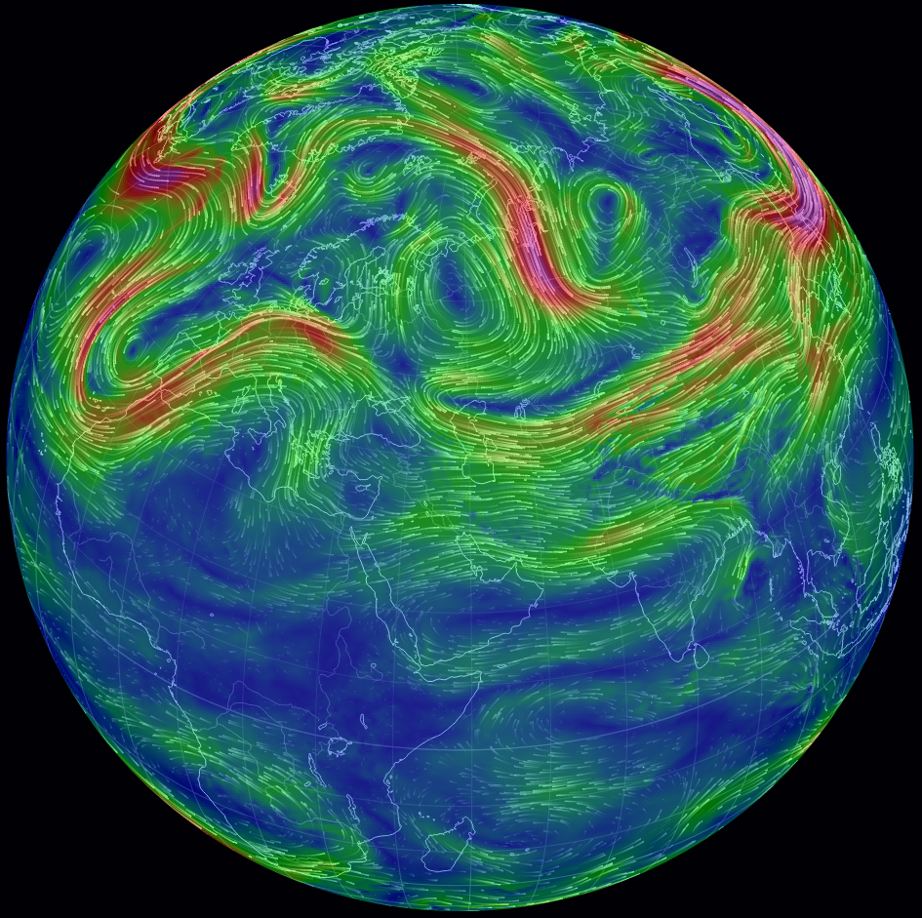
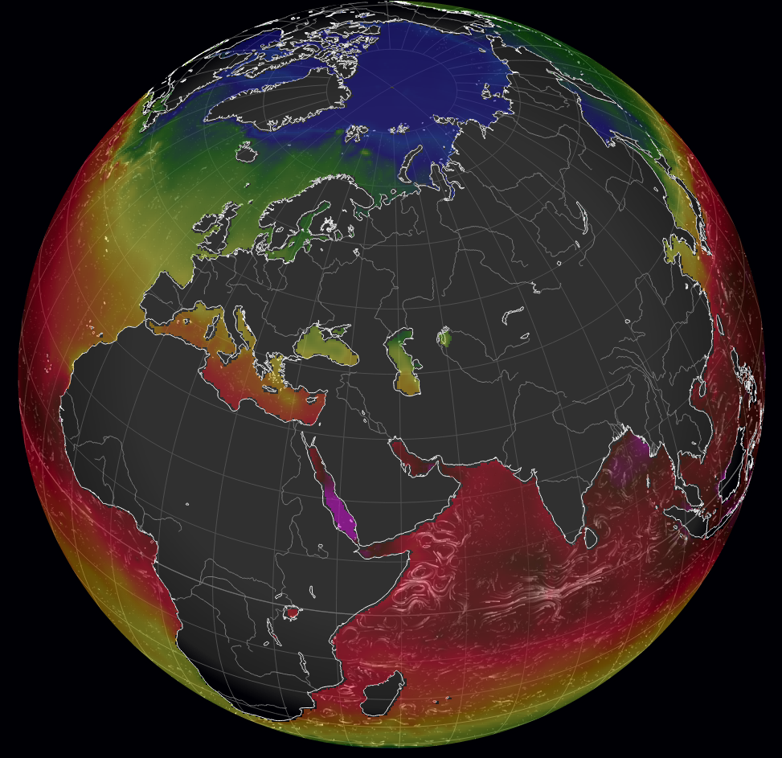
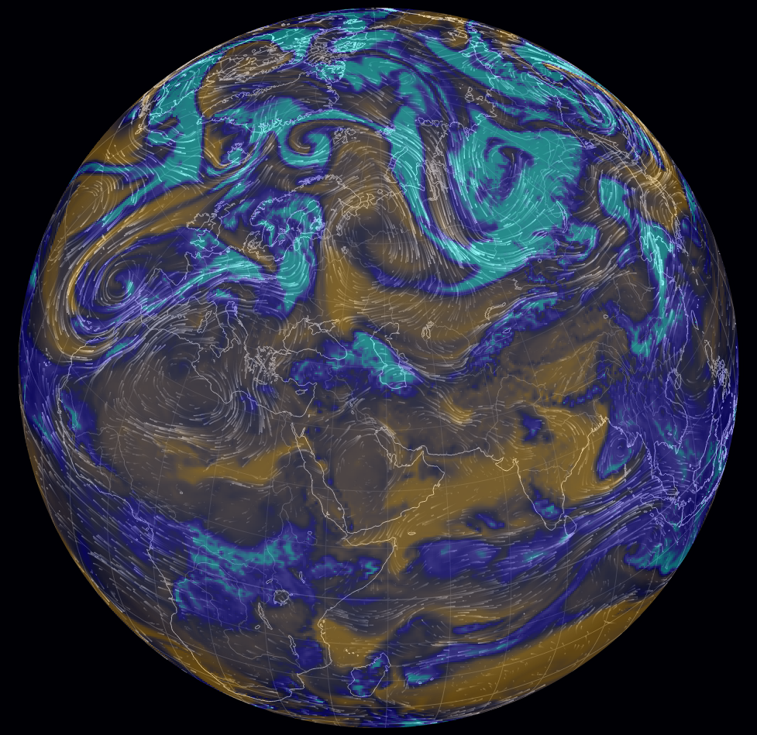
1
2
3
4
5
Slide by Vladimir Đurđević, University of Belgrade

Slide 6
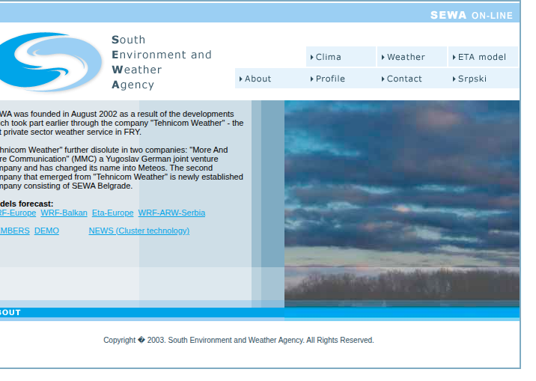
South Environment and Weather Agency (SEWA)
~25 years in business
In-house built Beowulf cluster
dedicated servers
Tailored weather products

Slide 7
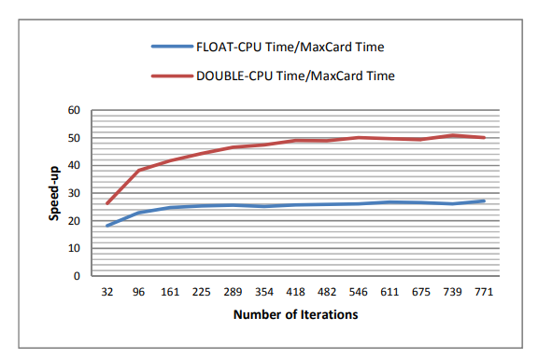
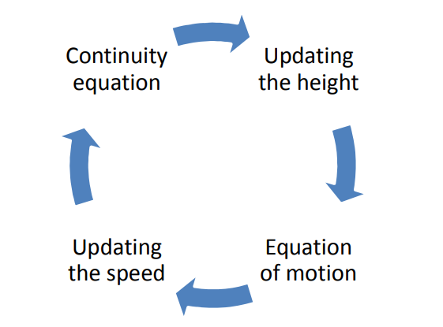
Exploring the accelerator option - dataflow
Meteos/Maxeler/school of Electrical engineering, university of Belgarde
Porting a system of Shallow water equations
a rotating rectangular pan filled with water
Strong dependance on data inputs
(Ivković et al, 2013)

Slide 8
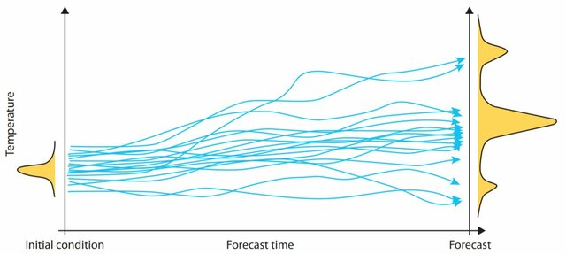

Chaos in the Atmosphere
Deterministic non-periodic flow (Lorenz, 1963)
Predictability of atmospheric flow
Ensemble prediction
Variable initial conditions
Spaghetti plot from Grönquist et al, 2019

Slide 9
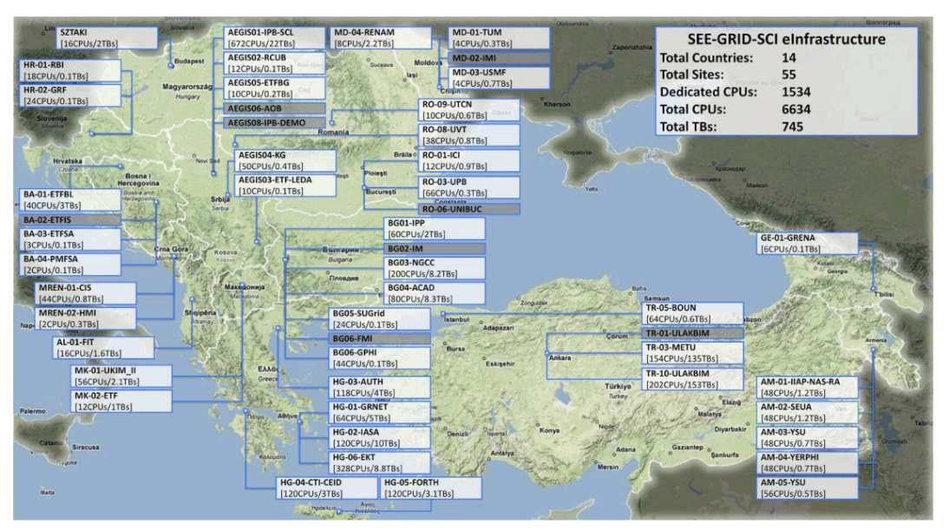
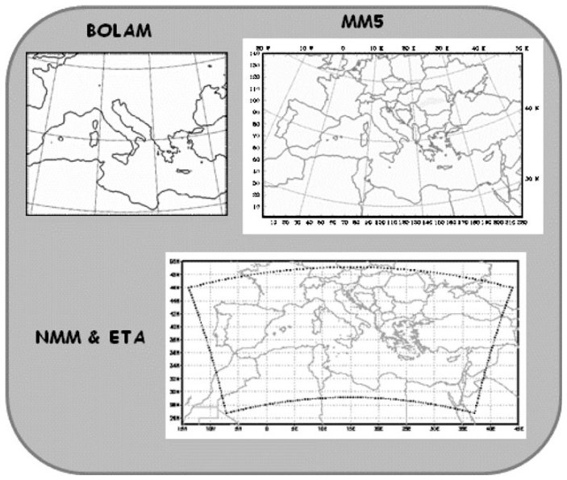
See-grid-sci FP7 project
Institute of Physics Belgrade (IPB) / SEWA / National Observatory of Athens (NOA)
Multi Model Multi Analysis Ensemble on the GRID (Kotroni et al. 2009)
Distributed HPC infrastructure (Balaž et al, 2011)

Slide 10
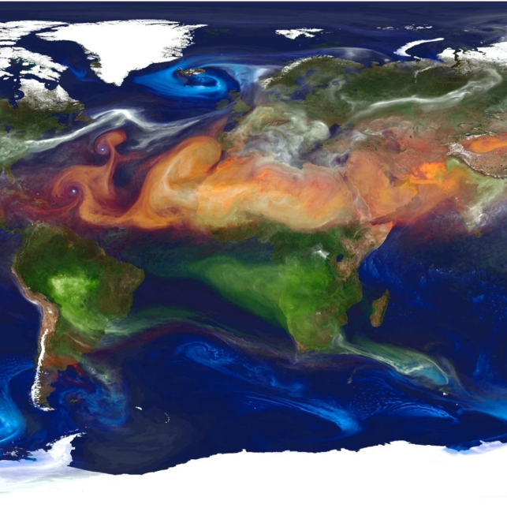
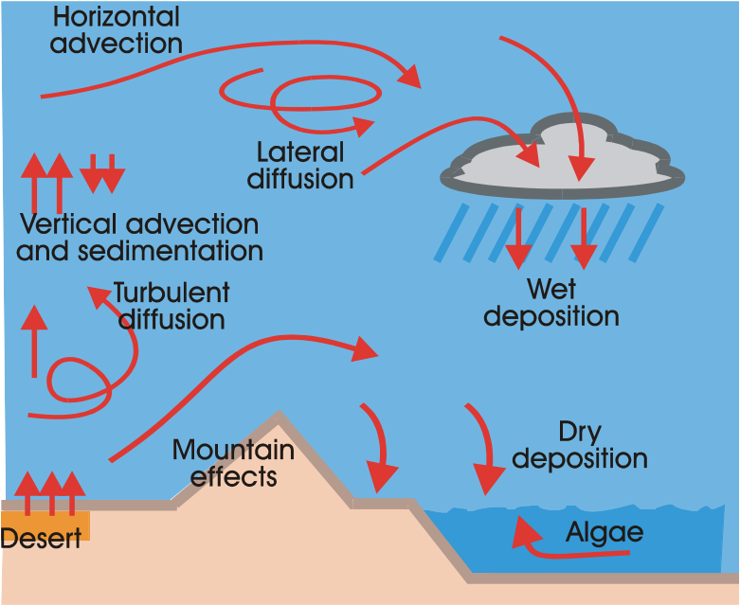
Can We Add a Few More Equations?
Dust Regional Atmospheric Model (DREAM)
Ničković et al, 1994
Radiation interactions
Ice nucleation
Algae bloom
Health impacts

Slide 11
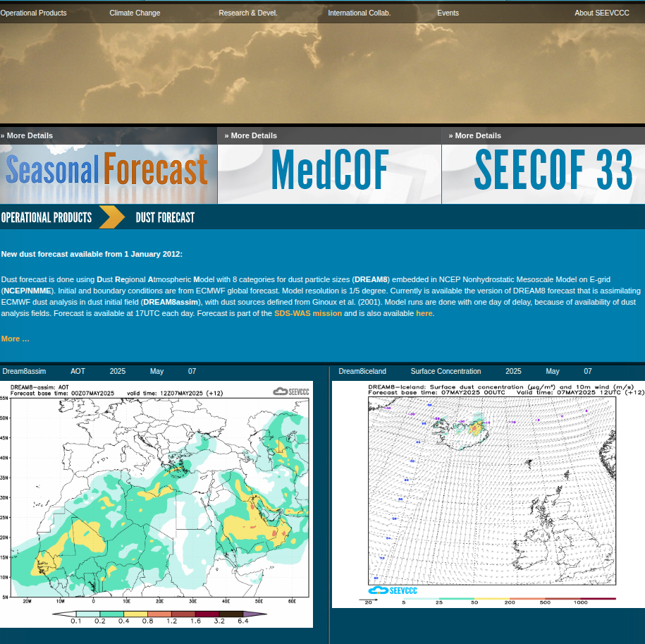
Republic Hydrometeorological Service of Serbia
Southeast European Virtual Climate Change Center (SEEVCCC)
Sand and dust storm warning and advisory system (sds-was)
World meteorological organization (wMO)
High-latitude dust - Iceland

Slide 12
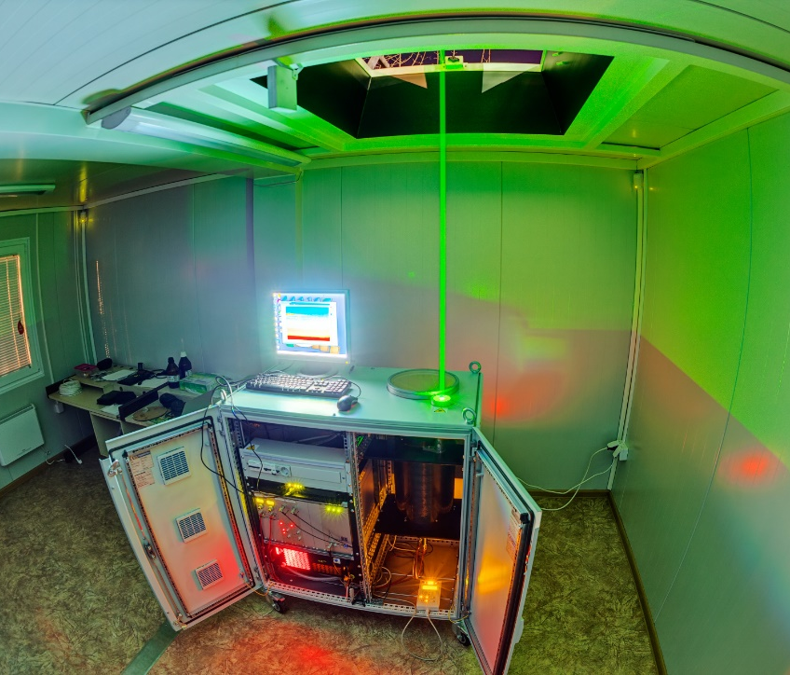
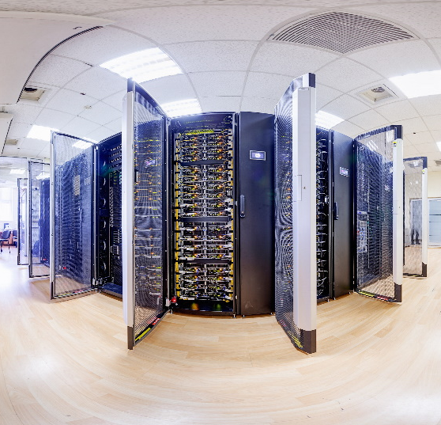
Atmospheric research at IPB
Environmental physics Laboratory
Scientific computing laboratory
DREAM model development
Dust research
Operational forecasting
Lidar measurements
Model validation

Slide 13
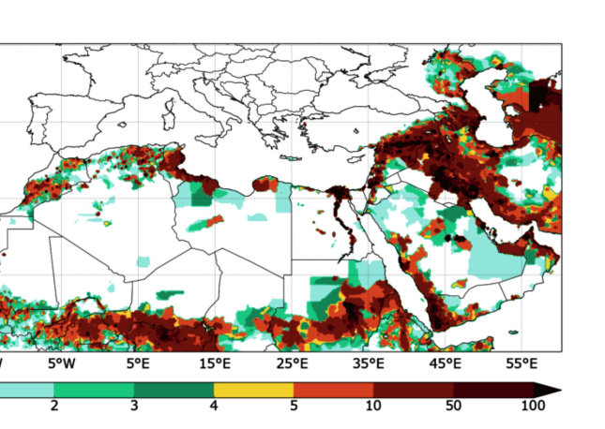
Climate Service at IPB
Vi-seem Horizon 202o project (Vudragović et al. 2018)
Climatological assessment as a service
use-case of dust contribution to PM2.5 pollution

Slide 14
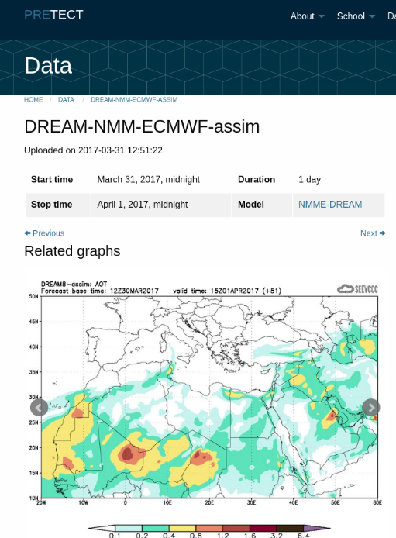
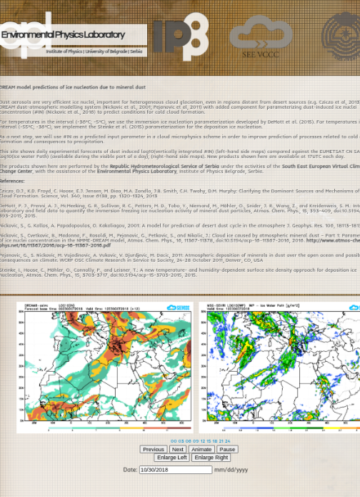
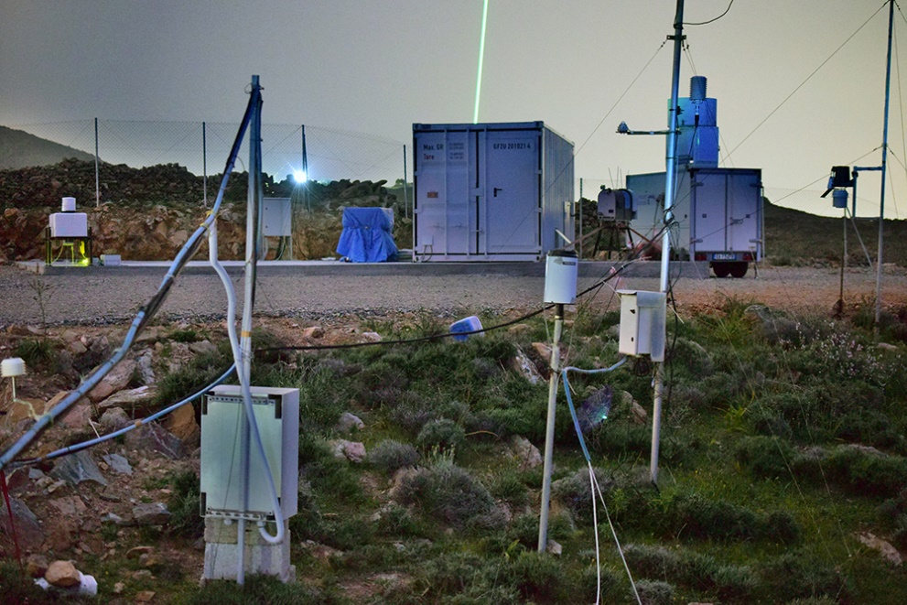
Research and Weather Service Collab.
Operational and research
Even more complexity
Mineralogy of dust
Ice nucleating particle concentrations
Ničković et al 2012, 2016, 2021; ilić et al 2022
Pre-tect campaign in Crete, April 2017

Slide 15
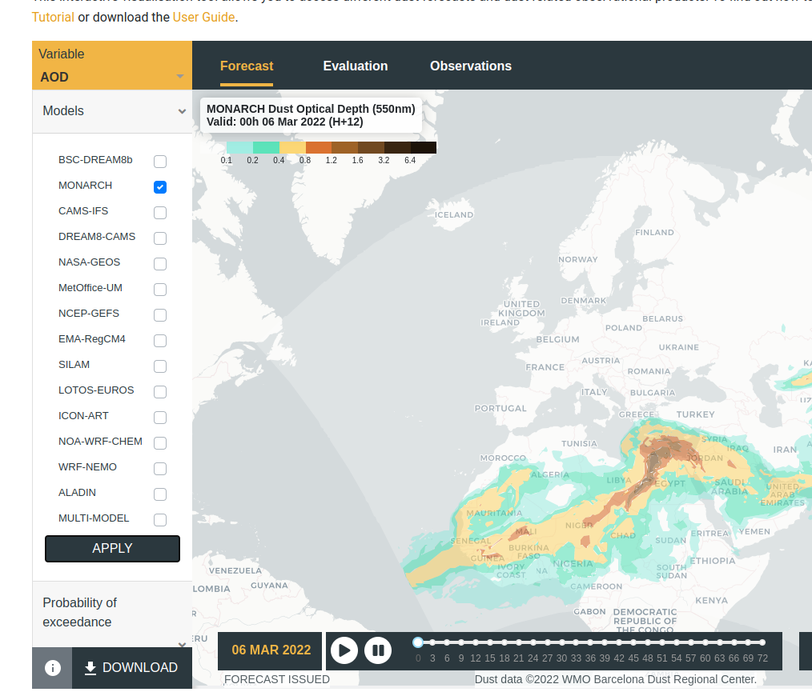
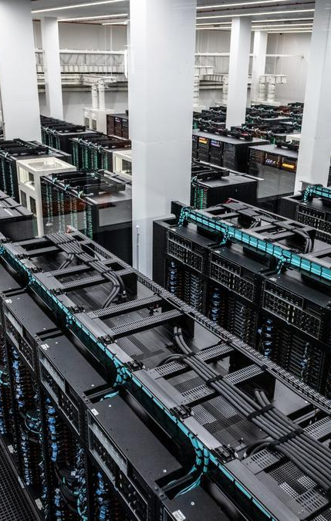
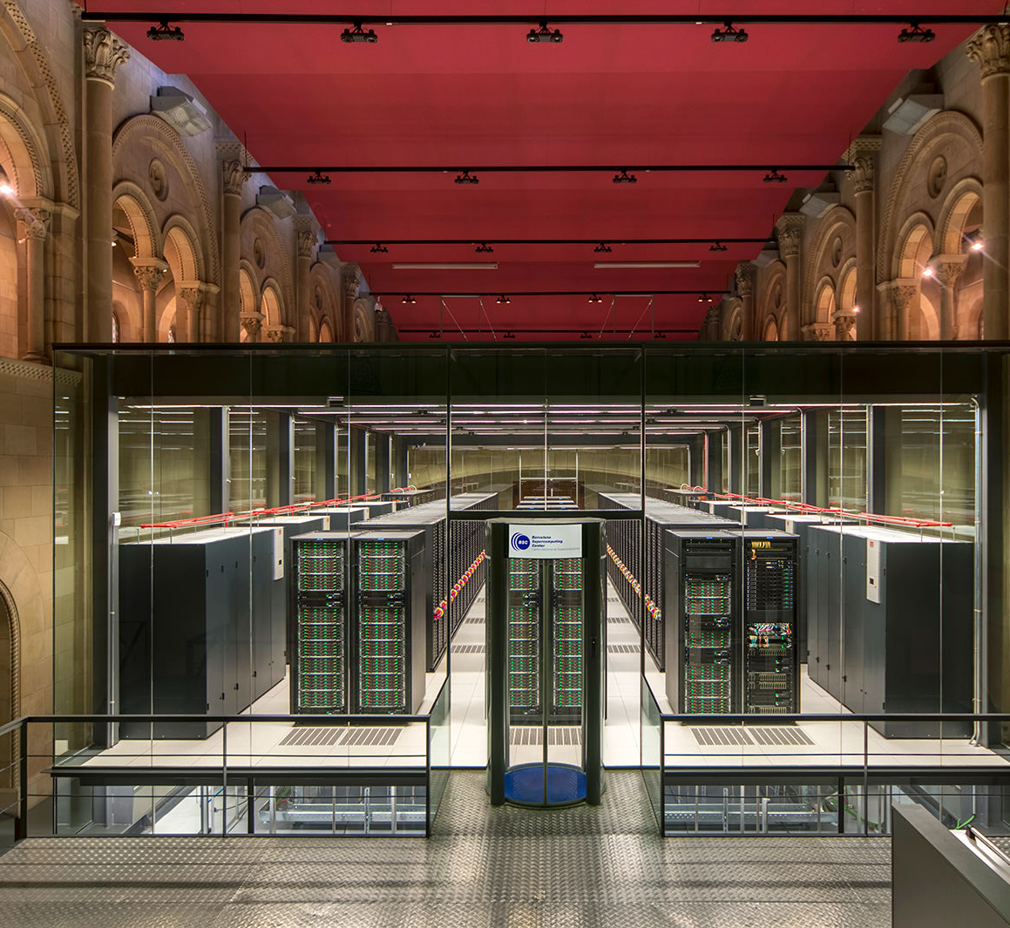
Scaling-up Even Further
Barcelona Supercomputing Center (BSC)
Monarch model (klose et al, 2021)
Mineralogy (Gonçalves Ageitos et al 2023)
Dust and chemistry (sousse et al, 2025)
Radiation interactions (Obiso et al, 2024)

Slide 16
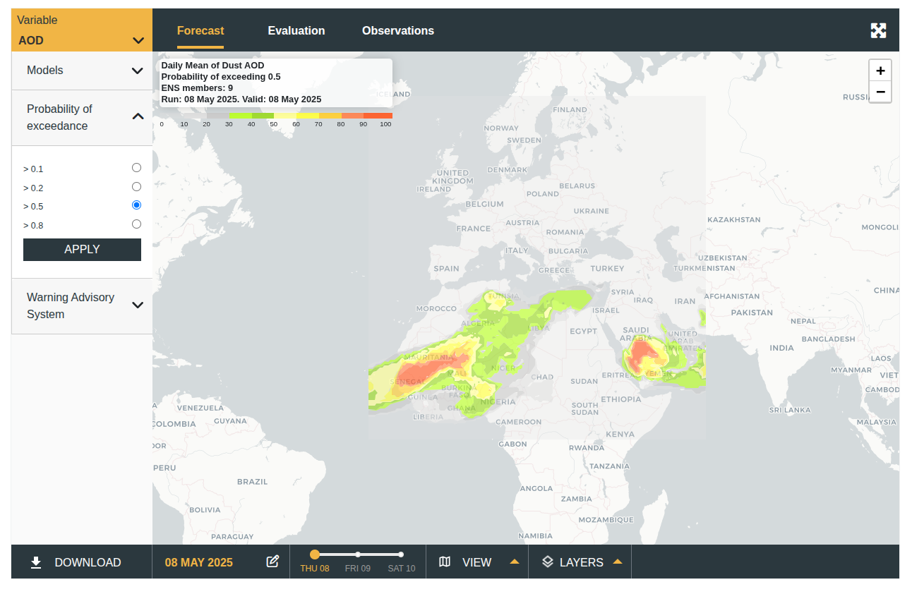
Back to SDS-WAS
Complex models, atmosphere and aerosols
Multi-model ensemble contributions from several regional centers

Slide 17
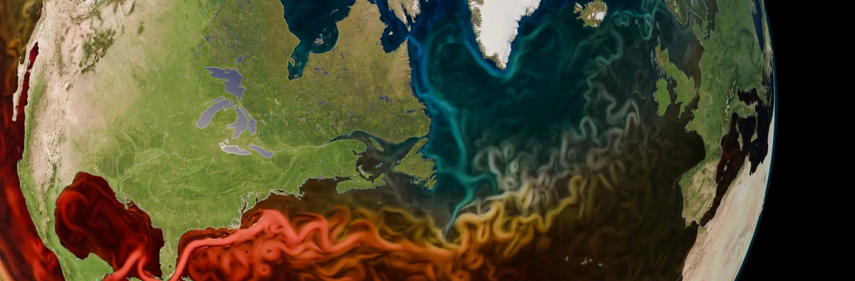
Digital Twins
ECMWF / ESA / EUMETSAT - the Destination Earth initiative
the first pre-exascale supercomputers in Europe
Operational production of global climate projections
globally consistent Earth system and impact sector information
from global to local scales

Slide 18
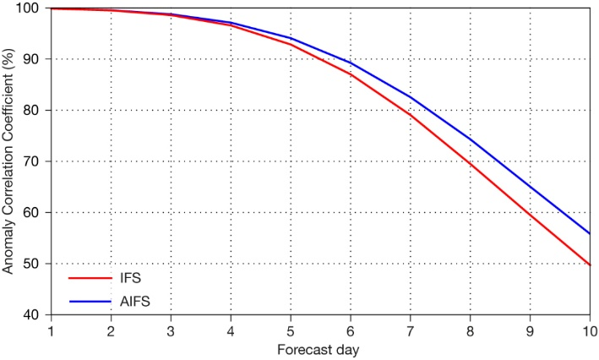
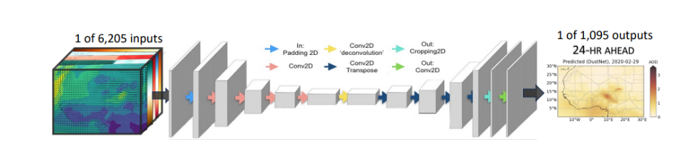
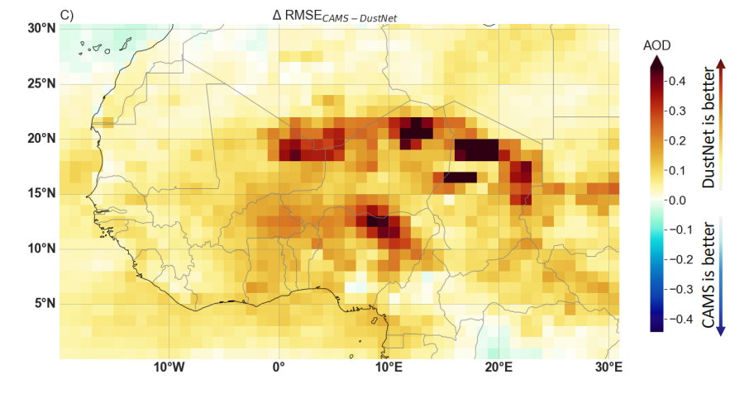
Machine Learning and AI in Weather and Climate
Speed
Efficiency
Skill
(still) dependent on physics-based models
AIFS: a new ECMWF forecasting system (Lang et al, 2024)
DustNET (Nowak et al, 2024)

Slide 19
Outlook on HPC in weather and climate
Provide space to improve on weather and climate research
increased complexity of the models, coupling
addressing uncertainties
Faster and cheaper operational forecasts
Availability of models as a service
predictability

Slide 20

Thank you!
Acknowledgments
www.atmosphericdust.com
This project has received funding from Juan de la Cierva Fellowship JDC2022-049038-I funded by MICIU and by European Union NextGenerationEU and AEI.
luka.ilic@bsc.es

