Slide 1
HPDA Service for Estimating the Brown Bear (Ursus arctos L.) Population in Bulgaria
EuroCC4SEE Workshop in Belgrade, 20 to 22 May 2025

Slide 2
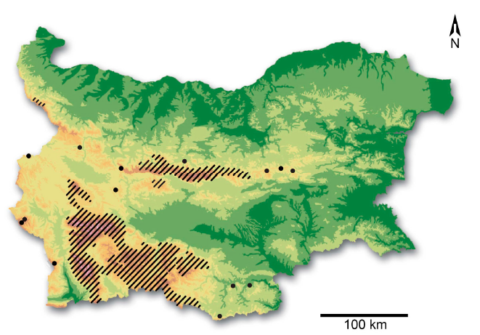
Motivation
The Habitat Directive requires strict protection of the species and the declaration of special protected areas for the conservation of its habitats.
According to the IUCN Red List (https://www.iucnredlist.org), the mammals are more than 5000 species worldwide, 26% of them threatened with extinction.
Brown Bear (Ursus arctos) is a priority species for the conservation of mammals in the European Union. Conservation status: in Bulgaria endangered EN [C2a (i)], BA-II, III, International: Beck-II; CITES-II; DH-II, IV.
Red Data Book of the Republic Bulgaria, Vol. 2 – Animals, Sofia, 2011. http://e-ecodb.bas.bg/rdb/en/

Slide 3
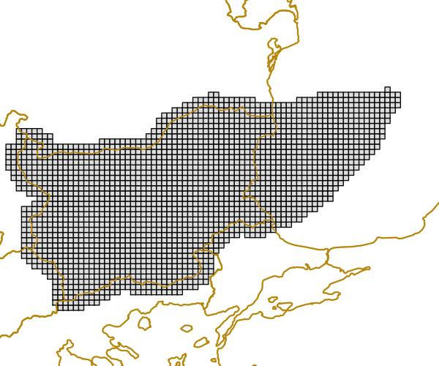
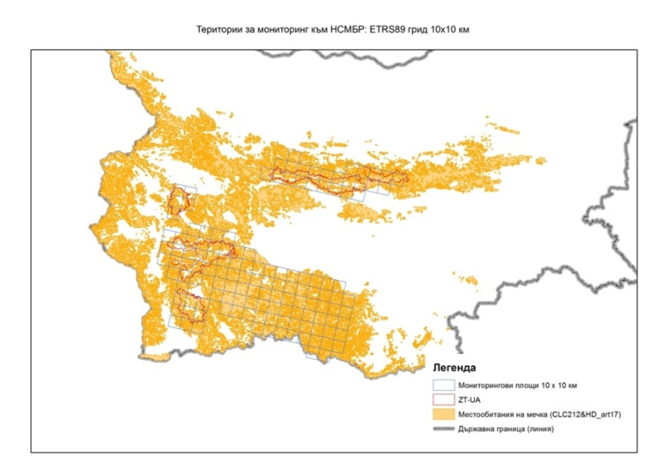
National monitoring
National Monitoring at the main mountain’s habitats (start since 2016):
Width/length of the front footprint and/or back footprint
Excrements
Found bear marking
A place where the bear has fed itself
Visual observation of a bear
Found winter dens
Bear bed
GPS coordinates of all bear’s traces/signs
EUROPEAN TERRESTRIAL REFERENCE SYSTEM 89 (ETRS89),
Grids 10х10 km

Slide 4
Number of grids in each subpopulation area
Areas for Monitoring | ETRS89 Grids 10х10 km | Number
Vitosha-Verila-Plana | E541N226; E541N225; E540N226; E540N225; E540N224; E540N223; E541N223;E541N224;E542N224; E542N225 | 10
Rila | E540N220; E540N221; E540N222; E541N219; E541N220; E541N221;E541N222; E542N219; E542N220; E542N221; E542N222; E542N223;E543N219; E543N219; E543N220; E543N221; E543N222; E544N220; E544N221; E544N222; E544N223; E545N220; E545N221; E546N222; E545N223; E543N223 | 26
Pirin | E542N215; E542N216; E542N217; E542N218; E543N215; E543N216; E543N217; E544N215; E544N216; E544N217 | 10
Rhodops | E546N217; E547N222; E548N219; E552N218; E552N220; E556N220; E545N218; E545N219; E546N219; E546N220; E547N217; E547N220; E547N218; E547N219; E547N221; E548N217; E548N218; E548N220; E548N221; E549N216; E549N217; E549N218; E549N219; E549N220; E549N221; E550N216; E550N217; E550N218; E550N219; E550N220; E550N221; E551N216; E551N217; E551N218; E551N219; E551N220; E551N221; E552N216; E552N217; E552N219; E552N221; E553N216; E553N220; E554N220; E556N218; E553N217; E553N218;E553N219; E553N221; E554N215; E554N216; E554N217; E554N218; E554N219; E554N221; E555N215; E555N216; E555N217; E555N218; E555N219; E555N220; E555N221; E556N216; E556N217; E556N219; E545N220 | 60
Central Balkan | E555N229; E551N230; E547N229; E549N229; E549N230; E556N231; E557N230; E558N231; E548N229; E548N230; E549N231; E550N229; E550N230; E551N229; E552N229; E552N230; E553N229; E553N230; E554N229; E554N230; E554N231; E555N230; E555N231;E556N230; E557N231 | 25
Kotlen mountain | E564N233;E564N234;E565N234; E566N234 | 4

Slide 5
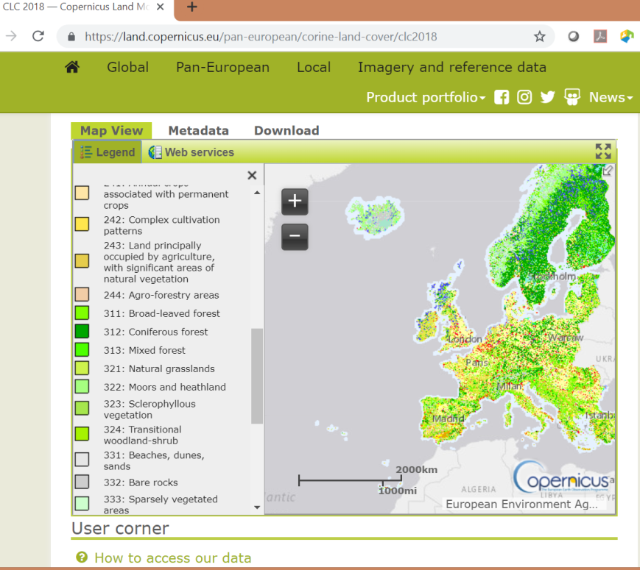
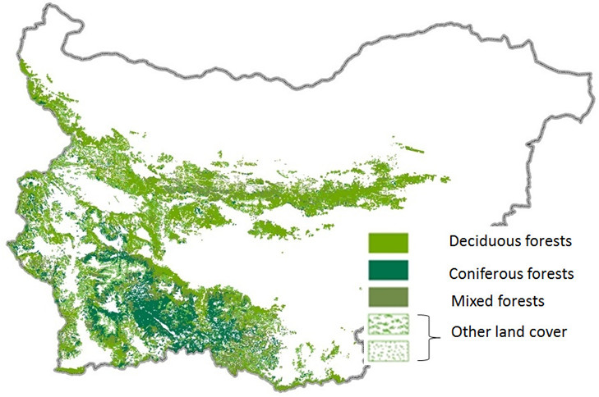
CORINE Land Cover (CLC)
CORINE Land Cover (CLC) is one of the most well-known and used products from the Copernicus Land Monitoring Service.
It has previously been produced in 1990, 2000, 2006 and 2012 and now the 2018 edition is available.

Slide 6
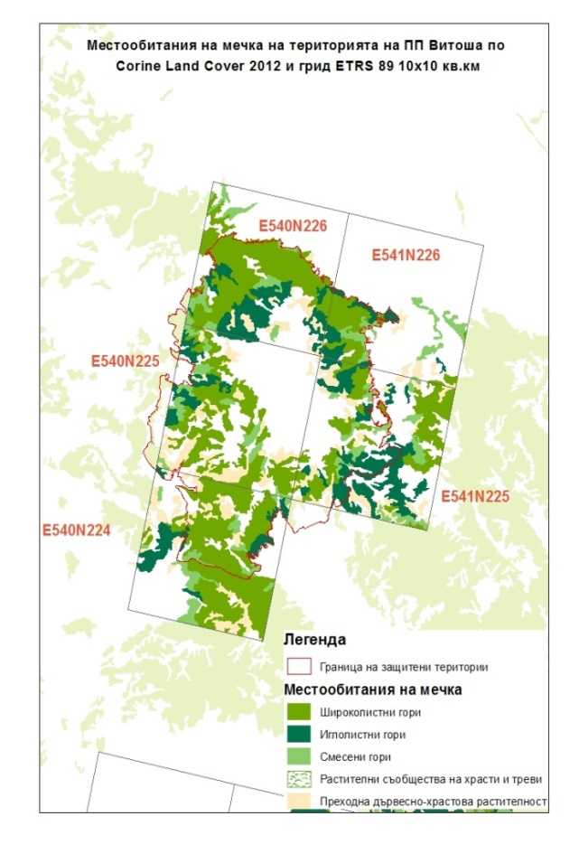
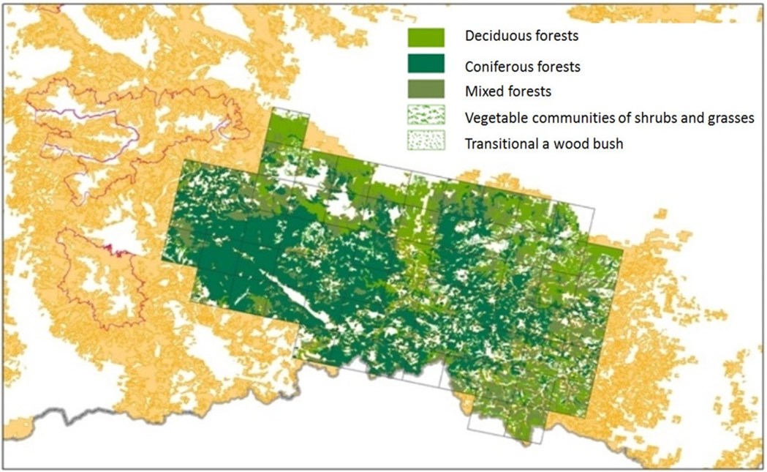
Transect method
It is based on the collection of brown bear sign on predefined set of routes (transects) and the determination of the unique traces (especially footprints).
Statistical estimates for population size of the brown bears using data of national monitoring and developed HPDA service.
Type of the forests:
Deciduous forests 311
Coniferous forests 312
Mixed forests 313
Vegetable communities of shrubs and grasses 322
Transitional a wood bush 324
Other land cover no code
Bears’ habitat for monitoring in the Western Rhodopes and Vitosha mounting

Slide 7
Start of the HPDA service
Input the monitoring data to start the preproduction process

Slide 8
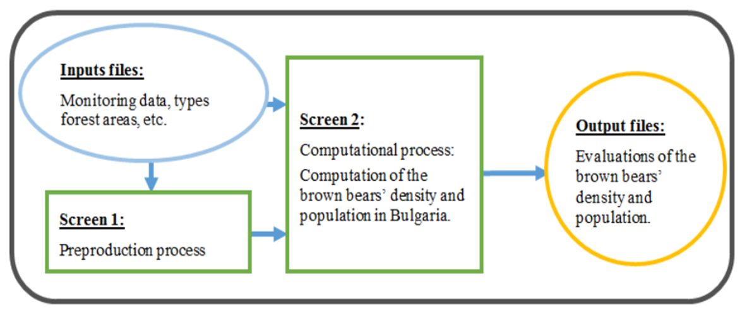
Estimation of the population size of the brown bears (1/2)
The evaluation is done in two steps.
First step: Identify unique traces based on collected observations in the national monitoring. The number of unique traces is determined by experts using the developed software product. Once the unique number of traces has been obtained, the program automatically allocates them by number in the respective 5 types of forest and in the residual area.

Slide 9
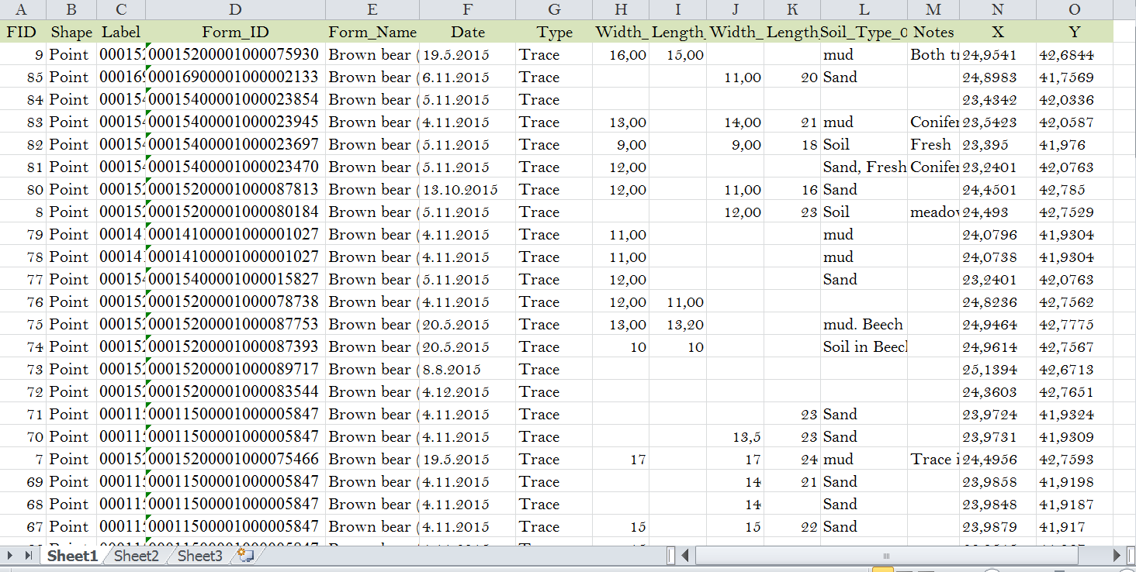
Input File - 1

Slide 10
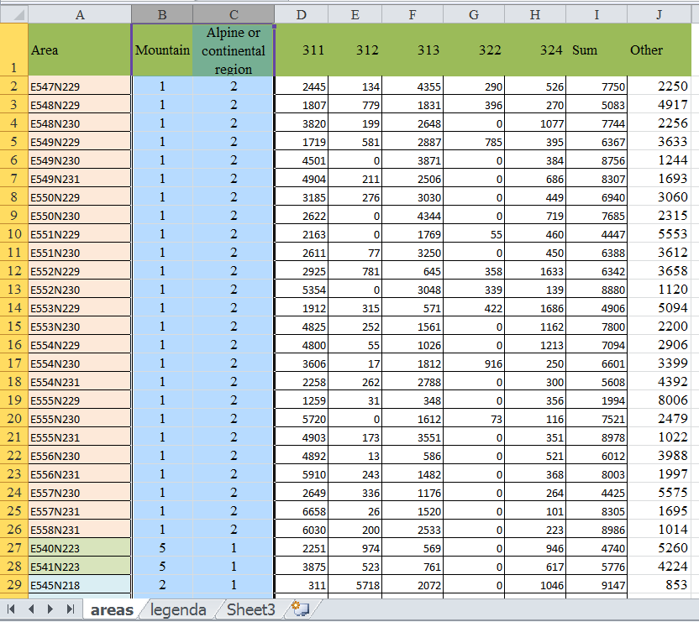
Input file -2
Code for each grid
(10x10 km) according to:
Code of the mountain
Type of areas in hectares

Slide 11
Preproduction process: Define the unique traces

Slide 12
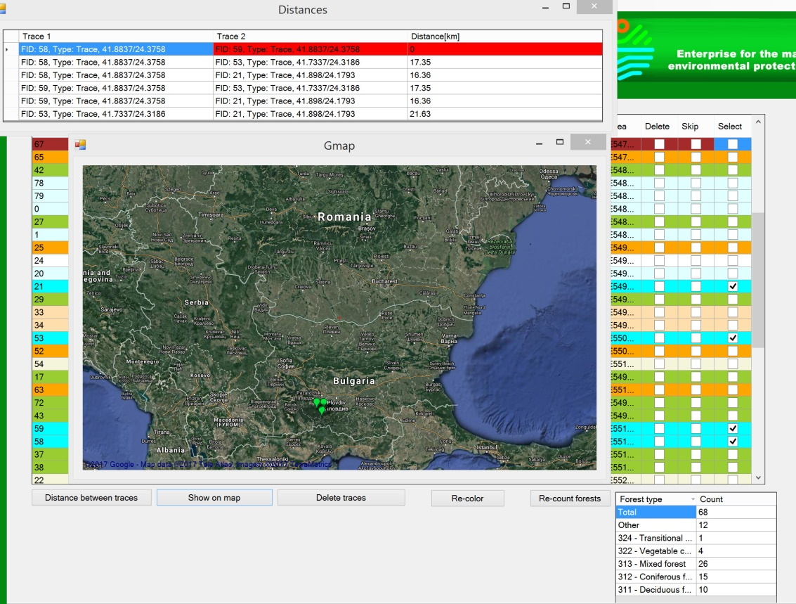
Compute distances and show traces on the Gmap

Slide 13
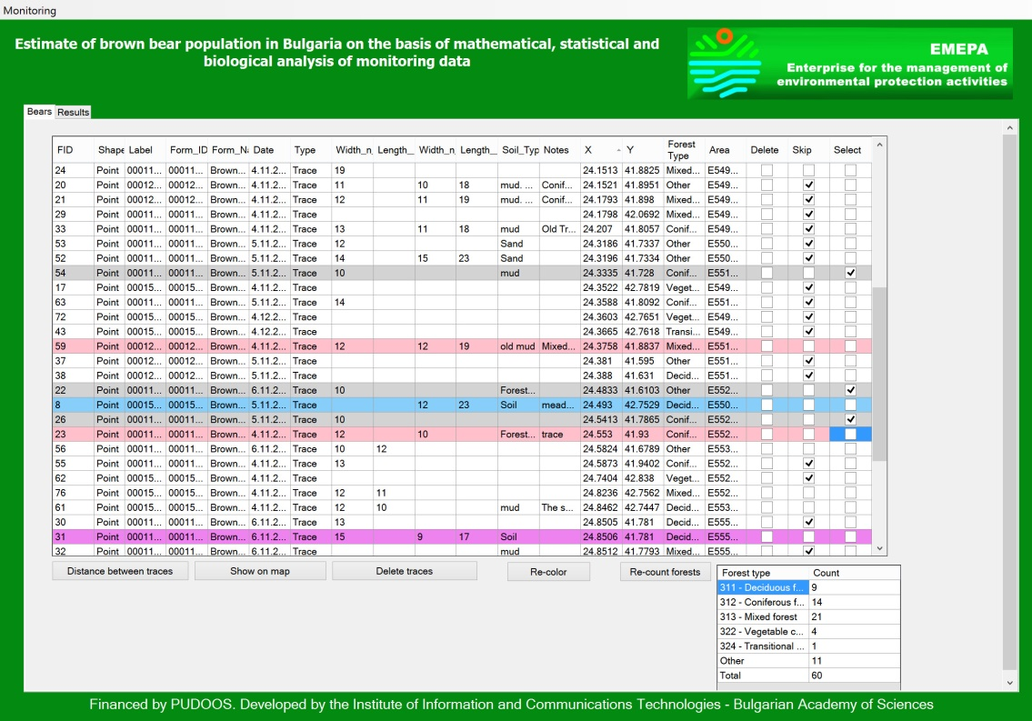
Skipping, re-coloring and re-counting

Slide 14
Estimation of the population size of the brown bears
Second step: At this stage, the program statistically estimates the number of population and the distribution density of the brown bear on the 6 geographic areas (mountains) and on two geographic climatic areas (alpine and continental).
Since there are not enough 232 transects covering all 142 grids during the national monitoring, the program automatically divides the number of grids into two sets.
The first set includes those grids which contain transects (grids) visited during the national monitoring. The number of the brown bear is estimated statistically using the maximum likelihood method.
The second set includes those grids which contain transects (grids), not visited during the national monitoring. The number of population in the second set is obtained by extrapolation.

Slide 15
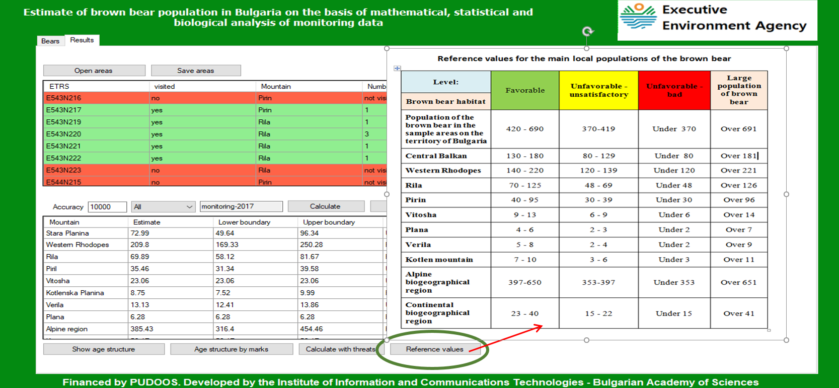
Computational process
Computation of the density and the population of the species

Slide 16
Statistical estimation of the bears’ population
We use maximum likelihood method with following parameters.
We have introduced the coefficients λ₁, ..., λ₅, to estimate the probability of detecting the presence of a bear in a given area (forest type), which are the parameters of the Poisson distribution (assumed the distribution is Poisson).
These parameters describe the number of bears per unit area in the respective forest type.
We have also introduced the coefficients ψ₁, ..., ψ₅, which correspond to the probability of finding a bear if it is in the relevant area (grid) and type of forest.
$$P\left(i,j,d\right)= e^{−λ_{j}}\sum_{k=d}^{∞}{\left(\begin{matrix}k \\ d\end{matrix}\right){{ψ_{i}}^{d}(1−ψ_{j})}^{k−d}{{ψ_{j}}^{d}(1−ψ_{j})}^{k−d}\frac{{λ_{j}}^{k}}{k!}}$$
Using these coefficients, we have constructed a likelihood function.
When $ψ_{j}=1$, (in case we have forest animal feeders in the each grid) we obtain simpler formula:
$e^{−λ_{j}}\frac{{λ_{j}}^{d}}{d!}$, where d is the number of the unique traces.
Using maximum likelihood estimation we can estimate the values of the coefficients λ₁, ..., λ₅, and ψ₁, ..., ψ_{5.}

Slide 17
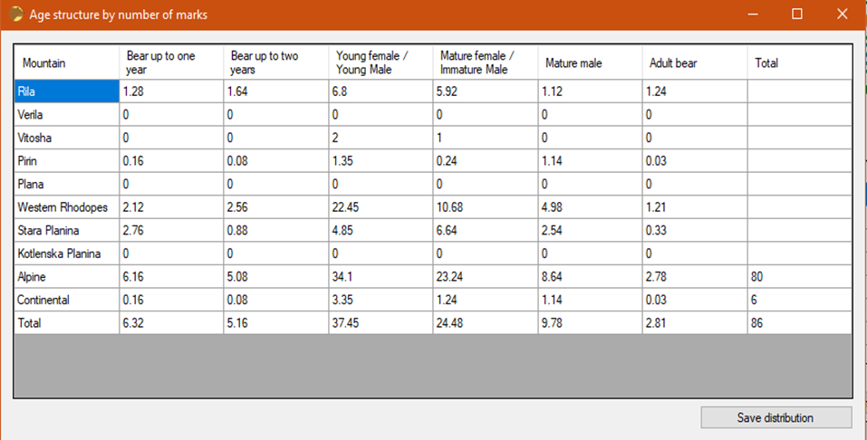
Age structures by unique traces

Slide 18
Table for Age Structure
Table: Size of the footprints of the brown bear from Bulgaria and Eastern Europe. Correlation between the length of the footprint of the hind paw, the width of the fore one, and the size, the sex and the age of the bear.
Feature | Width of the fore pow footprint | Width of the hind pow footprint | Length of the hind pow footprint
Category bear
1. A bear cub – 1st year | 5-7 cm | - | 6-11 cm
2. A bear cub – 2nd year, up to ~ 50 kg. | ~ 8-9 \10 | 0-0.5 cm narrower than the anterior one | 12-15
3. Young females (3 and 4 years’old) and young males ~ 3 years’ old (small bear: ~ 50-100 kg) | 10/11-12 cm. (the most frequent in the field) In the young individuals with 12 cm are most possibly young males because 12 cm is normal size for a mature female) | 0-0.5 cm. narrower than the anterior | 16-19/20
4. Adult females and subadult ( 4-5 years old) males (average-sized bear - 100 ~ 200 kg.) | 12/13-13.5/14; (extremely rarely 14 cm – for a female but most frequently for a young male) | ~ 0.5-1 cm Narrower than the anterior | 19/20-23/24 cm; (23/24 – only male individuals)
5. Mature males more than 5 years old (large bear ~ 200-250 kg) | 14.5-17 | It could be up to 1-1.5 cm narrower | 24-26/27
6. Very big, old males, usually more than 10 years’ old and more than 250 kg (records – above 350 kg) | 17 and more | Up to 1-2 cm narrower | 27-30 (31?) cm

Slide 19
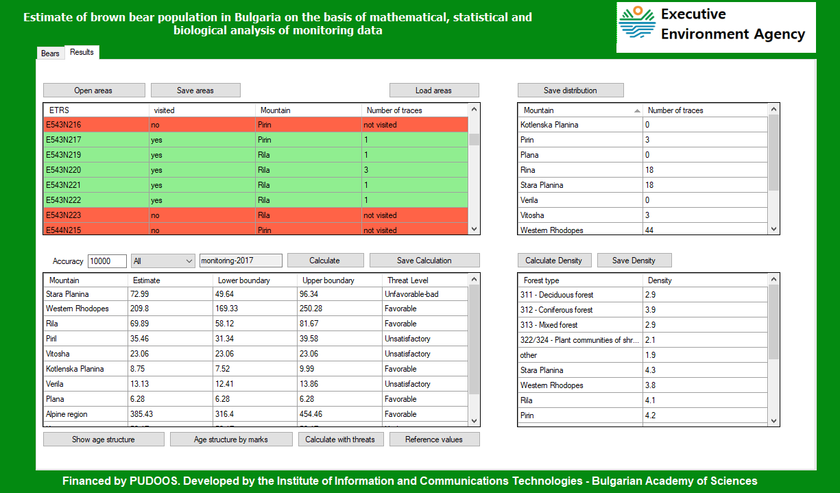
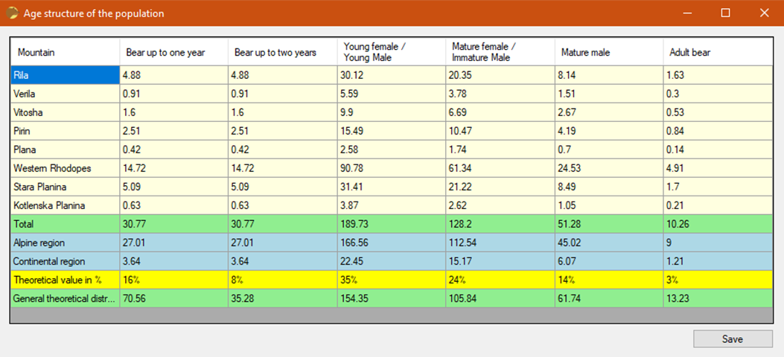
Age structures of the estimated population

Slide 20
List of pressures and threats
Pressures and Threats | weight | Favorable | Unfavorable - unsatisfactory | Unfavorable - bad
Derogation of problematic bears | L | 0 - 25% | 25 - 40% | Over 40%
Conflicts with farmers and local people | H | 0-10% | 11-30% | Over 30%
Poaching | H | 0-10% | 11-30% | Over 30%
Disturbance (human activities) | M | 0 - 20% | 21 - 50% | Over 50%
Destructions of bio-corridors | H | 0-10% | 11-30% | Over 30%
Natural threats (survival of bears up to two years of age) | L | 0 - 60% | 60-70% | Over 70%
Forest management for reduction ( reduction of the area) of old forests | H | 0-10% | 11-30% | Over 30%
Sports infrastructure and tourism infrastructure | M | 0 - 20% | 21 - 50% | Over 50%
Climate change | M | 0 - 20% | 21 - 50% | Over 30%

Slide 21
Formula for computing the accumulated tread
Justification for the choice of certain parameters: reflects the adverse effects on the condition and threats to the species in the studied habitats.
Method of calculation:
$$F\left(\%\right)=\frac{n∗(1−µ)}{N}∗100,$$
where n - means the number of sample areas (grids 10x10 km) in which the threat/impact is registered, and N - total number of sample areas in the studied habitats for a given level of analysis, and µ is an weight parameter depending on the degree of significance of the threat (L = low significance, M = medium significance, H = high significance. $µ$ is belong to (0,1).
For example: when we have H (high significance ), µ ≈ 0,90; if we have M , µ ≈ 0,50, and when we have L (low significance), µ ≈ 0, 20.
The integrated threat is calculated in percentages according to the formula:
$$F\left(\%\right)=\sum_{i=1}^{k}{\frac{n_{i}∗(1−µ_{i})}{N}}∗100.$$

Slide 22
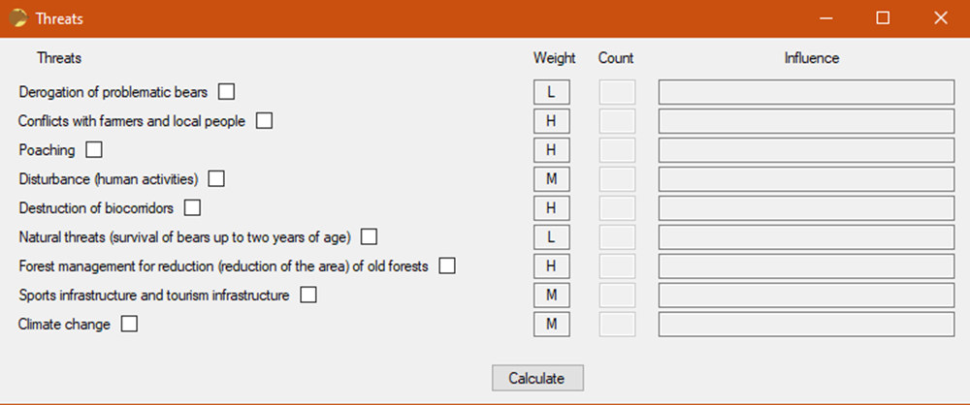
Calculate with threats

Slide 23
Created unique traces using the data of given monitoring
Mountain | Number of unique traces 2017 | Number of unique traces 2018 | Number of unique traces 2019 | Number of unique traces 2020
Central Balkan | 10 | 8 | 11 | 7
Western Rhodopes | 38 | 49 | 50 | 47
Rila | 11 | 11 | 9 | 21
Pirin | 6 | 2 | 3 | 5
Kotlen mountain | 1 | 0 | 1 | 0
Plana, Verila, Vitosha | 2 | 1 | 3 | 1
Alpine area | 60 | 68 | 71 | 75
Continental area | 8 | 3 | 6 | 6
Total | 68 | 71 | 77 | 81

Slide 24
Evaluation results using HPDA service
Mountain | 2017 | 2018 | 2019 | 2020
Central Balkan | 61 | 61 | 58 | 77
Western Rhodopes | 200 | 185 | 185 | 229
Rila | 70 | 84 | 59 | 93
Pirin | 37 | 40 | 41 | 35
Kotlen mountain | 6 | 2 | 8 | 5
Plana, Verila, Vitosha | 27 | 2 | 46 | 18
Alpine area | 368 | 369 | 339 | 438
Continental area | 33 | 5 | 58 | 19
Total | 401 | 374 | 397 | 457

Slide 25
Conclusion
The HPDA service was created for the needs of the ENVIRONMENTAL EXECUTIVE AGENCY (EIA), which is under the Ministry of the Environment and Water (MOEW) with the financial support of the ENTERPRISE FOR MANAGEMENT OF ENVIRONMENTAL PROTECTION ACTIVITIES (PUDOOS).

Slide 26
Thank you!
This project has received funding from the European High-Performance Computing Joint Undertaking (JU) under grant agreement No 101101903. The JU receives support from the Digital Europe Programme and Germany, Bulgaria, Austria, Croatia, Cyprus, Czech Republic, Denmark, Estonia, Finland, Greece, Hungary, Ireland, Italy, Lithuania, Latvia, Poland, Portugal, Romania, Slovenia, Spain, Sweden, France, Netherlands, Belgium, Luxembourg, Slovakia, Norway, Türkiye, Republic of North Macedonia, Iceland, Montenegro, Serbia.

