Slide 1
CAPABILITIES OF THE NATIONAL AI PLATFORM
Capacities of the existing supercomputer and plans for further expansion

Slide 2
Existing Supercomputer
VENDOR: NVIDIA
SUPPLIER: ЕВИДЕН (АТОС)
DECEMBER 2021.
VALUE: 2M EURO
4 x nVIDIA DGX A100 systems
1024 CPU threads (AMD)
32 GPU A100, 40GB RAM per GPU
DDN Storage 150TB
Data Science software
HDR (InfiniBand), 100Gb/s
5 PetaFLOPS AI performance
Consumption 34,5kW

Slide 3
Data Science Platform
FMLe (Fast Machine Learning engine)
- User-friendly GUI
- Easily create AI training, experiments, and monitoring
- Easy manipulation of the data sets
- Monitoring resource usage, training duration, occupancy
- Jupyter Lab as a service

Slide 4
Users of National AI Platform
38 INSTITUTIONS:
- UNIVERSITIES
- FACULTIES
- INSTITUTES
- SCIENCE-TECHNOLOGY PARKS
- INNOVATION FUND
38 STARTUP COMPANIES
400 USER ACCOUNTS

Slide 5
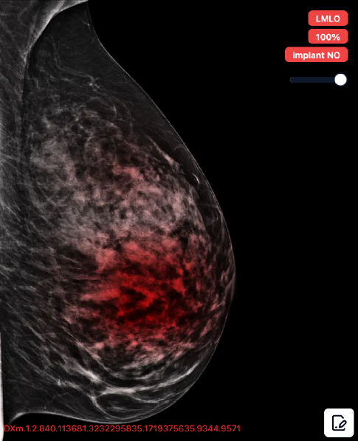
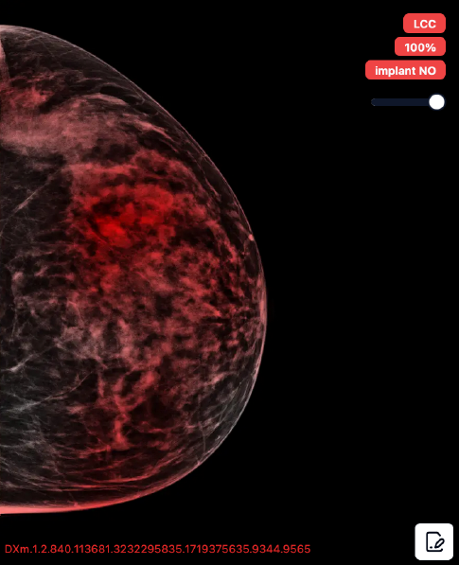
Automatic Ranking of Mammographic Images.
AI Mamography Project
DEVELOPED BY AI INSTITUTE OF SERBIA
DEVELOPED ON NATIONAL AI PLATFORM
APPLICATION IS HOSTED IN THE STATE DATA CENTER IN KRAGUJEVEC
AUTOMATIC RANKING OF MAMMOGRAPHIC IMAGES
EXPLAINABLE AI – MARKED REGIONS WHERE THE SOFTWARE DETECTED A POTENTIAL ISSUE
IORS FIRST USER

Slide 6
Expansion of the National AI Platform Phase 1
VENDOR: NVIDIA
SUPPLIER: EVIDEN (ATOS)
FIRST HALF OF 2024.
VALUE: 5M EURO
6 x nVIDIA DGX H200 systems
1344 CPU threads (Intel)
48 GPU H200, 141GB RAM per GPU
DDN Storage 120TB
NDR (InfiniBand) network technology, 200Gb/s
32 PetaFLOPS AI performance
Consumption 72kW
Planned Launch - Second Half of 2025.
* 7 X faster performance than the existing GPUs

Slide 7
Expansion of the National AI Platform
Phase 2
VENDOR: NVIDIA, EVIDEN
SUPPLIER: EVIDEN (ATOS)
FIRST HALF OF 2025.
VALUE: 36M EURO
Inference
DDN Storage 2.5PB
NDR (InfiniBand), 200Gb/s
22.5 PetaFLOPS AI performance
Consumption 550kW
Planned Launch - 2026.
Loan from the French government
HPC + Software stack + Mistral AI
4 x BullSequana XH3000 racks
640 x nVIDIA GraceHopper Superchip
96GB RAM per GPU
Jarvice AI

Slide 8
Integration of 3 Supercomputers
into one cluster
Planed integration of three supercomputers
Designed mini module with a water-cooling system (two technologies)
Double floor designed to support a weight of 2.5 tons per reck
Integration of all storages so that users perceive it as a one name space
Total consumption 656,5kW
Overview of IT Mini Module for Supercomputers at the State Data Center in Kragujevac

Slide 9
Thank you
for your attention!
In 2023, the OECD ranked the National Artificial Intelligence Platform as one of the 9 best innovative projects in the public sector, from a competition of 1,048 projects across 94 countries worldwide.
Contact: Богдан Стешевић
bogdan.stesevic@ite.gov.rs

