Slide 1
Bridging Borders: Advancing Translational Oncology Research through AI
EuroCC4SEE Workshop, May 20^{th,} 2025
Stefan Milosevic, University of Cambridge | BIO4 Campus Belgrade

Slide 2
Why Borders Still Exist in Cancer Research
Cancer doesn’t care about borders. So why do our research systems?
Translational oncology today is fragmented:
01
02
National borders limit clinical collaborations
Institutional silos slow down data integration
Underlining: Result: Up to 70% of patients fail first-line therapies. Over 85% of clinical trials miss their endpoints
Regulatory systems aren’t built for AI
03
04
Source: NIH, IQVIA

Slide 3
From Bench to Bedside: The Translational Oncology Challenge
Translational oncology means converting lab breakthroughs into clinical treatments
01
But there’s a “data chasm” between discovery and real-world deployment
02
Genomics ≠ Clinical trials ≠ Imaging ≠ Real-world outcomes
03
Solution: What’s missing? A common computational language across modalities and institutions
04

Slide 4
AI as the Bridge: Not a Silver Bullet, but a Shared Protocol
AI helps navigate complexity, not replace clinicians or researchers
c
High-impact roles for AI in translational oncology
Data harmonization (EHR + omics + imaging)
Predictive modelling of tumour response
Clinical trial simulation & stratification
However, adoption is low: trust, interoperability, and reproducibility are barriers

Slide 5
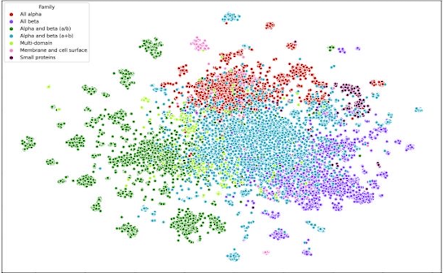
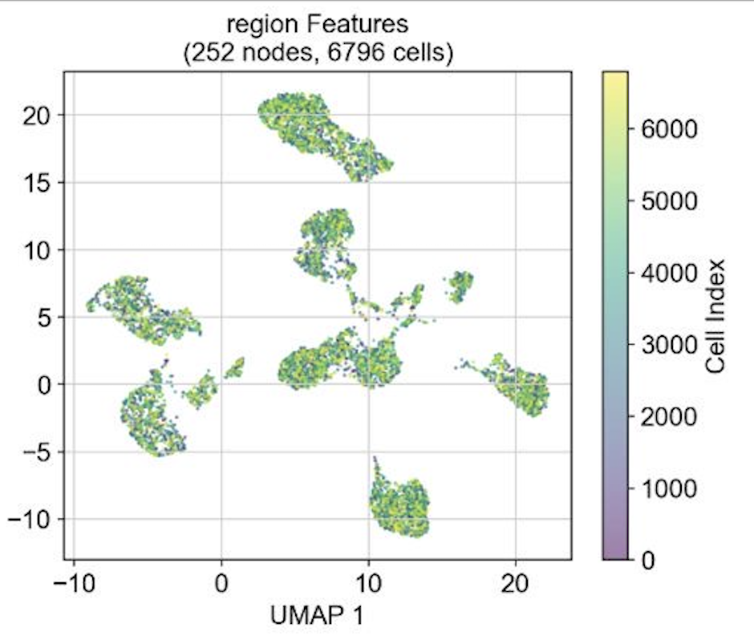
Problem?
Genomics data are often analyzed in silos-chromatin accessibility and gene expression separately
Result:
Amongst the first of the graph neural network models to connect multiomic data at single-cell resolution
Achieved high predictive accuracy across a set of variable genes
Broader implication:
Modelling regulatory gene networks dynamically- essential for understanding therapy response and disease mechanisms

Slide 6
From scMultiGraph to Real-World AI Barriers
STANDARDIZATION
ACCESS
CLINICAL VALIDATION
Lack of standardized architectures for multiomic data integration
Limited access to high-quality, diverse training data
Disconnection between academic modelling and clinical validation
My thesis clarified:
Next… How do we deploy this in real-world cancer settings-ethically and scale it properly?
—
BRaIn-MOD (Brain Response and Infiltration Modeling through Omics and Dynamics): Digital Twin Modeling of Glioma Evolution and Therapy Response

Slide 8
Oncology Across BIO4 - A Shared Domain
Oncology is not a separate pillar at BIO4; rather, it’s a cross-cutting domain worked on across multiple tenant institutions
Key Projects & BIO4 Tenants
IMGGE DNA repair and genome stability (BRCA2-related) Targeting vulnerabilities in HR-deficient cancers
Faculty of Medicine + IORS (Institute for Oncology and Radiology of Serbia) Biomarker discovery in rectal cancer Personalized treatment pathways through EU collaboration
IMI Anti-inflammatory diets during breast cancer therapy Linking nutrition, clinical outcomes, and ML models
IBISS + Faculty of Chemistry Novel hybrid anticancer compounds Designed to reduce toxicity and overcome drug resistance
BIO4 enables these projects to intersect through AI and infrastructure, without creating artificial silos

Slide 9
ASCO 2025 - Serbia’s Presence in Oncology & AI
I will represent BIO4 Campus at this year’s ASCO Annual Meeting 2025
Oncology projects from our BIO4 tenants
AI use cases in immunology, rare disease modelling, and drug delivery
Objective: Position Serbia not just as a consumer of oncology AI, but as a co-developer and global partner

Slide 10
Final Message - Research Without Borders
We don’t need more data. We need more connection.
Translational oncology requires:
Shared purpose across institutions
AI tools that are co-designed for use-case purposes, not copy-pasted
Platforms that respect institutional differences but enable common learning
Let’s move from bordered science to bridged ecosystems

