Slide 1
e-Science using Grid infrastructure
Boro Jakimovski
FINKI/UKIM

Slide 2
Abbreviations
EGI: European Grid Infrastructure
EGI.eu: European Grid Initiative organisation
EIRO: European International Research Organisation
ESFRI: European Strategy Forum on Research Infrastructures
HUC: Heavy User Community
NGI: National Grid Infrastructure/Initiative
RP: Resource infrastructure Provider
SSC: Specialised Support Centre
UMD: Unified Middleware Distribution
VO: Virtual Organisation
VRC: Virtual Research Community

Slide 3
Why build a European Grid Infrastructure?

Slide 4
Infrastructure (Wikipedia)
Infrastructure is the basic physical and organisational structures needed for the operation of a society or enterprise, or the services and facilities necessary for an economy to function
EGI provides a service infrastructure that exposes and helps coordinate a resource infrastructure
The Enterprise is the European Research Area

Slide 5
What is a Grid?
A grid consists of distributed resources controlled by separate organisations that be systematically used securely by users external to that organisation
Resources can include:
Commodity or HPC clusters
Disk or tape storage
Instruments
Data Archives or Digital Libraries

Slide 6
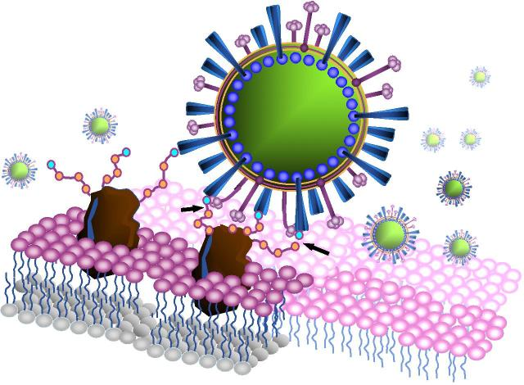
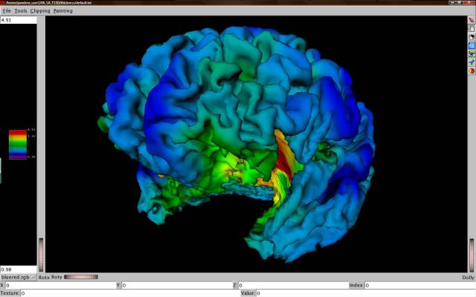
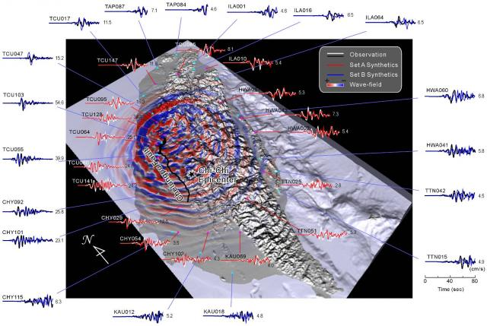
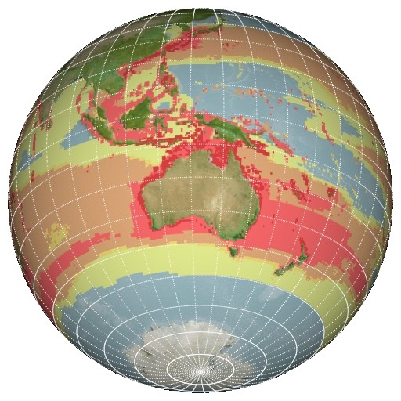
C21: Digital Research
Extracting Knowledge from the Data Deluge

Slide 7
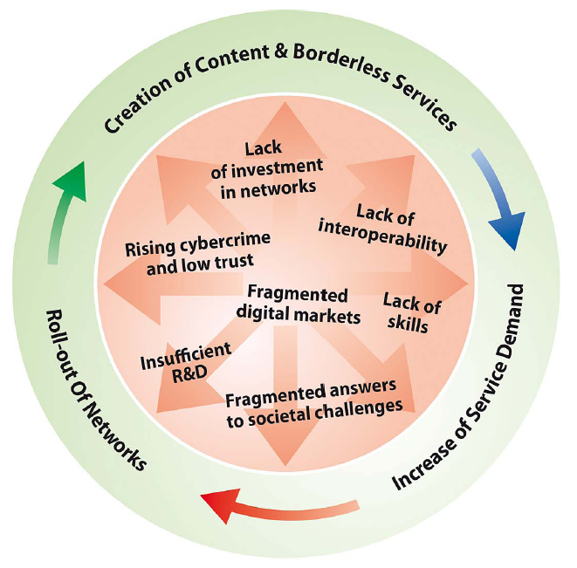
Digital Agenda for Europe
Borderless Services
Interoperability
Supporting Innovation
remove barriers to the free movement of knowledge
“Europe should also build its innovative advantage in key areas through reinforced e-Infrastructures (i.e. GEANT & EGI)”
Digital Agenda for Europe

Slide 8
EGI
Collaboration
Research
Community
N
G
I
N
G
I
N
G
I
E
I
R
O
Research
Community
E
I
R
O
Research
Community
N
G
I
NGI: National Grid Initiative
EIRO: European Intergovernmental Research Organisation (e.g. CERN, EMBL, ESA, …)
EGI.eu

Slide 9
EGI.eu
Coordination for European Grid resources
Established February 8th 2010
Central policy & services needed to run a grid
Sustainable small coordinating organisation
Based in Amsterdam
Coordinating core (~20 people) in Amsterdam
Technical services from partners (~20 people)
EGI and EGI.eu: Supported by the EGI-InSPIRE project

Slide 10
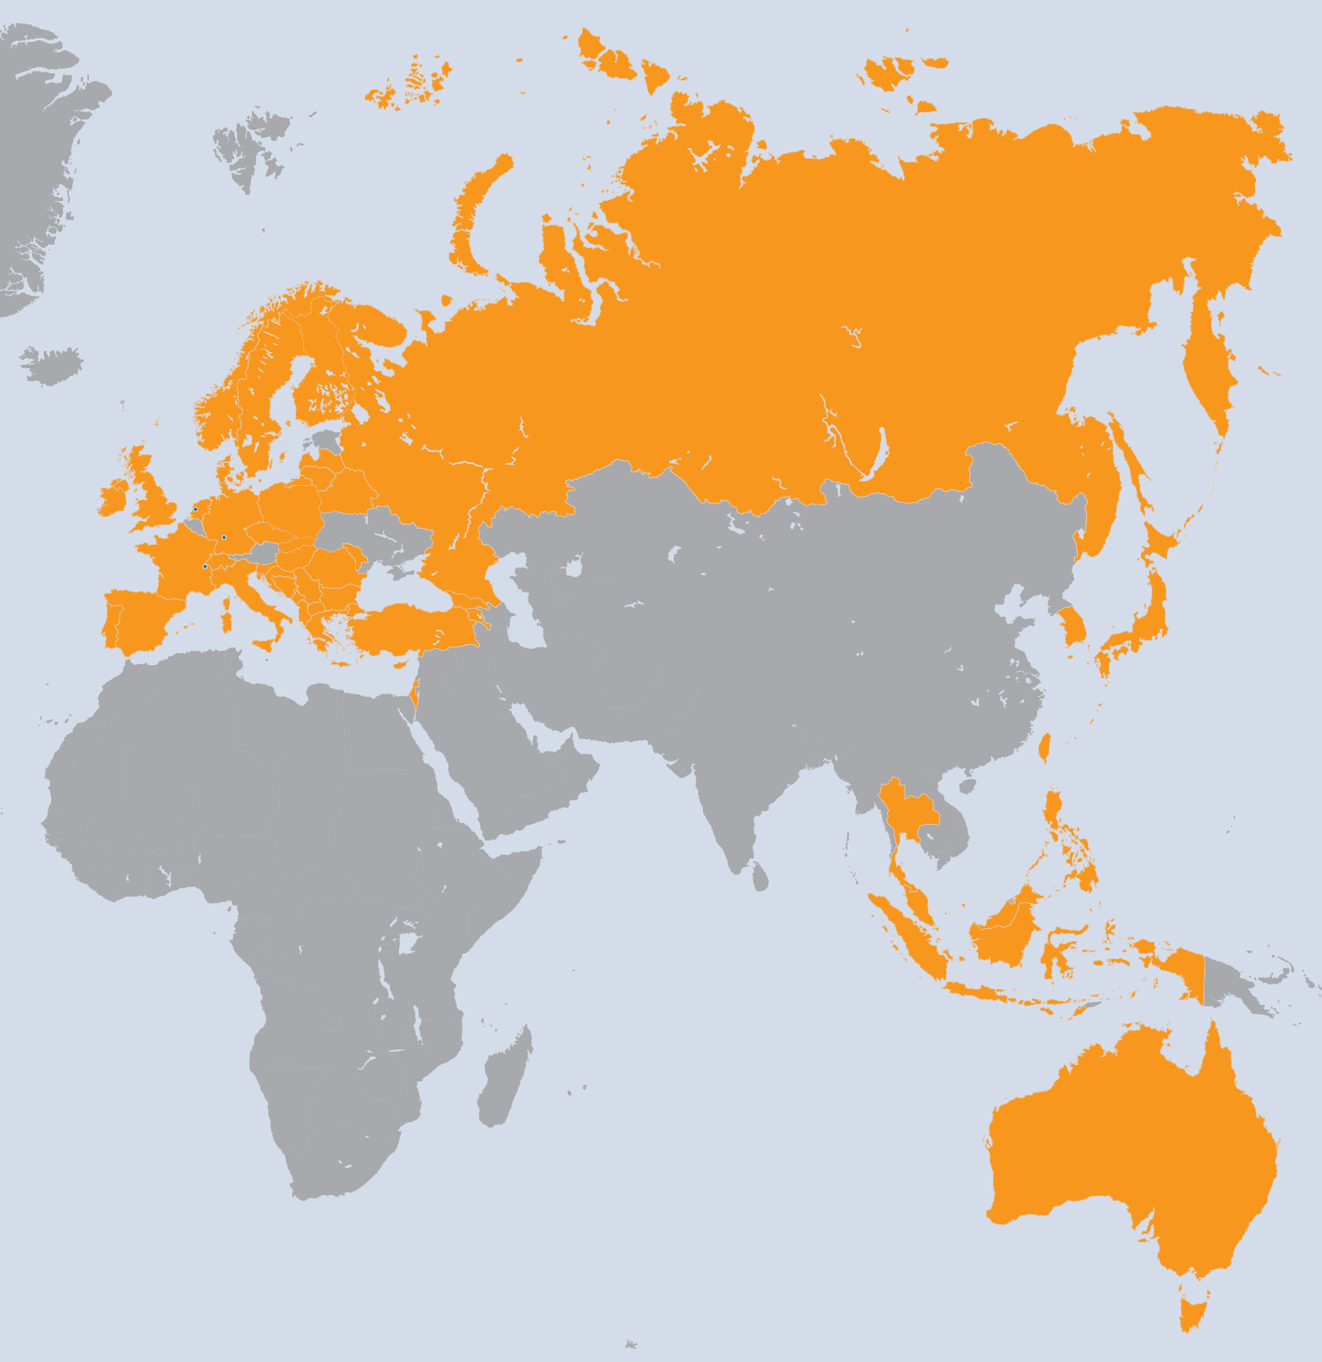
EGI-InSPIRE Project
Integrated Sustainable Pan-European Infrastructure for Researchers in Europe
A 4 year project with €25M EC contribution
Project cost €72M
Total Effort ~€330M
Effort: 9261PMs
Project Partners (50)
EGI.eu, 38 NGIs, 2 EIROs
Asia Pacific (9 partners)

Slide 11
Project Objectives
A sustainable production infrastructure
Resource providers in Europe and worldwide
With new technologies as they mature
Support structured international research
Sustain current domain specific services
Attract new user communities (e.g. ESFRI)

Slide 12
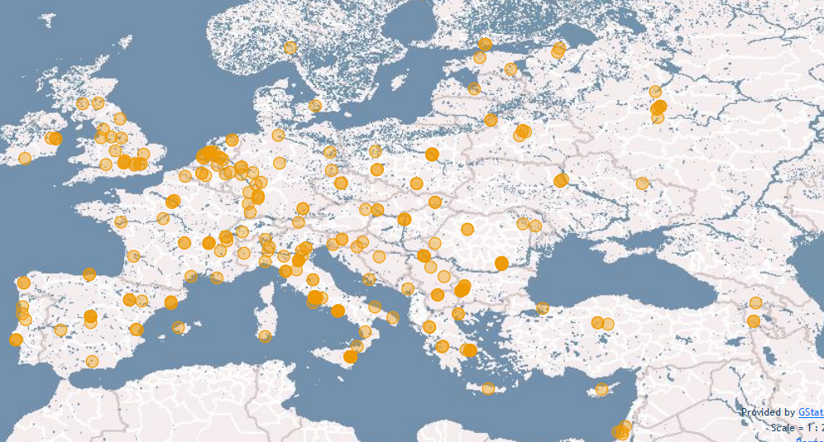
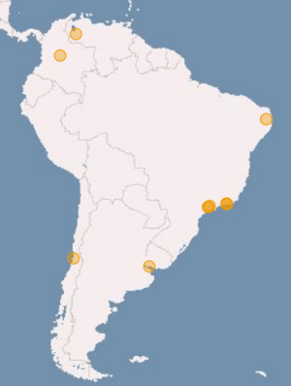
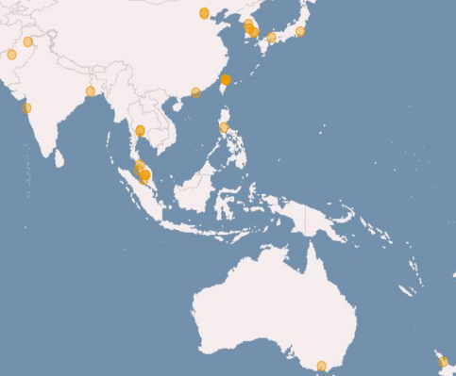
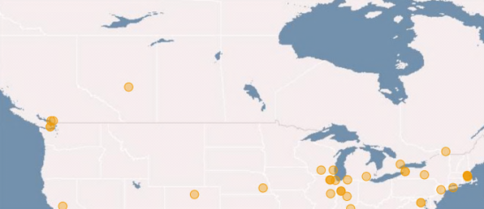
Resource Centres (RCs)
Number of RCs | Value (yearly increase)
EGI-InSPIRE and Council Participants | 326 (+3%)
Including integrated infrastructures | 352
Supporting MPI | 90 (+20%)

Slide 13
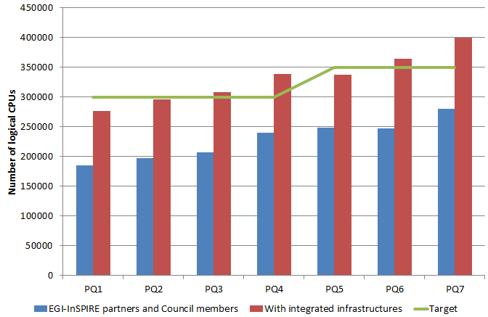
Installed Capacity
Logical CPUs | Value (yearly increase)
EGI-InSPIRE and Council Partic. | 270,800
Including integrated RPs | 399,300
Storage | Value (yearly increase)
Disk (PB) | 139 PB
Tape (PB) | 134 PB

Slide 14
VOs
Virtual organisations (VOs) are groups of researchers with similar scientific interests and requirements, who are able to work collaboratively with other members and/or share resources, regardless of geographical location
Resources can be:
data, software, expertise, CPU, storage space
Researchers must join a VO in order to use grid computing resources provided by EGI
http://www.egi.eu/how-do-I/join_or_start_a_community.html

Slide 15
VOs from VO database
http://operations-portal.egi.eu/vo
Grouped in following disciplines
Astronomy, Astrophysics and Astro-Particle Physics
Computational Chemistry
Computer Science and Mathematics
Earth Sciences
Fusion
High-Energy Physics
Life Sciences

Slide 16
VRC and VOs
Virtual research communities (VRCs) are groups of like-minded individuals organized by discipline or computational model
VRCs typically have an established presence in their field and represent a well-defined scientific or research community
VRC can include one or more virtual organisations (VOs)

Slide 17
Some VRCs
VRC | Discipline
WeNMR - A worldwide e-Infrastructure for NMR and structural biology | Structural Biology
LSGC - The Life-Science Grid Community | Life Sciences
HMRC - Hydro-Meteorology Research Community | Hydro-Meteorology
Worldwide LHC Computing Grid (wLCG) | High Energy Physics
CLARIN - Common Language Resources and Technology Infrastructure | Humanities
DARIAH - Digital Research Infrastructure for the Arts and Humanities | Humanities

Slide 18
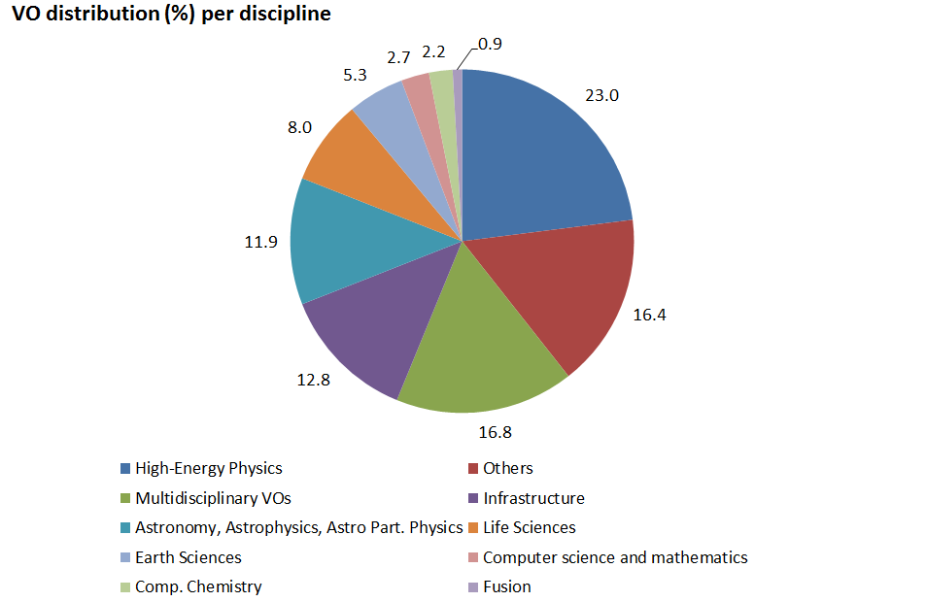
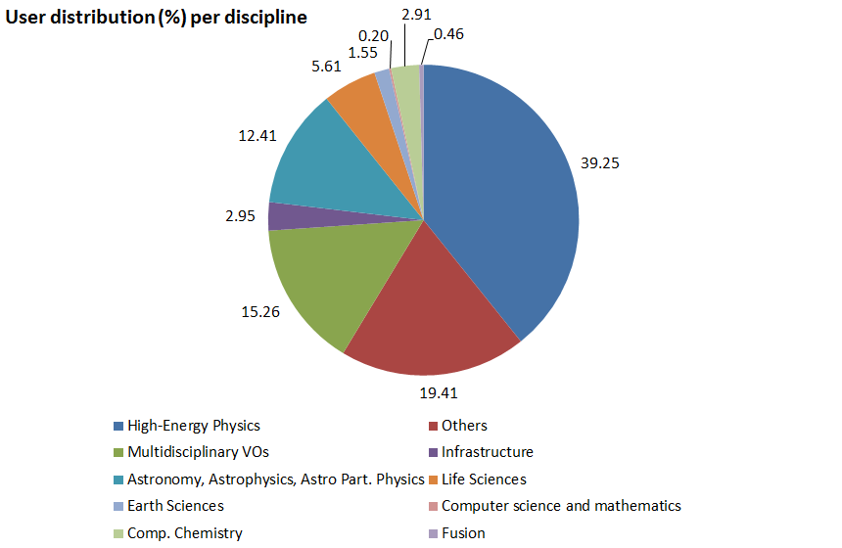
VO and user Statistics
Metrics | Values (April 2012)
Registered VOs | 226 – national and international Vos
Registered users | 20883

Slide 19
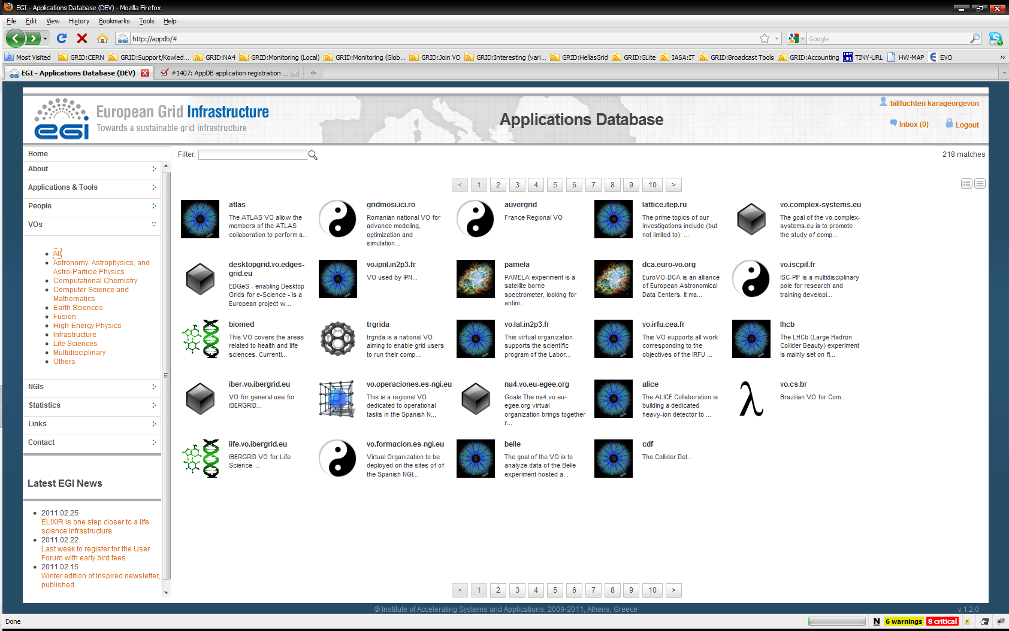
EGI Application Database
To give recognition to reusable applications
To give recognition for application developers
How to get involved
Register applications
Reuse applications
http://appdb.egi.eu

Slide 20
Becoming a Grid User

Slide 21
Step by step
Explore if your application is available (ported) for the Grid in AppDb or it can be ported for the Grid usage model
Explore if there is a VO supporting the application or sharing access to application data
If not available then national Catch All VOs can be used (e.g. MARGI VO)

Slide 22
Step by step
Acquire a grid certificate
One needs a Grid certificate to be able to access any Grid resource (CPU or Storage)
Port your application, upload the data and start using the resources
Report problems using the EGI helpdesk services
Notes:
ou

Slide 23
Grid Usage Model
EGI Grid applications must run under Linux
Mainly Scientific Linux 5, 6
Now some sites also are supporting Debian
The application should not be interactive, and it must run using parameters or input files.

Slide 24
Grid Usage Model
Each application run is called “Job”
A job can be:
Single process (standard application)
Parallel process (MPI)
Parameter sweep (running many standard applications using different input parameters)
Workflow (running many different applications as a workflow depending on each other)

Slide 25
Macedonian Academic and Research Grid Initiative
MARGI

Slide 26
MARGI
Activities started as early as 2004
Resource centers acquired the knowledge and were involved in several regional Grid projects
Currently has 3 Grid clusters
Runs the MARGI CA for issuing Grid certificates
Latest addition was the new HPC Cluster with 1008 CPU cores

Slide 27
MARGI
Established to support all Macedonian researches that want to use the Grid
Organize training activities for new users
Support with porting application to the Grid

Slide 28
Grid Use Cases

Slide 29
Grid Use Cases
These case studies show some of the advantages of using the grid:
allows world-wide multi-disciplinary collaboration;
integrate distributed resources into a single whole;
customised grid services to meet the unique demands of researchers;
reliable service for computation, data transfer and storage of large data sets;
reduced analysis time and analysis on-demand;
scientifically useful results are generated more quickly;
long term support;
sharing sensitive data securely among a trusted community;
allows member institutions to contribute computing power to the community;
generate data-intensive stimulations in a shorter amount of time;
reduce technical workload (by following grid standards), so scientists can concentrate more effort on the science

Slide 30
Use Case: Large Hadron Collider
World’s largest particle accelerator
Supports 8,000 researchers
1 billion CPU hours in the last 12 months
15Pb of data created annually

Slide 31
Use Case: Large Hadron Collider
Some advantages of using the grid:
allows worldwide mass collaboration with thousands of physicists;
customised grid services to meet the unique demands of the experiments;
large data storage facility;
physicists can access the data using their own computer locally.

Slide 32
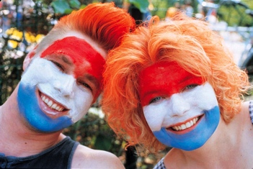
Use Case: GoNL
Mapping the genome of the Netherlands
Plan to sequence the genomes of 750 Dutch people
Currently 30Tb of data
Will generate 20 times that amount

Slide 33
Use Case: GoNL
Some advantages of using the grid:
analysis time reduced by 80%;
on-demand analysis – can be carried out as and when researchers need it;
provide development and support to help researchers get the most out of using the grid.

Slide 34
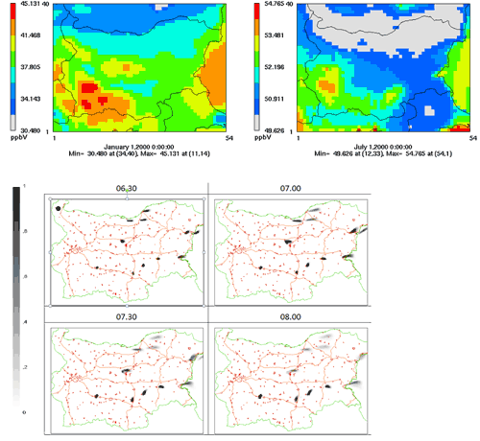
Use Case: Environmental Modelling
Bulgarian researchers have ported three applications to the grid
Study the impact of climate change on air quality
Model atmospheric composition
Investigate emergency responses to the release of harmful substances into the atmosphere

Slide 35
Use Case: Environmental Modelling
Some advantages of using the grid:
improved response times and decreased failure rate, so scientifically useful results are generated more quickly;
reliable service for computation, data transfer and storage of large sets of data;
using existing software with standard protocol means a quicker start-up time and compatibility between resource providers.

Slide 36
Use Case: ASTRA
Ancient instruments Sound/Timbre Reconstruction Application
Has recreated 4 instruments so far
Held concerts using these instruments

Slide 37
Use Case: ASTRA
Some advantages of using the grid:
can meet high demand for network and computing requirements;
high reliability;
allow multi-disciplinary collaboration between researchers, musicians and historians;
longevity: ASTRA running since 2006.

Slide 38
Use Case: ITER
Investigating viability of fusion as a power source
Modelling and simulating the reactor
Used 1 million CPU hours in the last 12 months

Slide 39
Use Case: ITER
Some advantages of using the grid:
perform the intensive computations needed to test the feasibility of fusion power before building the reactor;
open to future development: dedicated project ‘EUPHORIA’ was set up to further push the limits of existing state-of-the-art computing resources.

Slide 40
Use Case: DECIDE
Diagnostic Enhancement of Confidence by an International Distributed Environment
Diagnostic tools for the medical community
Example: Their Statistical Parametric Mapping application can help doctors to diagnose Alzheimer’s disease in its early stages and track the progress of the symptoms over time

Slide 41
Use Case: DECIDE
Some advantages of using the grid:
a single European-wide master database of images stored on the grid for doctors to use;
can set up diagnostic tools with a dedicated grid infrastructure;
customisable: dedicated software to track progression of the disease over time;
sharing medical data securely.

Slide 42
Use Case: CTA
The Cherenkov Telescope Array
Future ground-based high energy gamma-ray instrument
132 institutes in 25 countries
Using applications and grid technology provided by the European grid

Slide 43
Use Case: CTA
Some advantages of using the grid:
allows member institutions to contribute computing power to the CTA community;
generate data-intensive stimulations in a shorter amount of time;
reduce technical workload (by following grid standards), so scientists can concentrate more effort on the science.

Slide 44
Conclusion
The Grid is one of the basic pillars to modern eScience
Europe stays focused on supporting eScience development
There are many application already ported to the Grid, and the Grid model makes it very easy for porting others
MARGI stays focused on supporting Macedonian researches
44

Slide 45
Contacts
EGI representative for Macedonia
boro.jakimovski@finki.ukim.mk
MARGI web site
www.margi.marnet.net.mk (soon to be: www.margi.ukim.mk)
MARGI Certification authority
www.margi.marnet.net.mk/CA
EGI web site
www.egi.eu
EGI app DB
appdb.egi.eu

