Slide 1
Introduction to parallel computing concepts and technics
Paschalis Korosoglou (support@grid.auth.gr)
User and Application Support Unit
Scientific Computing Center @ AUTH

Slide 2
Overview of Parallel computing
In parallel computing a program spawns several concurrent processes
decrease the runtime needed to solve a problem or
increase the problem size to be solved
The original problem is decomposed into tasks that ideally run independently
Source code development within some parallel programming environment
hardware platform
nature of the problem
performance goals

Slide 3
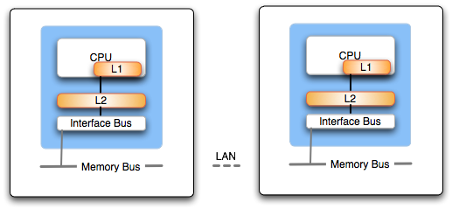
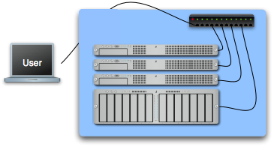
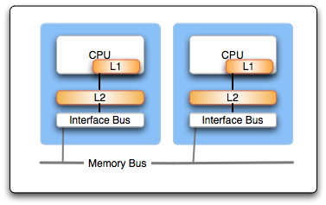
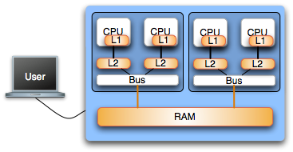
Hardware considerations

Slide 4
Hardware considerations
Distributed memory systems
Each process (or processor) has unique address space
Direct access to another processors memory not allowed
Process synchronization occurs implicitly
Shared memory systems
Processors share the same address space
knowledge of where data is stored is of no concern to the user
Process synchronization is explicit
Not scalable

Slide 5
Parallel programming models
Distributed memory systems
Programmer uses “Message Passing” in order to sync processes and share data among them
Message passing libraries
MPI
PVM
Shared memory systems
Thread based programming approach
Compiler directives (i.e. openMP)
Message passing may also be used

Slide 6
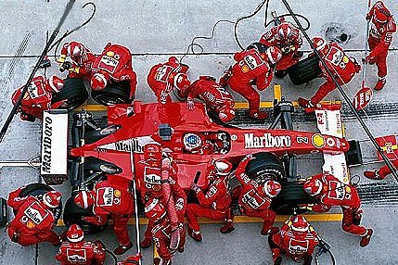
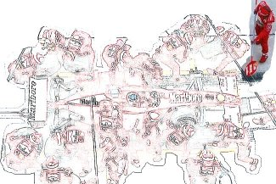
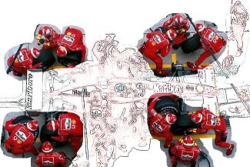
Nature of the problem
Parallel computing
Embarrassingly parallel (parametric studies)
Multiple processes concurrently (Domain and/or functional decomposition)

Slide 7
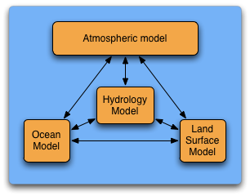
Nature of the problem (examples)
Functional partitioning
Domain decomposition

Slide 8
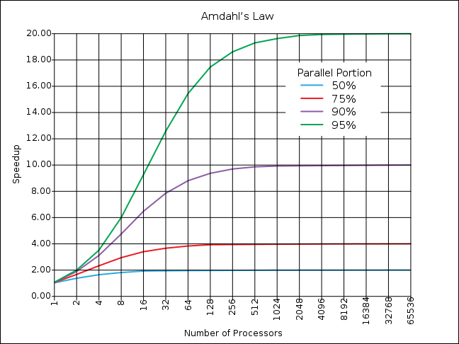
Amdahl’s Law
Amdahl’s law predicts the theoretical maximum speedup when using multiple processors

Slide 9
Message Passing Model
A process may be defined as a program counter and an address space
Each process may have multiple threads sharing the same address space
Message Passing is used for communication among processes
synchronization
data movement between address spaces

Slide 10
Message Passing Interface
MPI is a message passing library specification
not a language or compiler specification
no specific implementation
Source code portability
SMPs
clusters
heterogenous networks

Slide 11
Types of communication
Initialization, Finalization and Synchronization calls
Point-to-Point calls
data movement
Collective calls
data movement
reduction operations
synchronization

Slide 12
MPI Features
Point-to-point communication
Collective communication
One-sided communication
Communicators
User defined datatypes
Virtual topologies
MPI-I/O

Slide 13
Basic MPI
MPI_Init
MPI_Comm_size (get number of processes)
MPI_Comm_rank (gets a rank value assigned to each process)
MPI_Send (cooperative point-to-point call used to send data to receiver)
MPI_Recv (cooperative point-to-point call used to receive data from sender)
MPI_Finalize

Slide 14
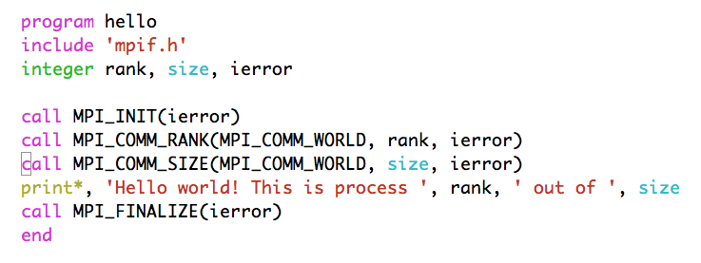
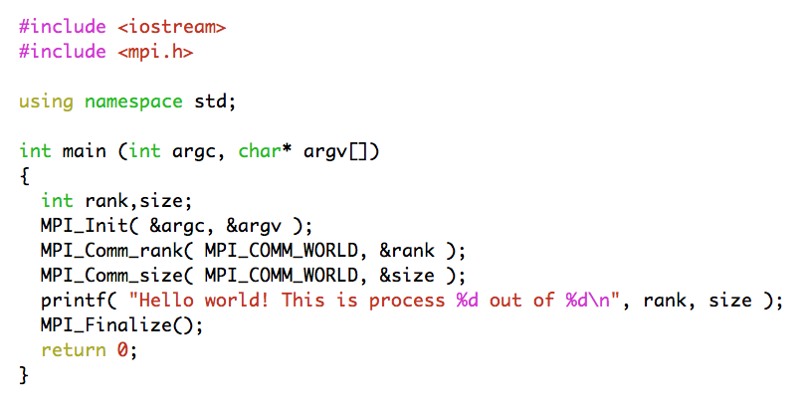
Hello World!

Slide 15
Hello World!
if ( ierror .ne. MPI_SUCCESS ) then
... do error handling as desired ...
end if

Slide 16
Starting and exiting the MPI environment
MPI_Init
C style: int MPI_Init(int *argc, char ***argv);
accepts argc and argv variables (main arguments)
F style: MPI_INIT ( IERROR )
Almost all Fortran MPI library calls have an integer return code
Must be the first MPI function called in a program
MPI_Finalize
C style: int MPI_Finalize();
F style: MPI_FINALIZE ( IERROR )

Slide 17
Communicators
All mpi specific communications take place with respect to a communicator
Communicator: A collection of processes and a context
MPI_COMM_WORLD is the predefined communicator of all processes
Processes within a communicator are assigned a unique rank value

Slide 18
A few basic considerations
Q: How many processes are there? A: (N)
(C) MPI_Comm_size( MPI_COMM_WORLD, &size );
(F) MPI_COMM_SIZE( MPI_COMM_WORLD, size, ierr)
Q: Which one is which? A: [0,(N-1)]
(C) MPI_Comm_rank( MPI_COMM_WORLD, &rank );
(F) MPI_COMM_RANK( MPI_COMM_WORLD, rank, ierr)
The rank number is between 0 and (size - 1) unique per process

Slide 19
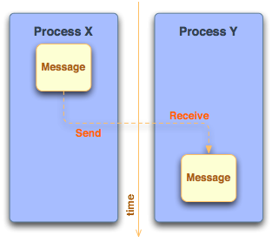
Sending and receiving messages
Questions
Where is the data?
What type of data?
How much data is sent?
To whom is the data sent?
How does the receiver know which data to collect?

Slide 20
What is contained within a message?
message data
buffer
count
datatype
message envelope
source/destination rank
message tag (tags are used to discriminate among messages)
communicator

Slide 21
MPI Standard (Blocking) Send/Receive
Syntax
MPI_Send(void *buffer, int count, MPI_Datatype type, int dest, int tag, MPI_Comm comm);
MPI_Recv(void *buffer, int count, MPI_Datatype type, int src, int tag, MPI_Comm comm, MPI_Status status);
Processes are identified using dest/src values and the communicator within the message passing takes place
Tags are used to deal with multiple messages in an orderly manner
MPI_ANY_TAG and MPI_ANY_SOURCE may be used as wildcards on the receiving process

Slide 22
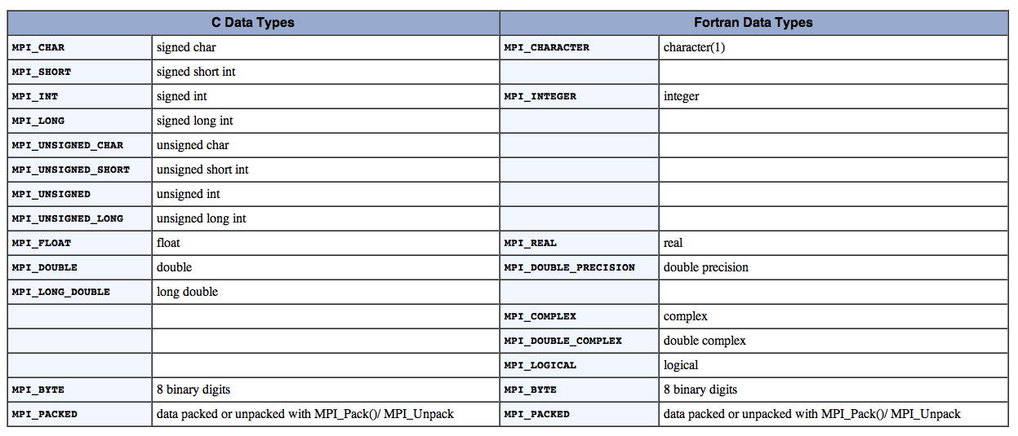
MPI Datatypes

Slide 23
Getting information about a message
Information of source and tag is stored in MPI_Status variable
status.MPI_SOURCE
status.MPI_TAG
MPI_Get_count can be used to determine how much data of a particular type has been received
MPI_Get_count( &status, MPI_Datatype, &count);

Slide 24
Yet another listing (deadlock?)
Program Output:
from process 1 using tag 158 buf1[N-1] = 8.1
from process 0 using tag 157 buf0[N-1] = 0.9
double buf0[N], buf1[N];
MPI_Status status;
int tag_of_message, src_of_message;
if( rank == 0 )
{
for(int i=0; i<N; i++) buf0[i] = 0.1 * (double) i;
MPI_Send(buf0, N, MPI_DOUBLE, 1, 157, MPI_COMM_WORLD);
MPI_Recv(buf1, N, MPI_DOUBLE, 1, 158, MPI_COMM_WORLD, &status);
tag_of_message = status.MPI_TAG;
src_of_message = status.MPI_SOURCE;
cout << "from process " << src_of_message << " using tag " <<
tag_of_message << " buf1[N-1] = " << buf1[N-1] << endl;
}
else if ( rank == 1 )
{
for(int i=0; i<N; i++) buf1[i] = 0.9 * (double) i;
MPI_Send(buf1, N, MPI_DOUBLE, 0, 158, MPI_COMM_WORLD);
MPI_Recv(buf0, N, MPI_DOUBLE, 0, 157, MPI_COMM_WORLD, &status);
tag_of_message = status.MPI_TAG;
src_of_message = status.MPI_SOURCE;
cout << "from process " << src_of_message << " using tag " <<
tag_of_message << " buf0[N-1] = " << buf0[N-1] << endl;
}

Slide 25
Blocking communication
MPI_Send does not complete until buffer is empty (available for reuse)
MPI_Recv does not complete until buffer is full (available for use)
MPI uses internal buffers (the envelope) to pack messages, thus short messages do not produce deadlocks
To avoid deadlocks one either reverses the Send/Receive calls on one end or uses the Non-Blocking calls (MPI_Isend or MPI_Irecv respectively followed by MPI_Wait)

Slide 26
Communication Types
Blocking: If a function performs a blocking operation, then it will not return to the caller until the operation is complete.
Non-Blocking: If a function performs a non-blocking operation, it will return to the caller as soon as the requested function has been initialized.
Using non-blocking communication allows for higher program efficiency if calculations can be performed while communication activity is going on. This is referred to as overlapping computation with communication

Slide 27
Communication (i.e. Send) Modes
Standard mode (MPI_Send, MPI_ISend)
Send will complete when buffer is available for use
Synchronous mode (MPI_Ssend, MPI_Issend)
The send will complete only until a matching receive has been posted and transfer has started
Buffered mode (MPI_Bsend, MPI_Ibsend)
Send is complete as soon as the user buffer is copied to the system buffer
Ready mode (MPI_Rsend, MPI_Irsend)
send starts only if a matching receive has been posted

Slide 28
Collective communications
All processes within the specified communicator participate
All collective operations are blocking
All processes must call the collective operation
No message tags are used
Three classes of collective communications
Data movement
Collective computation
Synchronization

Slide 29
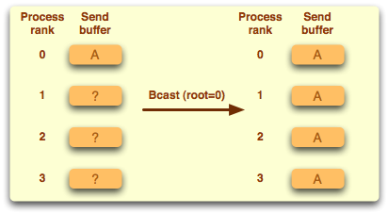
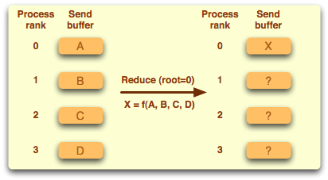
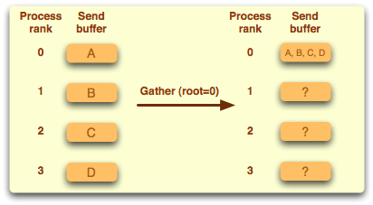
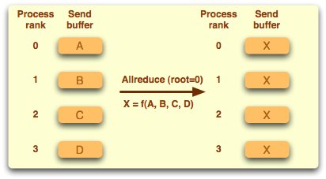
Examples of collective operations

Slide 30
Synchronization
MPI_Barrier ( comm )
Execution blocks until all processes in comm call it
Mostly used in highly asynchronous programs
Notes:
Good point to switch to exercises

Slide 31
Addition of two vectors
#include “mpi.h”
int main(int argc, char **argv){
int rnk, sz, n, i;
double *x, *y, *buff;
n = atoi(argv[1])
MPI_Init(&argc, &argv);
MPI_Comm_rank(MPI_COMM_WORLD, &rnk);
MPI_Comm_size(MPI_COMM_WORLD, &sz);
chunk = n / sz;
.
.
MPI_Scatter(&buff[rnk*chunk],chunk,MPI_DOUBLE,x,chunk,MPI_DOUBLE,0,MPI_COMM_WORLD);
MPI_Scatter(&buff[rnk*chunk],chunk,MPI_DOUBLE,y,chunk,MPI_DOUBLE,0,MPI_COMM_WORLD);
for (i=0; i<chunk; i++) x[i] = x[i] + y[i];
MPI_Gather(x,chunk,MPI_DOUBLE,buff,chunk,MPI_DOUBLE,0,MPI_COMM_WORLD);
MPI_Finalize();
}

Slide 32
Timing using MPI
MPI_Wtime returns number of seconds since an arbitrary point in the past
double mpi_t0,mpi_t1;
if(rank == 0)
{
mpi_t0 = MPI_Wtime();
}
sleep(1);
MPI_Barrier( MPI_COMM_WORLD );
if(rank == 0)
{
mpi_t1 = MPI_Wtime();
printf("# MPI_time = %f\n", mpi_t1-mpi_t0);
}

Slide 33
Addition of two vectors
int main(int argv, char **argv)
{
int n, i;
double *x, *y, *buff;
n = atoi(argv[1]);
x = (double *)malloc(n*sizeof(double));
y = (double *)malloc(n*sizeof(double));
.
.
.
#pragma omp parallel for private(i) shared (x,y)
for (i=0; i<n; i++){
x[i] = x[i] + y[i];
}
}

Slide 34
Addition of two vectors
#include “mpi.h”
int main(int argc, char **argv){
int rnk, sz, n, I, info;
double *x, *y, *buff;
n = atoi(argv[1]);
MPI_Init_thread(&argc, &argv, MPI_THREAD_FUNNELED, &info);
MPI_Comm_size(MPI_COMM_WORLD, &sz);
chunk = n / sz;
MPI_Scatter(&buff[rnk*chunk],chunk,MPI_DOUBLE,x,chunk,MPI_DOUBLE,0,MPI_COMM_WORLD);
MPI_Scatter(&buff[rnk*chunk],chunk,MPI_DOUBLE,y,chunk,MPI_DOUBLE,0,MPI_COMM_WORLD);
#pragma omp parallel for
for (i=0; i<chunk; i++) x[i] = x[i] + y[i];
MPI_Gather(x,chunk,MPI_DOUBLE,buff,chunk,MPI_DOUBLE,0,MPI_COMM_WORLD);
MPI_Finalize(); }

